Slide 1
About Airplanes
Chapter Presenter
The development of this program was made possible in part by
a generous donation from the Sporty’s Foundation.
Notes:
In this module, you will be discussing different types of aircraft, parts of an aircraft, and control surfaces. A best practice is to complete the presentation and then complete the corresponding worksheet in conjunction with an airplane tour. It’s important to have a plane(s) available for this activity. Be sure to have plenty of supervision and remind participants of safety procedures around aircraft.

Slide 2
Session Objectives
You’ll be able to describe
Cool airplanes
  Typical airplane configurations
  How they are used
How they work
  Control surfaces and the three axes of control
  Key parts of an airplane
About Airplanes

Slide 3
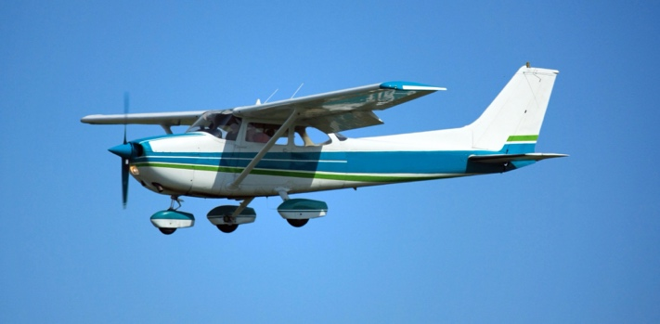
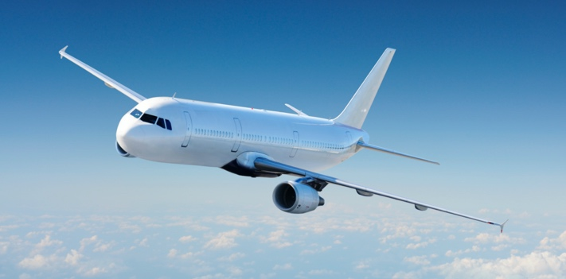
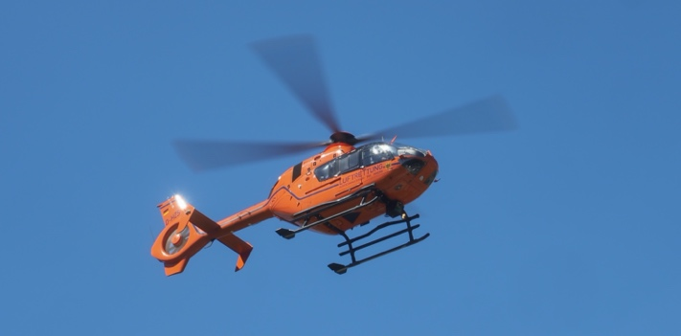
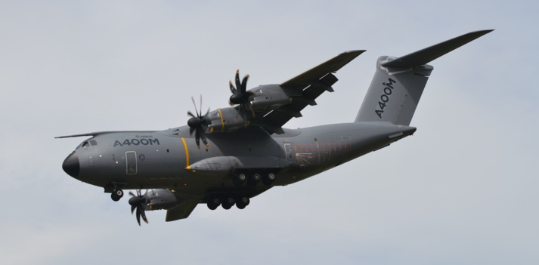
Types of Aircraft
General aviation
Commercial transport
Public service
Military
About Airplanes
Notes:
This is a chance to dive into how diverse aviation really is. What kind of airplanes do you typically see at your airport?
Describe how each of these types of aircraft serve the public.

Slide 4
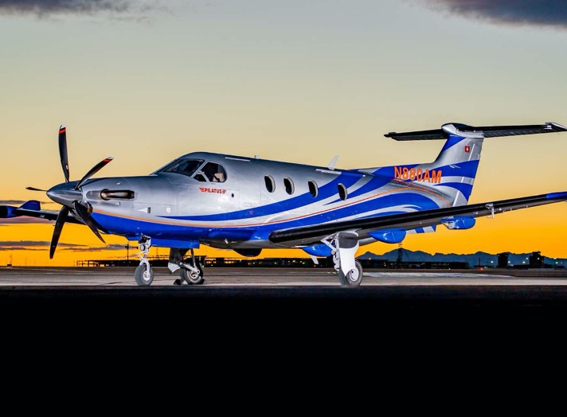
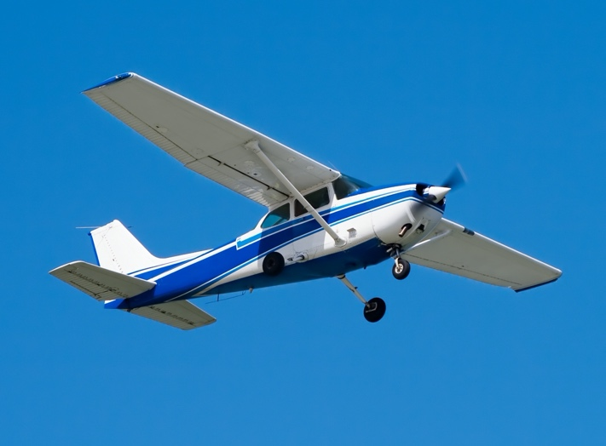
General Aviation Airplanes
Personal or
business use
Recreation
About Airplanes
Notes:
Describe how each of these types of aircraft serve the public.

Slide 5
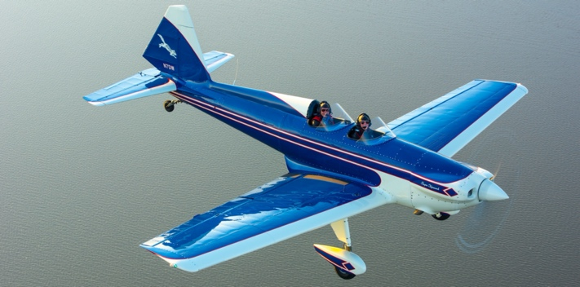
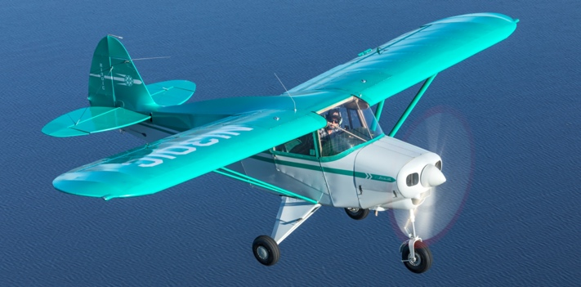
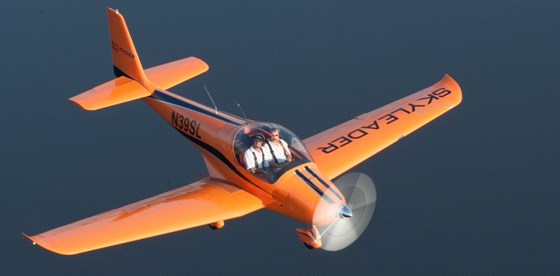
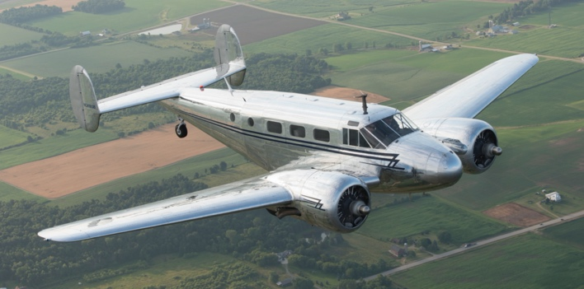
Airplane Configurations
Observe the differences
Low wing
High wing
Single engine
Multi engine
About Airplanes
Notes:
Describe the basic differences in these aircraft.
Ask the students, which one they like the most.

Slide 6
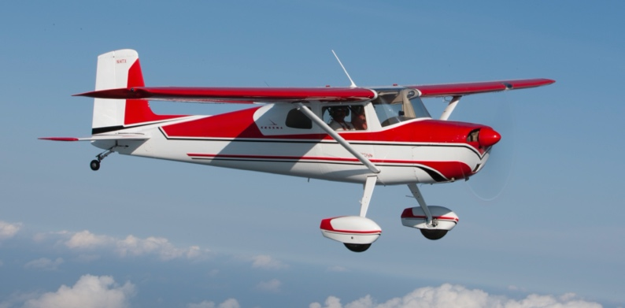
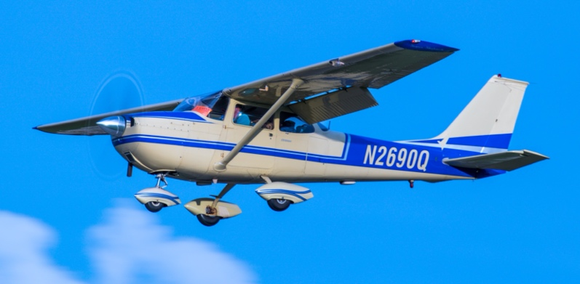
Configurations:
Landing Gear
Conventional gear
or “tailwheel”
Nosewheel or ”tricycle gear”
About Airplanes
Notes:
Describe how these differ:
The tailwheel configuration offers several advantages over the nose wheel or tricycle gear arrangement, which make tailwheel aircraft less expensive to manufacture and maintain.
Because of the way airframe loads are distributed while operating on rough ground, tailwheel aircraft are better able to sustain this type of use over a long period of time, without cumulative airframe damage occurring.
Due to the increased propeller clearance on tailwheel aircraft less stone chip damage will result from operating a conventional geared aircraft on rough or gravel airstrips, making them well suited to bush flying.
Tailwheel aircraft are more suitable for operation on skis.
Tailwheel aircraft are easier to fit into and maneuver inside some hangars.
The nose wheel at the front is a safety device intended to prevent nose-over accidents. Tailwheel aircraft are more subject to "nose-over" accidents due to severe application of brakes by the pilot.
Tailwheel aircraft generally suffer from poorer forward visibility on the ground, compared to nose wheel aircraft. Often this requires continuous "S" turns on the ground to allow the pilot to see where they are taxiing.

Slide 7
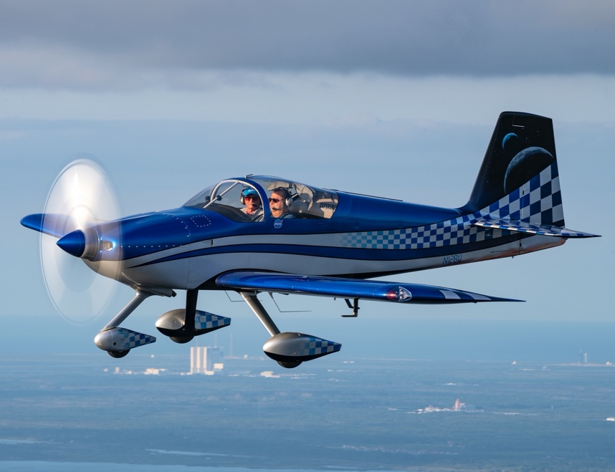
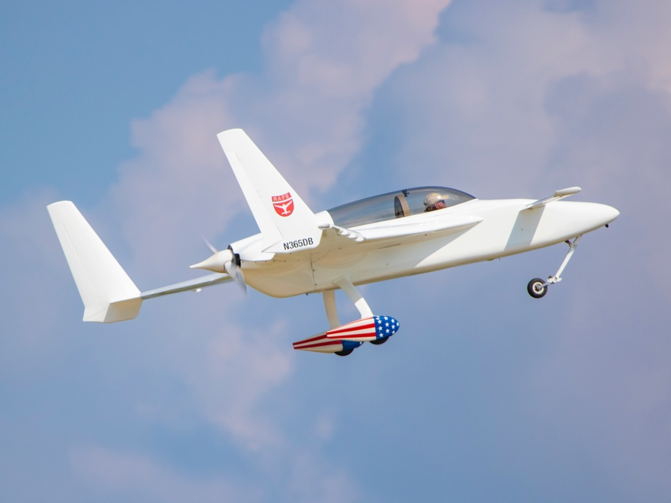
Experimental
Amateur-Built
You can build your own airplane!
”From scratch” using plans – or from a kit, like a large model airplane.
About Airplanes
Notes:
Has anyone in your chapter built a plane? There are hands on activities and a module that you can cover the basics of Aircraft Building. It might be beneficial to have a homebuilder present for these!

Slide 8
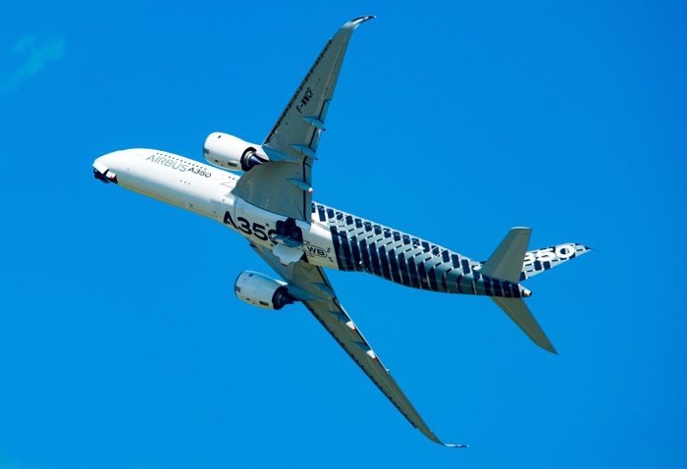
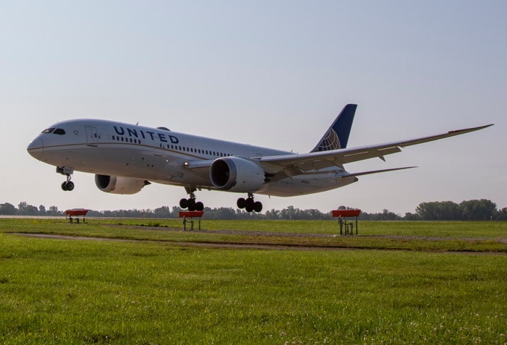
Commercial Transport
Passenger service
Often jet powered
Long range – thousands of miles
Speeds can reach > 500 mph
About Airplanes
Notes:
An airliner is a type of airplane for transporting passengers and cargo.
These aircraft are often operated by airlines. An airliner is typically defined as an airplane intended for carrying multiple passengers or cargo in commercial service. The largest of them are wide body jets which are also called twin-aisle because they generally have two separate aisles running from the front to the back of the passenger cabin. These are usually used for long haul flights between major cities. A smaller, more common class of airliners is the narrow body or single-aisle. These are generally used for short to medium-distance flights with fewer passengers than their wide-body counterparts.

Slide 9
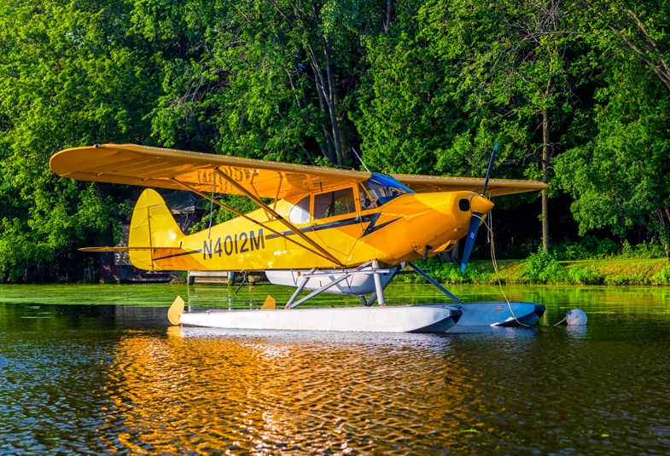
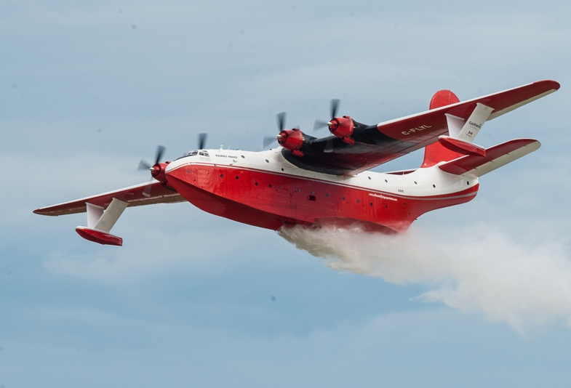
Seaplanes
and Amphibians
Have floats installed or have a boatlike fuselage
Most can land on both land and sea (amphibian)
Often used to land on lakes to camp, fish, or hunt
About Airplanes
Notes:
Are there any sea plane pilots in your chapter? Can they share any of their experiences?
A seaplane is a powered fixed-wing aircraft capable of taking off and landing on water.
Seaplanes are usually divided into two categories: floatplanes and flying boats.
Flying Boats are generally far larger and can carry far more. Seaplanes that can also take off and land on airfields are in a subclass called amphibious aircraft, or amphibians.
In the 21st century, seaplanes maintain a few specific uses, such as for dropping water on forest fires, air transport around archipelagos, and access to undeveloped or roadless areas, some of which have numerous lakes.

Slide 10
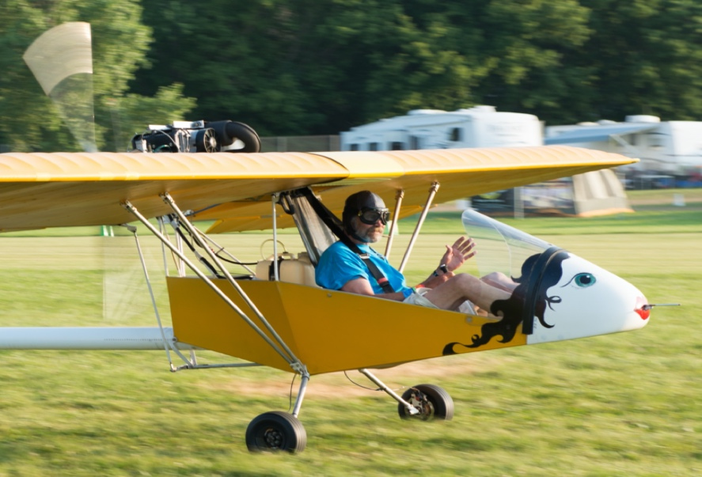
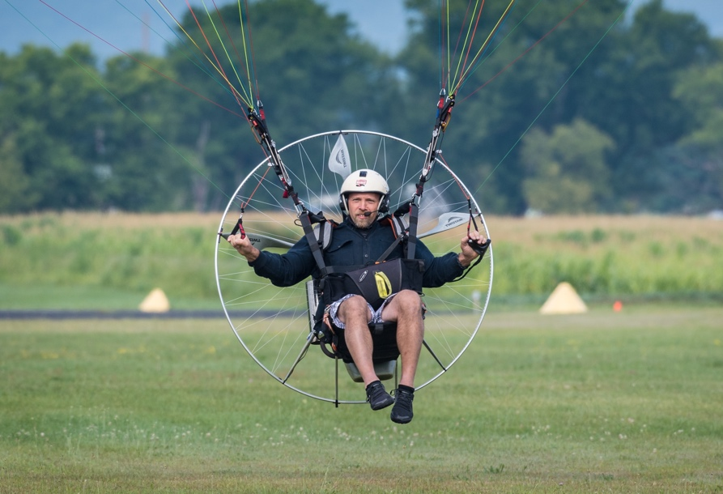
Ultralights
Powered fixed wing
Powered parachute/paraglider
About Airplanes
Notes:
Are there any ultralight pilots in your chapter? Can they share any of their experiences?
Ultralight flying represents one of the fastest and purest ways to experience the joys of aviation. From powered-parachutes and trikes to traditional fixed wings and even amphibians and rotorcraft, ultralights are fun, exciting, and in most cases, remarkably affordable. Flying ultralights is not a step up or down, but a step into a completely different and exciting sector of the flying community.
In the U.S., flying an ultralight doesn't require a license or a medical certificate of any kind, providing the aircraft meets the Federal Aviation Regulation called Part 103. Part 103 defines an ultralight as an aircraft that meets the following criteria:
Seats 1
Max. Empty Weight (Powered Aircraft) 254 lbs
Max. Empty Weight (Unpowered Aircraft) 155 lbs
Max. Fuel Capacity 5 Gallons
Max. Speed @ Full Power 55 knots
Max. Stall Speed (Power Off) 24 knots

Slide 11
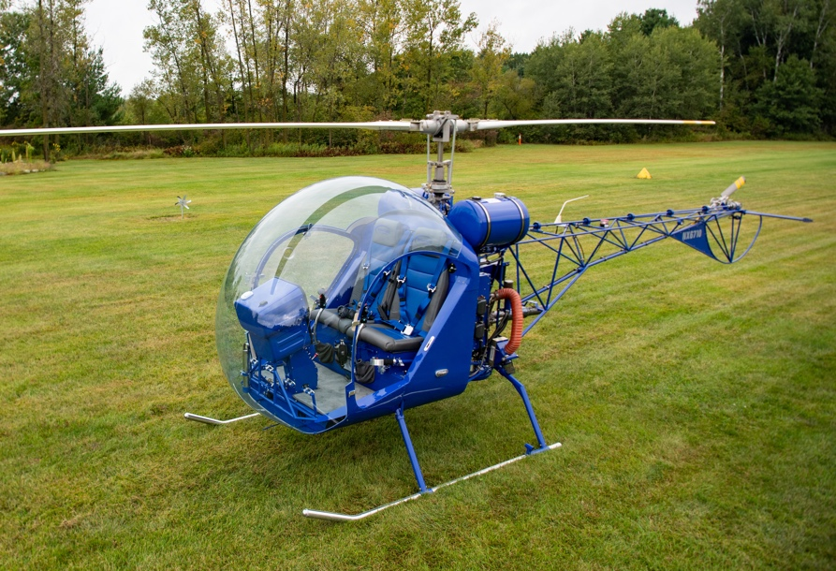
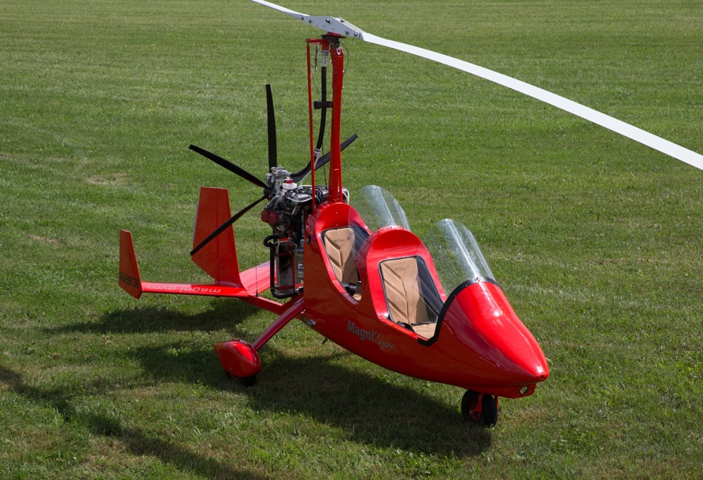
Rotorcraft
Helicopters (one or two main rotors)
Gyrocopters (nonpowered main rotor)
About Airplanes
Notes:
Are there any rotorcraft pilots in your chapter? Can they share any of their experiences?
Rotorcraft can generally be divided into two categories: helicopters and gyroplanes (often referred to as gyrocopters or autogyros.)
A helicopter uses one or more powered rotors or rotary wings to fly and maintain directional control, while a gyroplane uses a traditional engine and propeller for thrust, and an unpowered rotor for lift.
While helicopters and gyroplanes look superficially similar, there are key differences between the two.
Because their main rotor is powered, helicopters can hover, and takeoff and land vertically, while a gyroplane generally requires a small amount of runway for both takeoff and landing, and can’t hover unless there is a modest wind.
Gyroplanes tend to be simpler, both in terms of operation and construction, but both types can be built from plans or kits, or purchased complete.

Slide 12
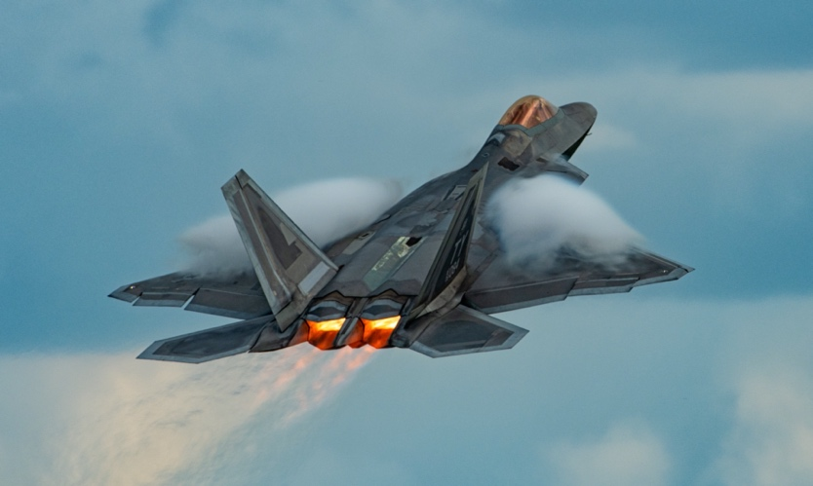
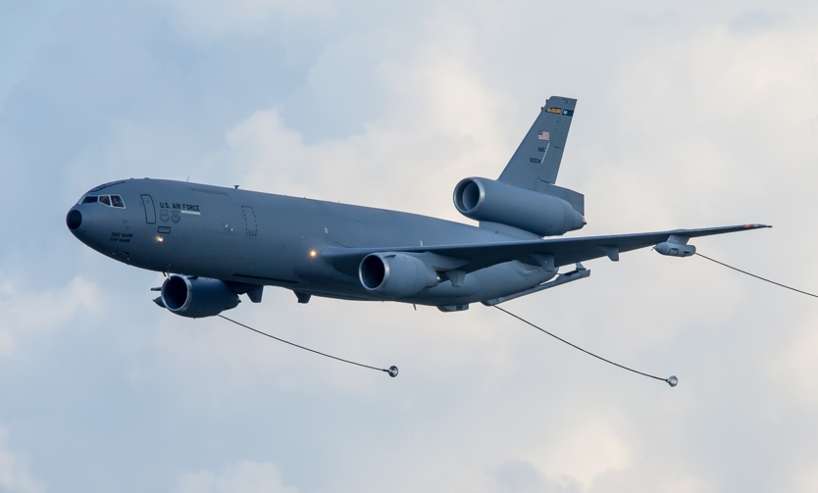
Military
Aircraft
Built for specific tasks
  Carry weapons
  Intercept enemy
  Surveillance
  Command/control
  Cargo
  Aerial refueling
Unmanned aerial vehicles
Expensive and complicated
About Airplanes
Notes:
Are there any military pilots in your chapter? Can they share any of their experiences?

Slide 13
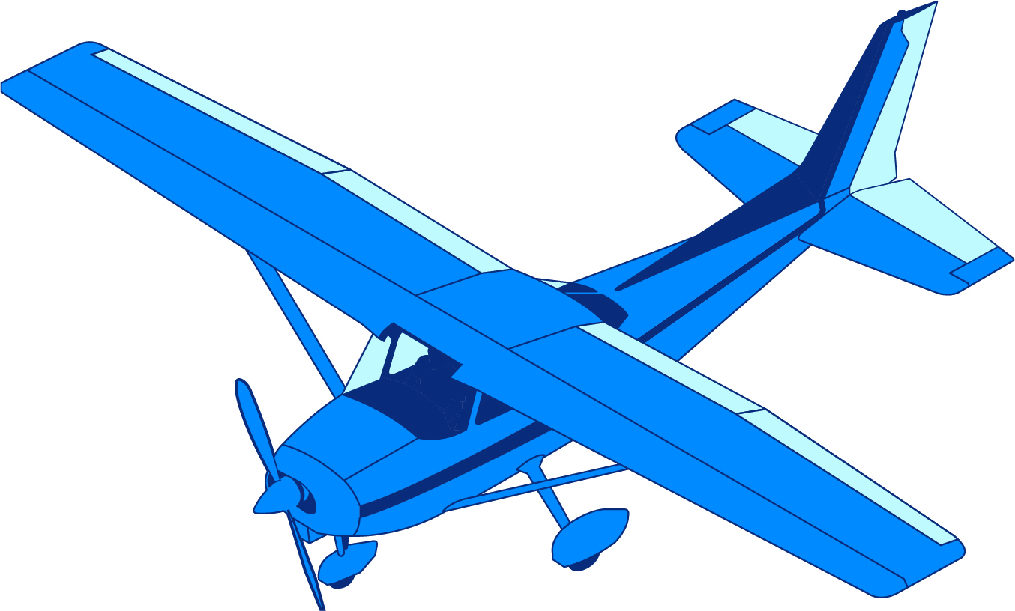
Parts of an Airplane
Ailerons
Vertical
stabilizer
Rudder
Flaps
Elevator
Wing
Horizontal
stabilizer
Propeller
Fuselage
Landing gear
About Airplanes
Notes:
The Wing
The wings of the plane are their most identifiable parts. These wings work just like those of a bird to lift the plane into the air and control the airflow as the plane flies. The tilt of the wings is a crucial part of the overall structure of the airplane as they allow the pilot to decrease or increase the descent rate of the plane when flying. It’s a big deal when a wing suffers damage, and it’s one of the reasons planes are generally kept in hangars when out of use – but building a hangar can be its own issue.
Aileron
The ailerons are the hinged surfaces of wings that aids in controlling lateral balance. These work to move the aircraft left or right by allowing the plane to roll in the desired direction. The ailerons work asymmetrically when flying. This means when the right aileron goes up, the left one goes down. When the right goes down, the left aileron goes up.
Flap
Located at the back of the wing, the flaps are included to help increase the lift of the plane into the air. These flaps are fitted to trail the edge of the wing sections. These flaps extend out from the wing and increase the camber of the wings airfoil so that it can lift at low speeds, which is vital to landing successfully.
Elevator
The elevators work to control the pitch motion of the craft. These are hinged surfaces that are fitted to the rear of the horizontal stabilizers. These work as a symmetrical pair. When the elevators go up, the aircraft goes up. When the elevators go down, the aircraft goes down.
Fuselage
This is the centermost piece of the aircraft that is responsible for the structural integrity of the cargo and passengers. Most of the modern day aircraft can hold up to 800 passengers and about 250,000 pounds in the cargo.
Rudder
The rudder is responsible for controlling the yaw motion of the aircraft. This is the side to side movement of the nose of the craft. You’ll find the rudder as a hinged section at the rear of the vertical stabilizer of the plane.
Vertical Stabilizer
On the tail section of the plane, you’ll notice a shark-like fin. This is referred to as the vertical stabilizer. This helps to prevent lateral movements of the craft which could easily lead to slippage, making the plane uncontrollable to handle.
Horizontal Stabilizer
At the tail of the plane, there is a horizontal wing-like structure that protrudes out. These are the horizontal stabilizers and help to keep the aircraft’s equilibrium when flying up and down.
Propeller
Most aircraft have at least one propeller to thrust the plane forward at a specific pitch, depending on the angle of the propeller blades. In smaller crafts, you’ll see the large propeller blades on the front. For commercial crafts, these tend to be integrated into the wings of the plane.

Slide 14
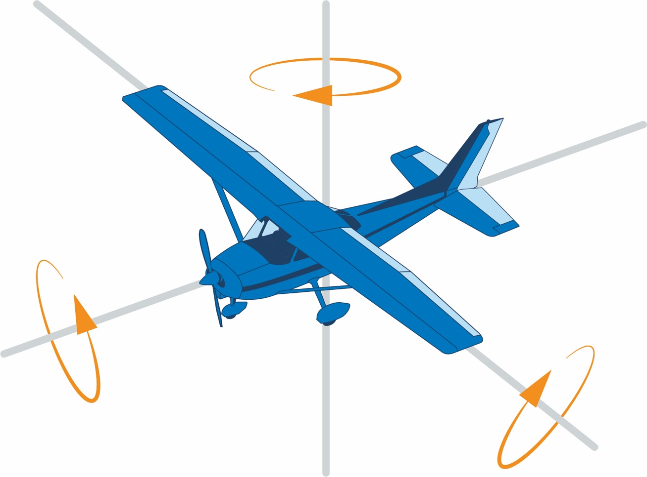
Three Axes of Control
Yaw Axis
(Vertical)
Roll Axis
(Longitudinal)
Pitch Axis
(Lateral)
About Airplanes
Notes:
To reinforce the three axes of control, use a balsa wood glider or model airplane to simulate the roll, yaw, and pitch axes.

Slide 15
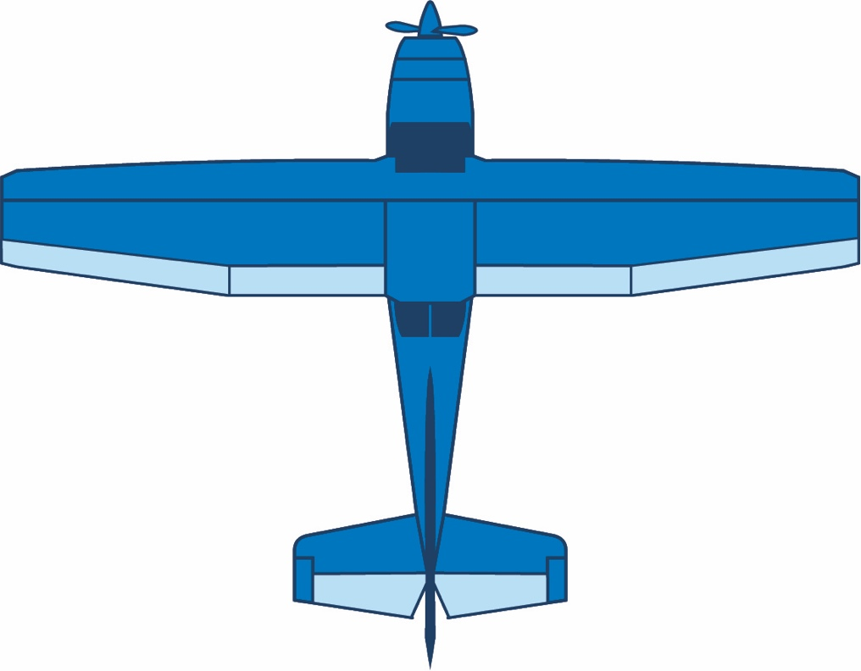
Control Surfaces
Ailerons
Flaps
Elevator
Rudder
About Airplanes
Notes:
Be prepared for some participants to not fully understand how the control surfaces move with the inside controls. You will have an opportunity to give a live demonstration of this during the hands on worksheet.
During the presentation utilize the balsa wood glider for demonstration.

Slide 16

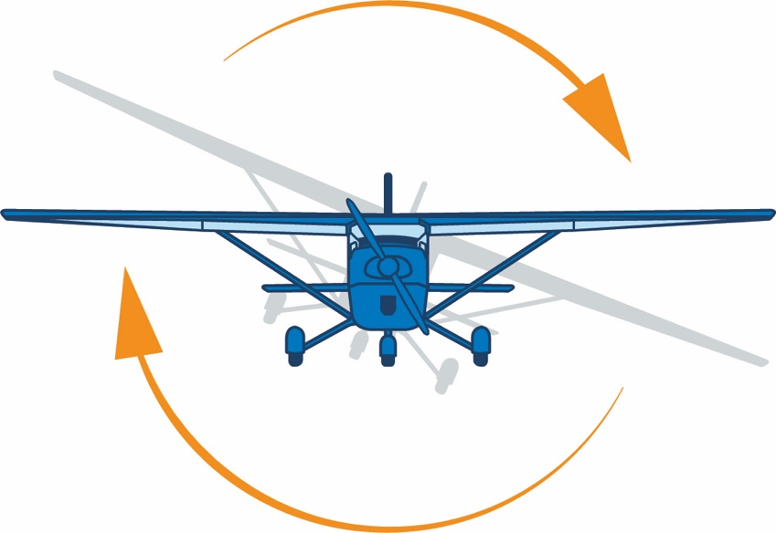

Ailerons Control Roll
Airplanes roll to turn
Controlled by the yoke
• Turn the yoke left to bank left
• Turn the yoke right to bank right
About Airplanes

Slide 17
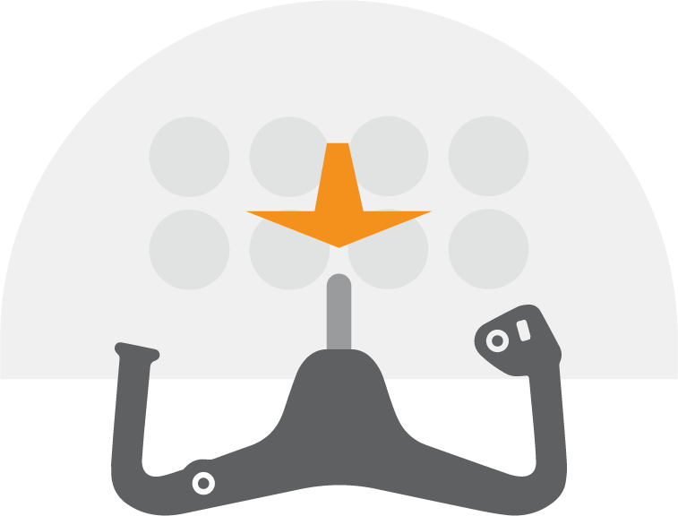
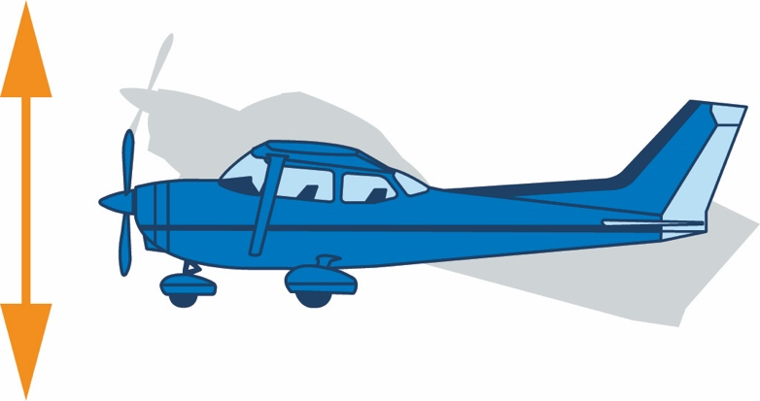

Elevator Controls Pitch
Pull yoke back, elevator rises, nose pitches up to climb
Push yoke forward, elevator drops, nose pitches down to descend
• Pull yoke back
• Push yoke forward
About Airplanes

Slide 18
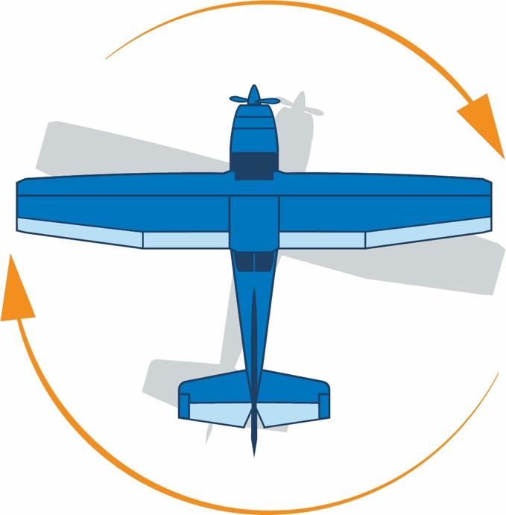
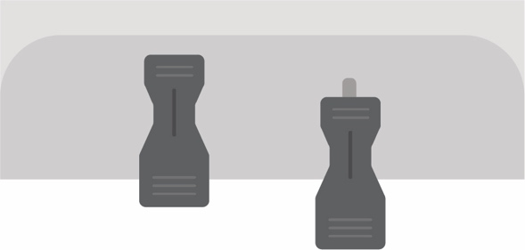
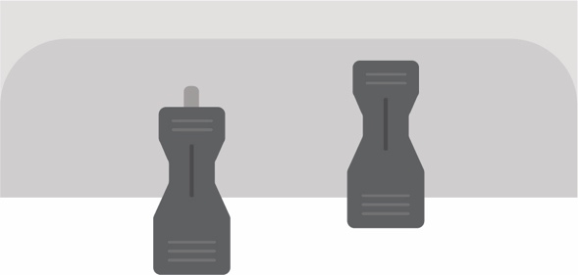
Rudder Controls Yaw
Rudder maintains straight flight and coordinated turns
Controlled by rudder pedals
• Push on left pedal to yaw left
• Push on right pedal to yaw right
About Airplanes

Slide 19
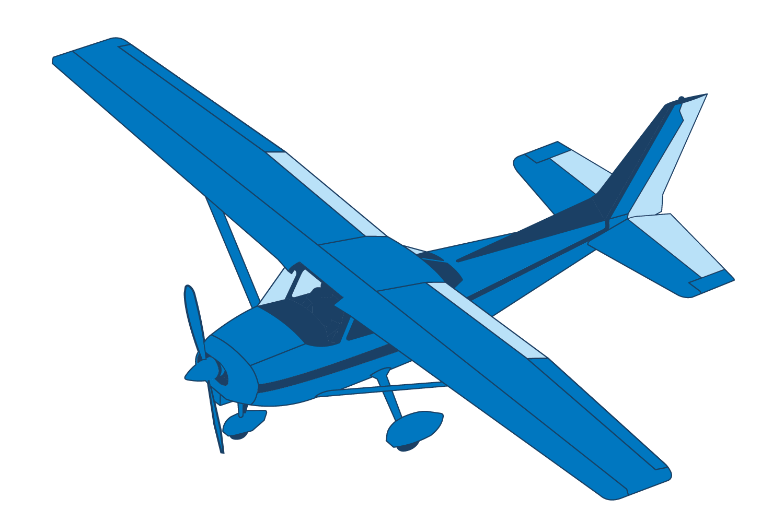
Flaps
Change wing shape, increase lift
Reduce stall speed
Allow slower landing
Flaps
About Airplanes
Notes:
The flap is a high lift device used to reduce the stalling speed of an airplane wing. Flaps are usually mounted on the trailing edges of a wing. Flaps are used to reduce the take-off distance and the landing distance. Flaps also cause an increase in drag so they are retracted when not needed.
Extending the wing flaps increases the camber or curvature of the wing, raising the maximum lift coefficient or the upper limit to the lift a wing can generate. This allows the aircraft to generate the required lift at a lower speed, reducing the minimum speed (known as stall speed) at which the aircraft will safely maintain flight.

Slide 20
Activity
Exploring Airplanes Worksheet
Airplane Control Surfaces Worksheet
About Airplanes

Slide 21
Objectives
Now you can describe
Cool airplanes
  Identify airplane configuration differences
  Describe how they are used
How they work
  Differentiate among pitch, roll, and yaw
  Describe control surfaces
  Name parts of an airplane
About Airplanes

Slide 22
About Airplanes
Questions?
The development of this program was made possible in part by
a generous donation from the Sporty’s Foundation.

