Slide 1
Aerodynamics of Flight
Chapter Presenter
The development of this program was made possible in part by
a generous donation from the Sporty’s Foundation.

Slide 2
Session Objectives
You’ll be able to
Explain how an aircraft stays in the air
Describe the four forces of flight
Explain what a stall is and why it occurs
Aerodynamics of Flight

Slide 3
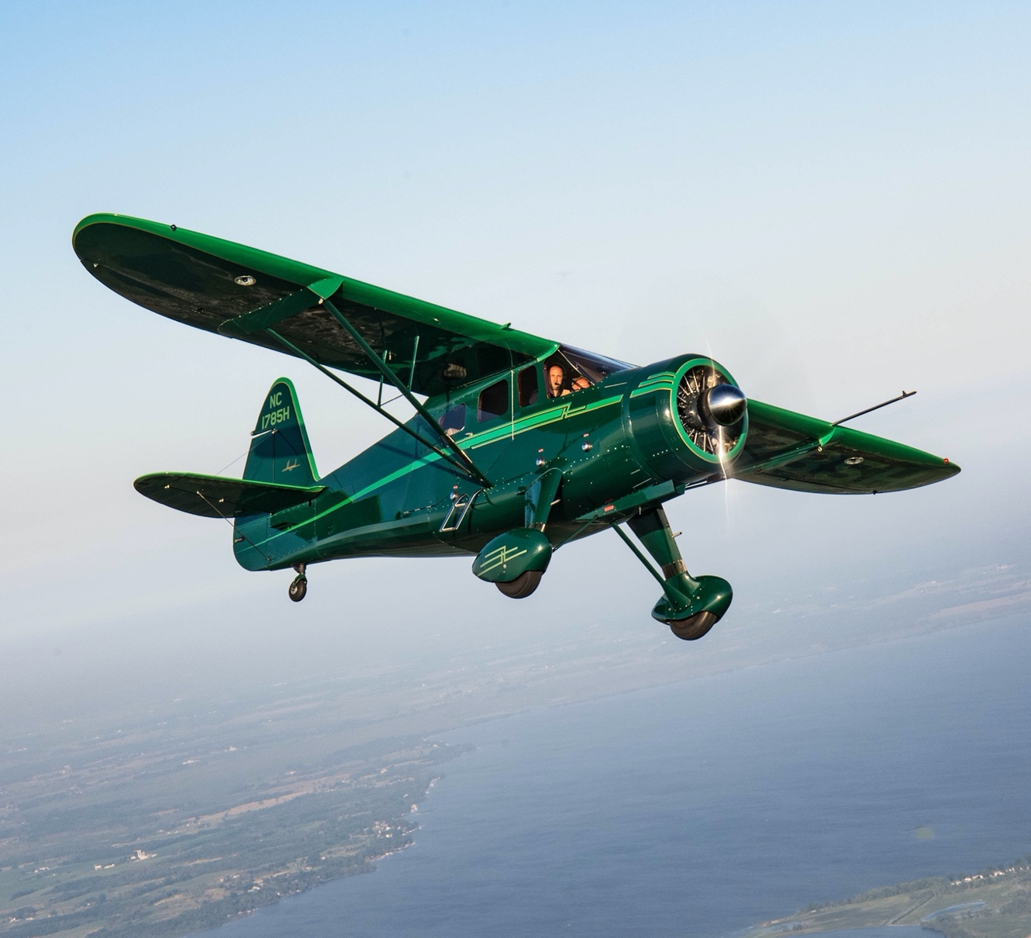
How Airplanes Fly
How does an airplane stay up?
Aerodynamics of Flight
Notes:
In this module participants will learn what makes an airplane fly.

Slide 4
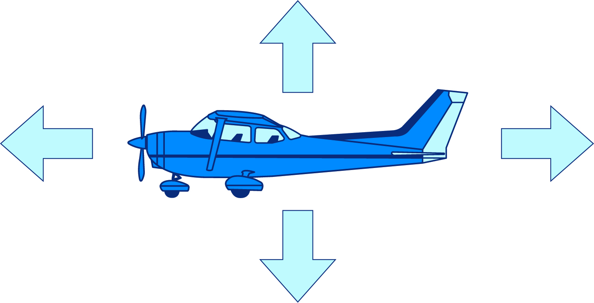
4 Forces of Flight
Lift
Upward force opposes gravity, supports the weight of an aircraft
Drag
Opposes forward
movement
Thrust
Variable with throttle: Pulls an aircraft forward
Weight
Gravity: Stays constant in level unaccelerated flight
Aerodynamics of Flight
Notes:
The way the four forces act on the airplane make the plane do different things. Each force has an opposite force that works against it. Lift works opposite of weight. Thrust works opposite of drag. When the forces are balanced, a plane flies in a level direction. The plane goes up if the forces of lift and thrust are more than gravity and drag. If gravity and drag are bigger than lift and thrust, the plane goes down. Just as drag holds something back as a response to wind flow, lift pushes something up. The air pressure is higher on the bottom side of a wing, so it is pushed upward.
When an airplane is flying straight and level at a constant speed, the lift it produces balances its weight, and the thrust it produces balances its drag. However, this balance of forces changes as the airplane rises and descends, as it speeds up and slows down, and as it turns.

Slide 5
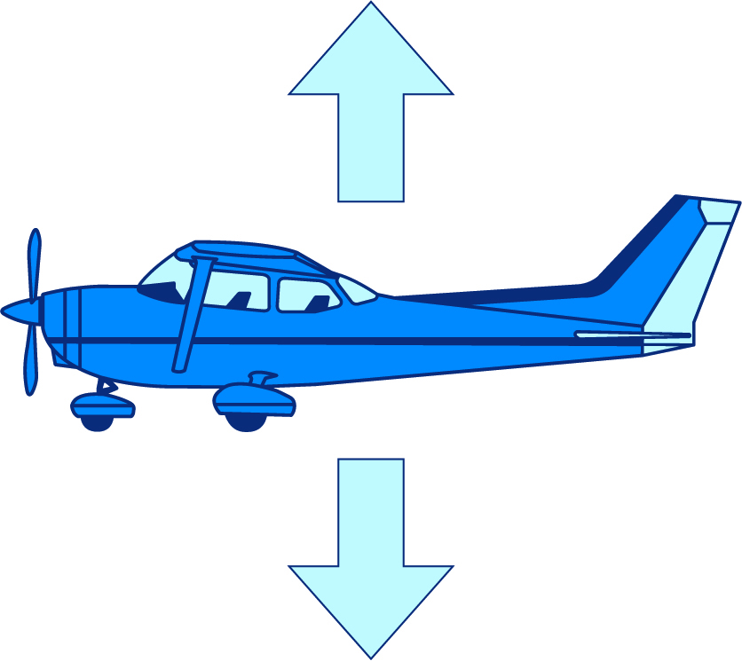
Weight
For an airplane to fly, the lift must be equal to or greater than weight
Lift
Weight
Aerodynamics of Flight
Notes:
Weight is the force of gravity. It acts in a downward direction—toward the center of the Earth.

Slide 6
Lift
Produced by airflow around the wing
Lift
Pressure exerted by faster-moving air
Wing
Air
Air
Pressure exerted by slower-moving air
Higher pressure below creates lift
Aerodynamics of Flight
Notes:
Discuss how the air has to move faster over the top of the wing since there is more surface for it to cover. The air below the wing has less surface to move over, so it can move slower. This leads causes there to be an area of high pressure below the wing, which creates lift.
Lift is the force that acts at a right angle to the direction of motion through the air. Lift is created by differences in air pressure.
Let’s take a look at the shape of an airplane as seen in the image here. The shape if a wing as seen here is called an airfoil.
Imagine that air is flowing from right to left, similar to when an airplane is moving through the sky. Image that air contacts the front (leading edge) of the wing. Some of the air will travel up and over the wing, while other air will travel along the bottom side of the wing. Let’s assume that the air splits at the leading edge of the wing, so some air flows over and some air flows under, and let’s assume the same air has to meet back together at the trialing edge of the wing. Notice that the air taking the upper path has to travel farther than the air taking the lower path. Recall that the air splits at the leading edge of the wing and meets back up at the trailing edge. My question to you is, which path of the air travel (upper or lower) needs to move faster for the air the meet up again at the trailing edge?
Correct, the air taking the upper path needs to travel faster, as it takes a longer trip.
We learned that as a fluid (air) increases in speed, the pressure it exerts decreases. My next question is, which side of the airfoil (upper or lower) will have less pressure exerted on it?
Correct, the upper surface of the airfoil will have less pressure exerted on it.
If the upper surface has less pressure exerted on it, the lower surface has MORE pressure exerted on it!
What do these pressure make the wing do?
Correct, the wing will rise!
Faster air = lower pressure

Slide 7
Bernoulli’s Principle
As velocity (speed) of a fluid (air) increases, its pressure decreases
Try it:
Blow air over a piece of paper
Paper Wing
Blowing Air
Aerodynamics of Flight
Notes:
We learned that as a fluid (in this case air) increases in the speed, the pressure it exerts decreases.
The action and affect we just learned is called Bernoulli’s principle.
Daniel Bernoulli (1700 – 1782) was a mathematician and physicist and best remembered for his applications of mathematics to mechanics, especially to aviation enthusiasts regarding what makes an airplane fly.
Let’s do an experiment.
Take a piece of paper, hold it horizontally in front of your mouth, and blow across the upper surface of the paper.
What do you think the paper will do? Think about what we learned about Bernoulli's Principle.
Try it.
The paper rises.

Slide 8
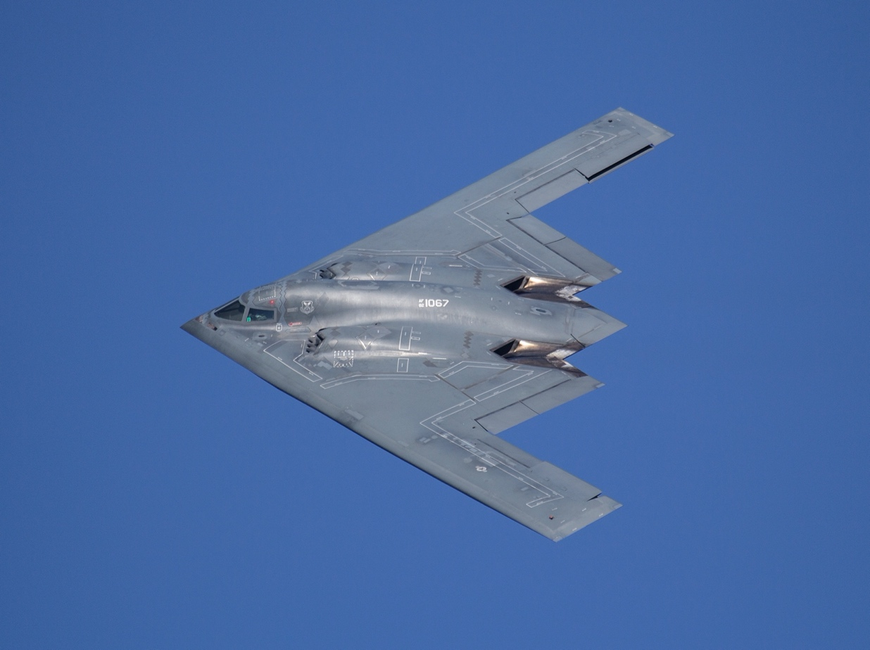
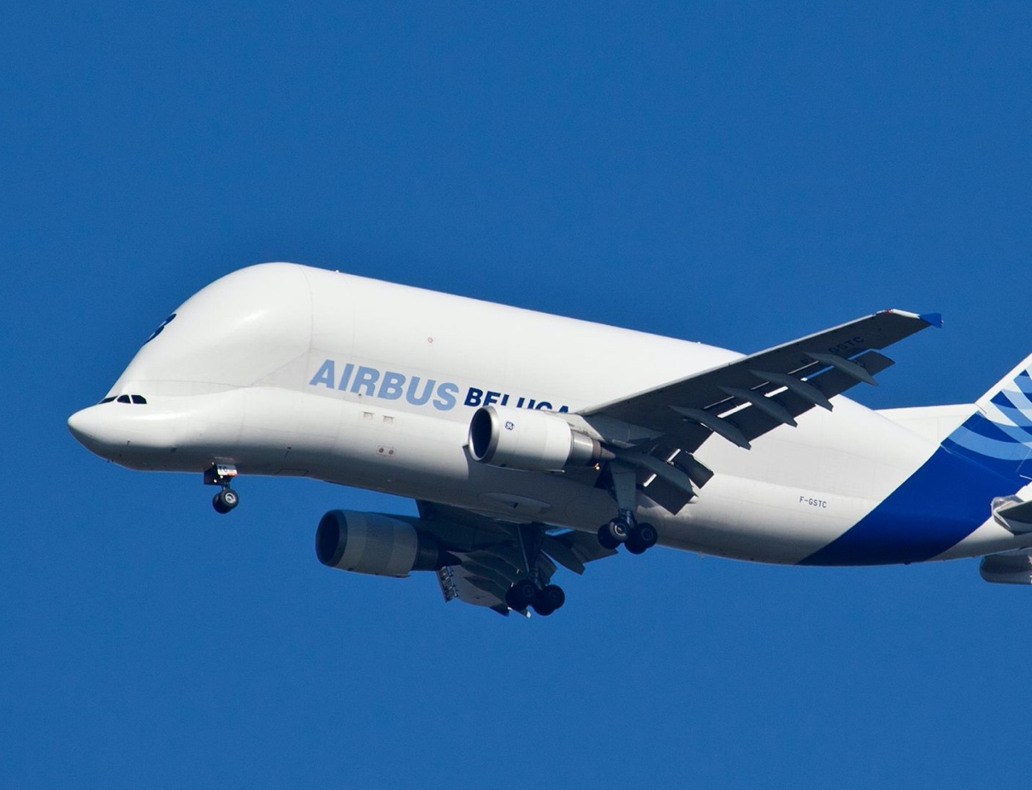
Drag
Friction of air against surfaces
Question: Which airplane has less drag?
Aerodynamics of Flight
Notes:
You could relate this to a more familiar topic. Racecars are more angular and look more like the airplane on the left, they have less drag and are MORE aerodynamic to allow them to go faster. On the contrary, a semi-truck is not built to be as aerodynamic since they need to carry more cargo, it doesn’t matter if they go fast or not. This relates to the airplane on the right. It is meant to carry large cargo not go extremely fast.
Drag is the force that acts opposite to the direction of motion. Drag is caused by friction and differences in air pressure.

Slide 9
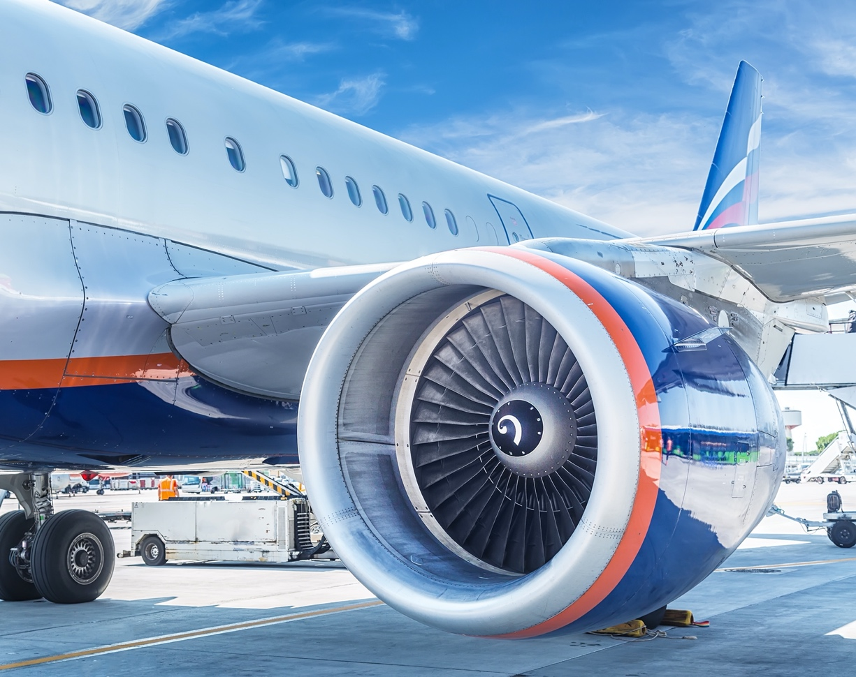
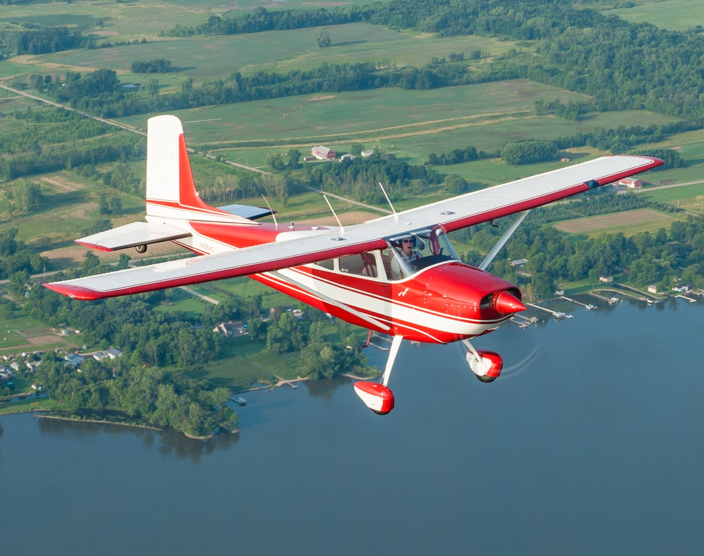
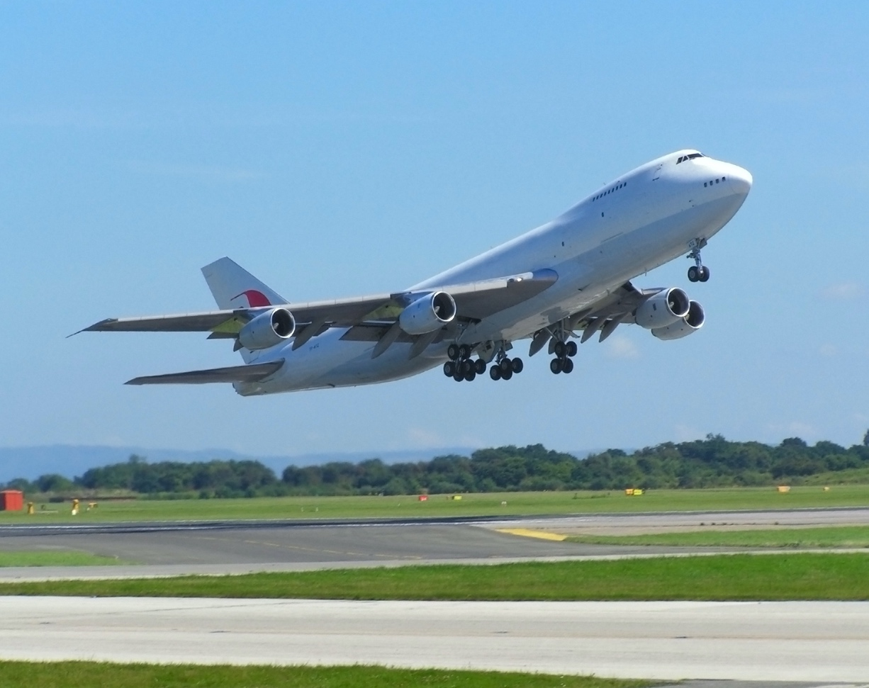
Thrust
Thrust is produced by the aircraft engine(s)
It propels the airplane forward
Aerodynamics of Flight
Notes:
Thrust is the force that propels a flying machine in the direction of motion. Engines produce thrust.
More thrust makes the airplane move faster through the air.

Slide 10
4 Forces of Flight in Balance
Lift
Drag
Thrust
To move forward at a steady speed, thrust must equal drag
Weight
To maintain level flight, lift must equal weight
Aerodynamics of Flight
Notes:
In steady flight, the sum of these opposing forces is always zero.
Discuss:
As thrust increases by pushing the throttle forward a little, thrust overcomes drag, and the plane accelerates for a period of time, and is no longer in steady flight. When the pilots stops moving the throttle forward, drag will eventually equal thrust, and the plane will stop accelerating, and simply remain at a constant speed, again being in steady flight.
Similarly, when the plane accelerates (it is in the process of increasing speed), lift occurs due to Bernoulli's Principle and plane will rise. As the plane rises, it is not in steady flight, rather it is changing. As the plane stops accelerating and settles into a constant speed, the lift will equal weight again, and the plane will remain in steady flight, neither rising of falling.

Slide 11
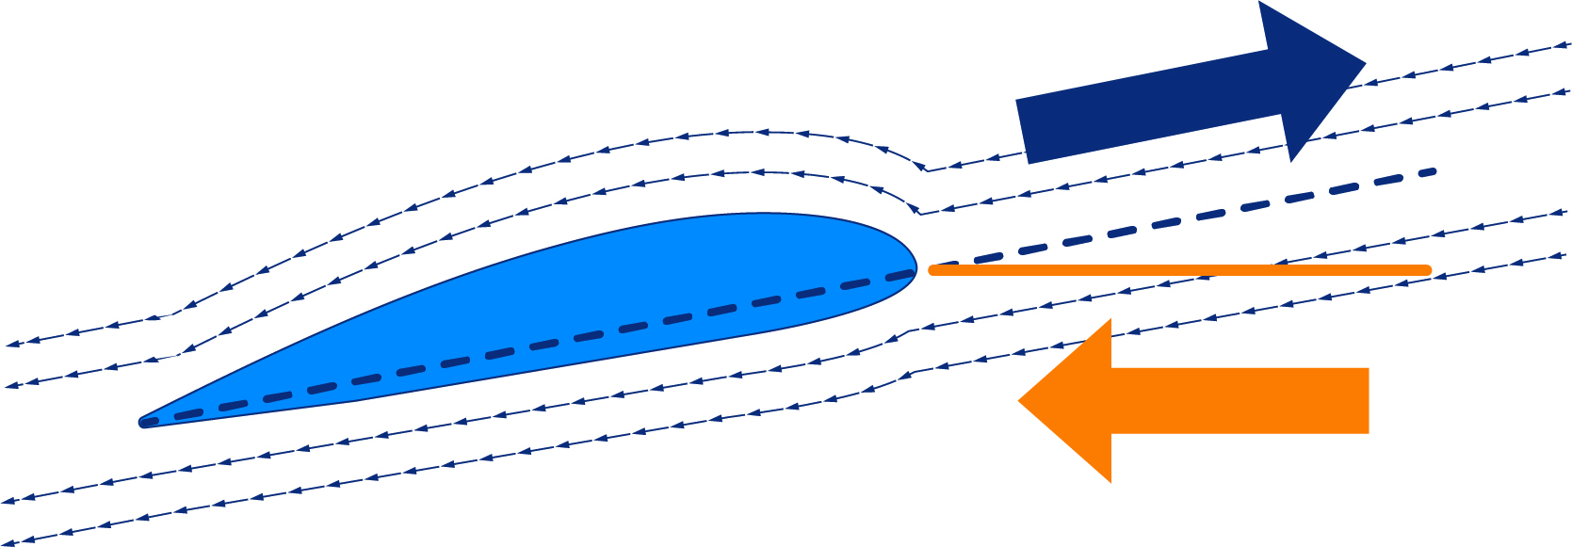
The Wing in Air
Relative Wind: Flow of air opposite the direction of the wing
Flight Path
Chord Line
Chord Line
Relative Wind
Relative Wind
Aerodynamics of Flight
Notes:
relative wind is the direction of movement of the air relative to an airfoil (wing).
It is opposite to the direction of movement of the aircraft or airfoil relative to the atmosphere.
Close to any point on the surface of an aircraft or airfoil, the air is moving parallel to the surface; but at a great distance from the aircraft or airfoil the movement of the air can be represented by a single vector (arrow or line). This vector is the relative wind.
The angle between the chord line of an airfoil and the relative wind defines the angle of attack. The relative wind is of great importance to pilots because exceeding the critical angle of attack will result in a stall, regardless of airspeed.

Slide 12
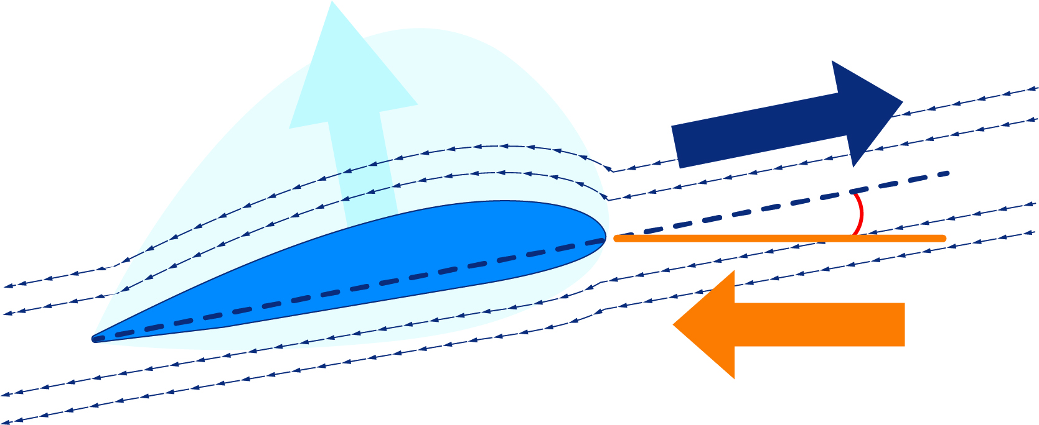
The Wing in Air
Angle of Attack: Angle between the chord line and relative wind
Flight Path
Angle of Attack
Chord Line
Chord Line
Relative Wind
Relative Wind
Aerodynamics of Flight
Notes:
Angle of attack (AOA) is the angle between the oncoming air or relative wind and a reference line on the airplane or wing. Sometimes, the reference line is a line connect- ing the leading edge and trailing edge at some average point on the wing.
It's important to understand relative wind – this is the way the air flows over the wing – when this is disrupted, air can no longer flow the way it's designed to over the wing, and lift decreases.

Slide 13
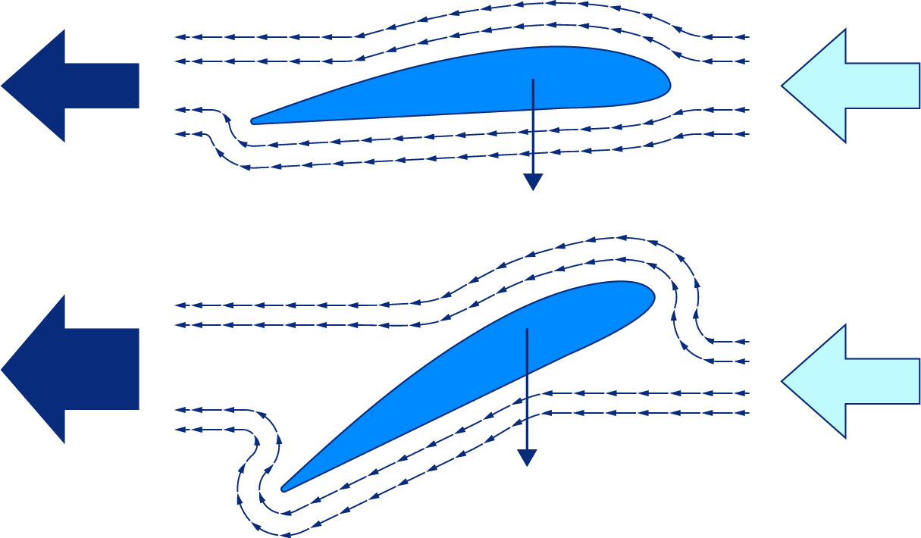
Stall
What is a stall?
A stall occurs when the angle of attack is too high
This causes the air to detach from the top of the wing, reducing or eliminating the wing's ability to produce lift
Drag
RW
5° angle of attack
Weight
Drag
RW
Weight
40° angle of attack
Aerodynamics of Flight
Notes:
A stall is a condition in aerodynamics and aviation such that if the angle of attack increases beyond a certain point, then lift begins to decrease. The angle at which this occurs is called the critical angle of attack.
Consider using a model airplane to show what a stall would look like in real life

Slide 14
Activity
Aerodynamics of Flight Worksheet
Aerodynamics of Flight

Slide 15
Objectives
Now you can
Explain how an aircraft stays in the air
Describe the four forces of flight
Explain what a stall is and why it occurs
Aerodynamics of Flight

Slide 16
Aerodynamics of Flight
Questions?
The development of this program was made possible in part by
a generous donation from the Sporty’s Foundation.

