Slide 1
Flight
Instruments
Chapter Presenter
The development of this program was made possible in part by
a generous donation from the Sporty’s Foundation.

Slide 2
Session Objectives
You will be able to
Recognize the six primary flight instruments
Read key instruments
Interpret both traditional and glass panel displays
Flight Instruments

Slide 3
Six Primary
Flight Instruments
Attitude Indicator (AI)
Airspeed Indicator
(ASI)
Altimeter
Turn Coordinator
(Includes Rate of Turn Indicator and Inclinometer)
Vertical Speed
Indicator (VSI)
Directional Gyro (DG)
or Heading Indicator
Commonly called the “Six Pack”
Flight Instruments

Slide 4
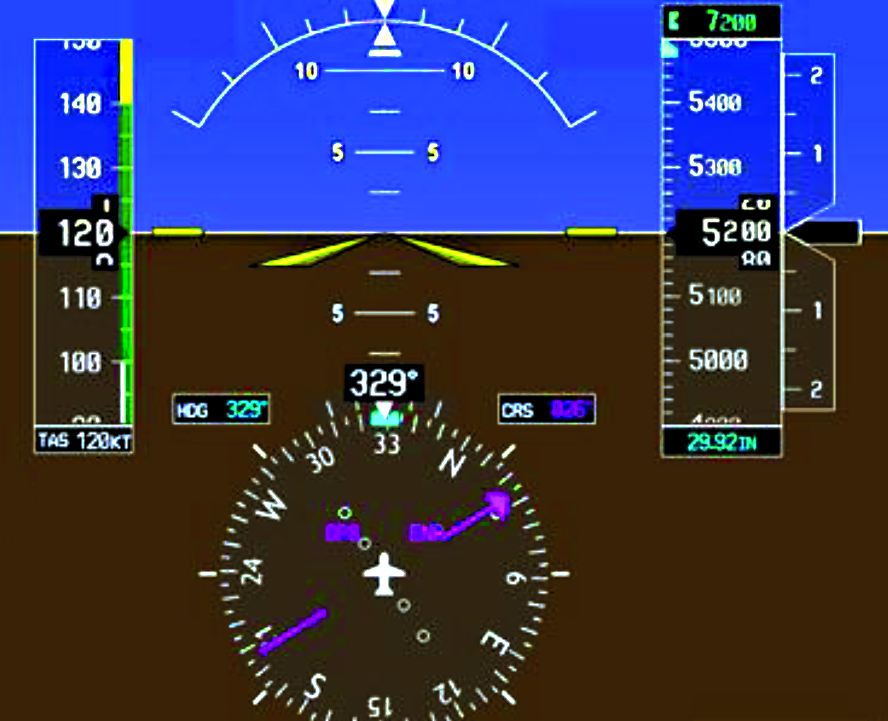
Where Is the Six Pack?
Attitude Indicator
Turn
Coordinator
Altimeter
Airspeed
Indicator
Vertical Speed Indicator (VSI)
Heading Indicator
Commonly called the “Glass Panel”
Flight Instruments

Slide 5
Traditional vs. Glass
Flight Instruments

Slide 6
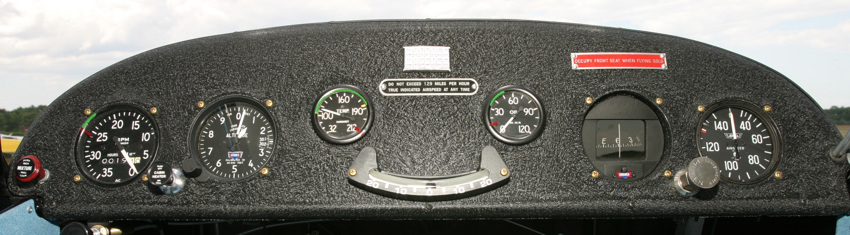
Less Than a Six Pack
Altitude
Airspeed
Inclinometer
This 1945 Aeronca Champ has only the essentials!
Flight Instruments

Slide 7
Reading Instruments
How Fast?
Airspeed
Flight Instruments

Slide 8
Reading Instruments
Climbing or Turning?
Attitude Indicator (AI)
Flight Instruments

Slide 9
Reading Instruments
How High?
Altimeter
Flight Instruments

Slide 10
Reading Instruments
What Direction?
Heading Indicator or
Directional Gyro (DG)
Flight Instruments

Slide 11
Reading Instruments
Climbing or Descending?
Vertical Speed
Indicator (VSI)
Flight Instruments

Slide 12
Reading Instruments
Coordinated or Uncoordinated?
Turn Coordinator
Flight Instruments

Slide 13
What Is Happening?
Speed? Straight and Level?
Flight Instruments

Slide 14
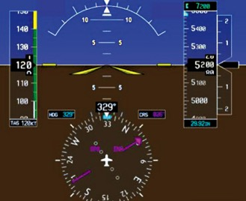
What Is Happening?
Flight Instruments

Slide 15
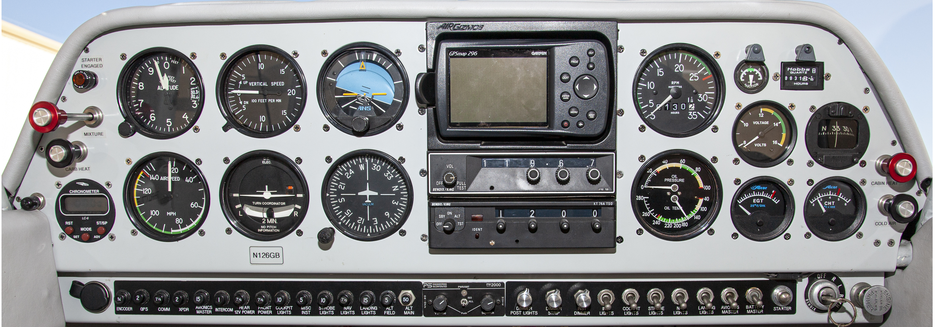
Instrument Panel: Beyond the Six Pack
Navigation and Communication
Engine
Instruments
“Six Pack”
Flight Instruments

Slide 16
Activity
Flight Instruments Worksheet
Flight Instruments

Slide 17
Objectives
Now you can
Read key instruments
Recognize the six primary flight instruments
Interpret both traditional and glass panel displays
Flight Instruments

Slide 18
Flight
Instruments
Questions?
The development of this program was made possible in part by
a generous donation from the Sporty’s Foundation.

