Slide 1
Weather
Basics
Chapter Presenter
The development of this program was made possible in part by
a generous donation from the Sporty’s Foundation.

Slide 2
Session Objectives
You will learn about
What is weather?
How does weather affect flying?
How do we know the weather?
What makes weather?
Clouds
Visibility
Wind
Weather Basics

Slide 3
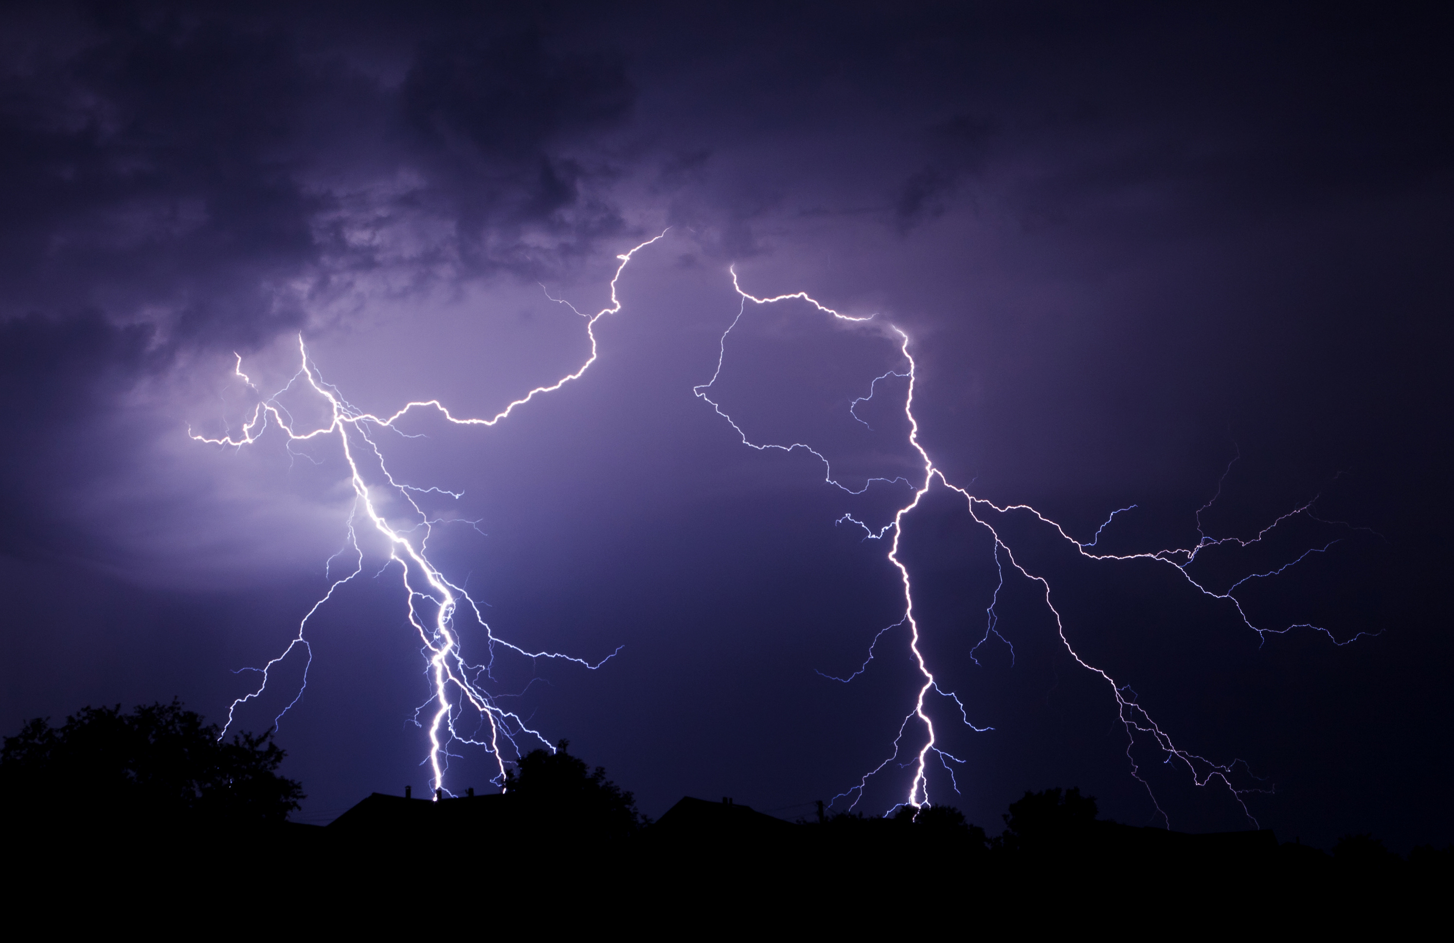
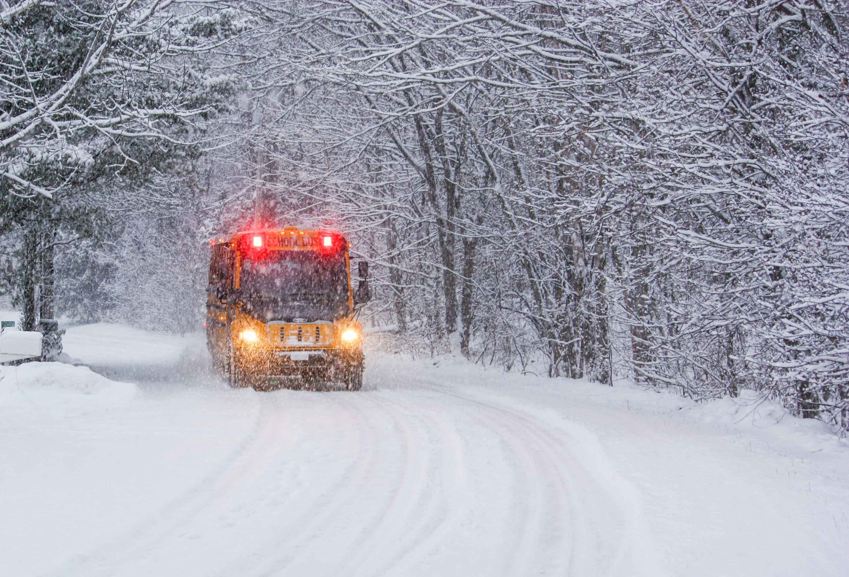
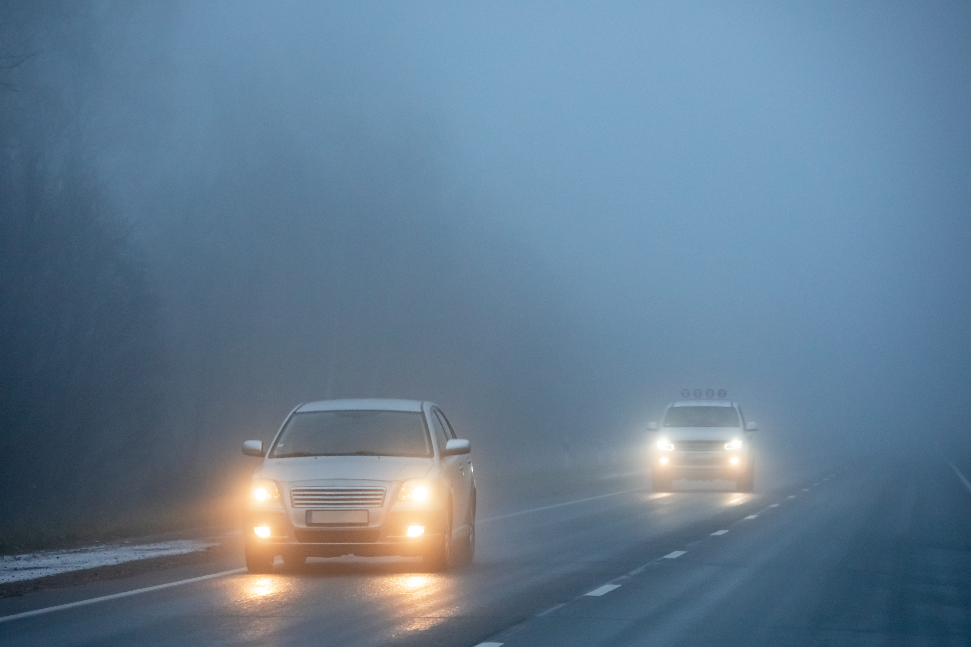
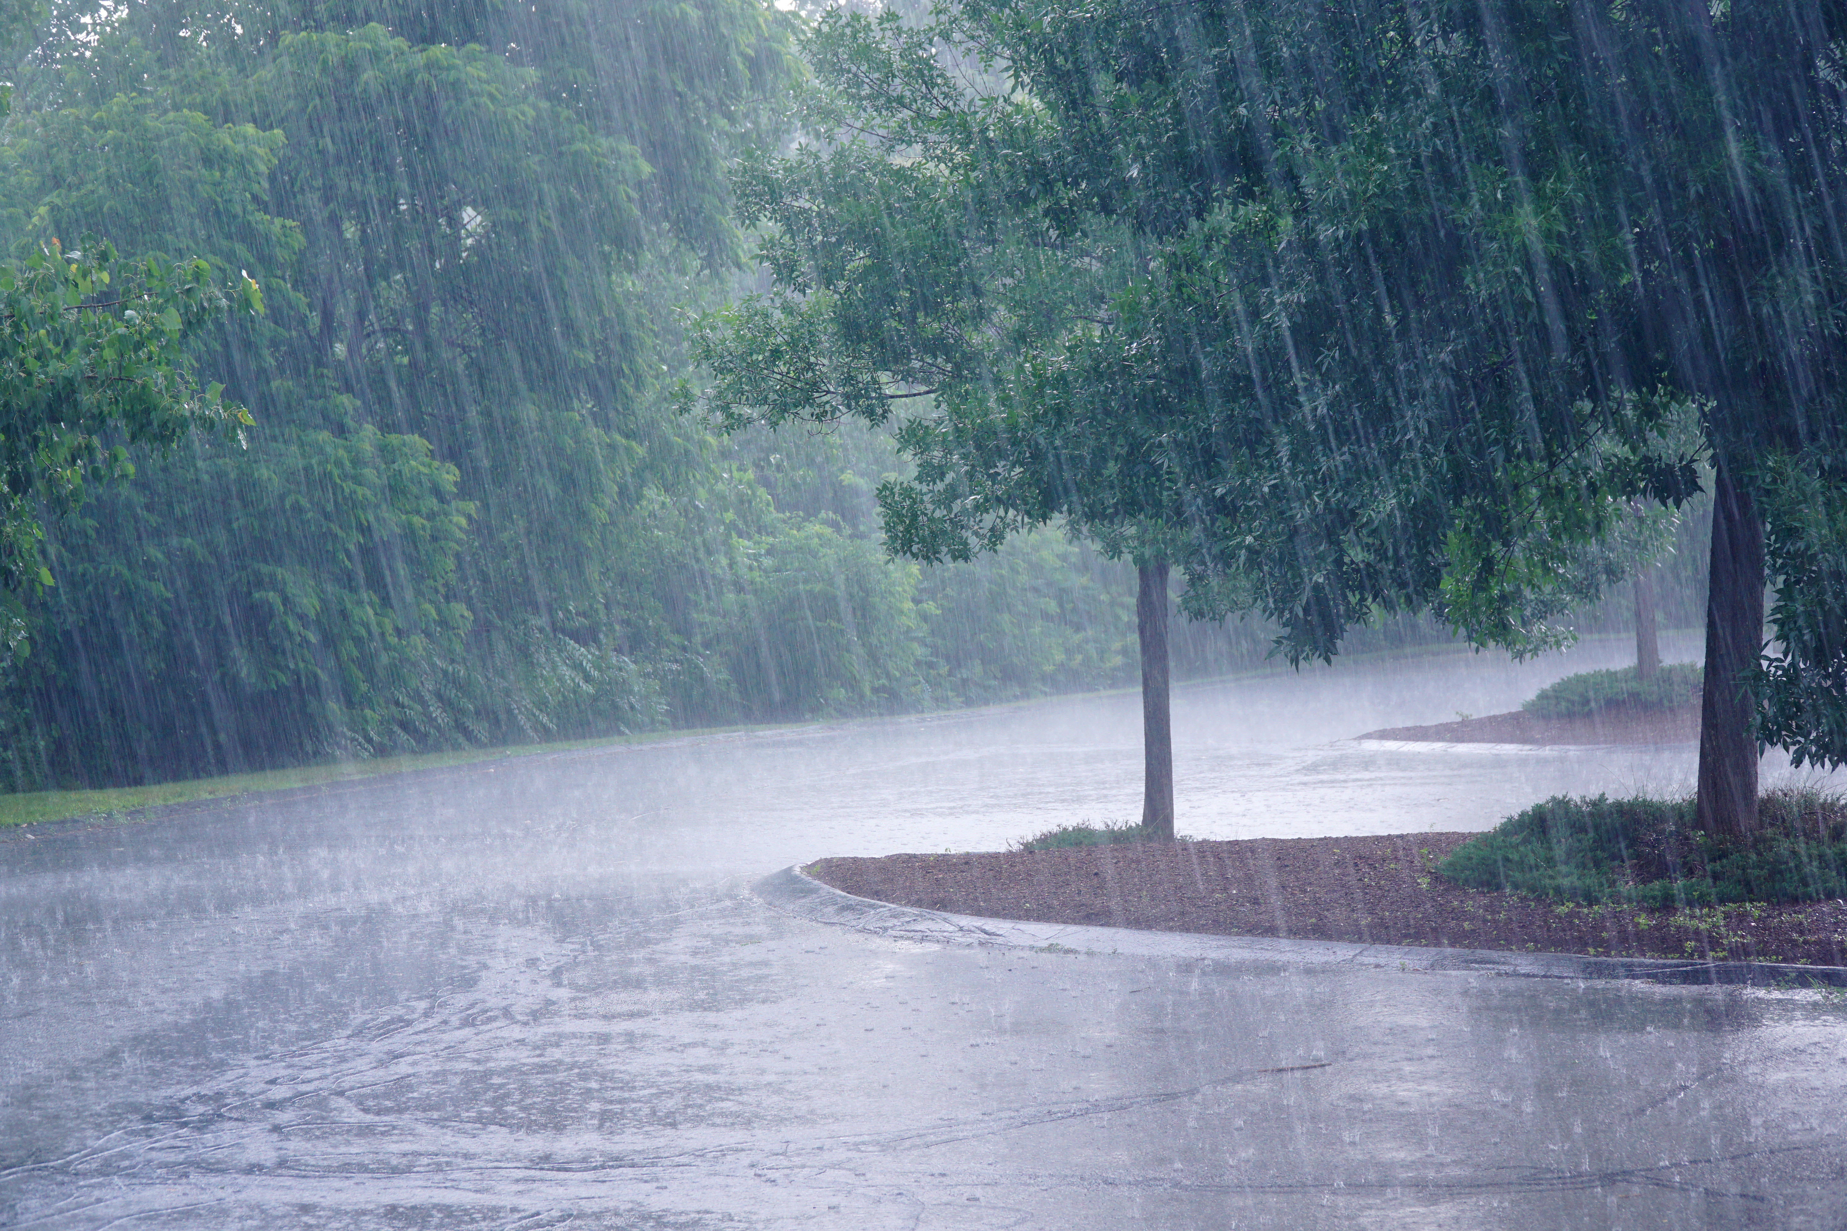
What Is Weather?
Is lightning weather?
Is snow weather?
Is fog weather?
Is rain weather?
Weather Basics
Notes:
What is this weather?
Weather is simply the condition of the outdoors at any time.
When we think of conditions, we think of temperature, precipitation, air pressure and cloud cover. Talk about of the conditions mentioned.
What do we think of when we think of weather?
We usually think of bad weather. Would you consider this dangerous weather?
Can you tell me what the temperature is in these photos?
Is there precipitation in these photos.
Can you tell me about cloud cover in these photos?

Slide 4
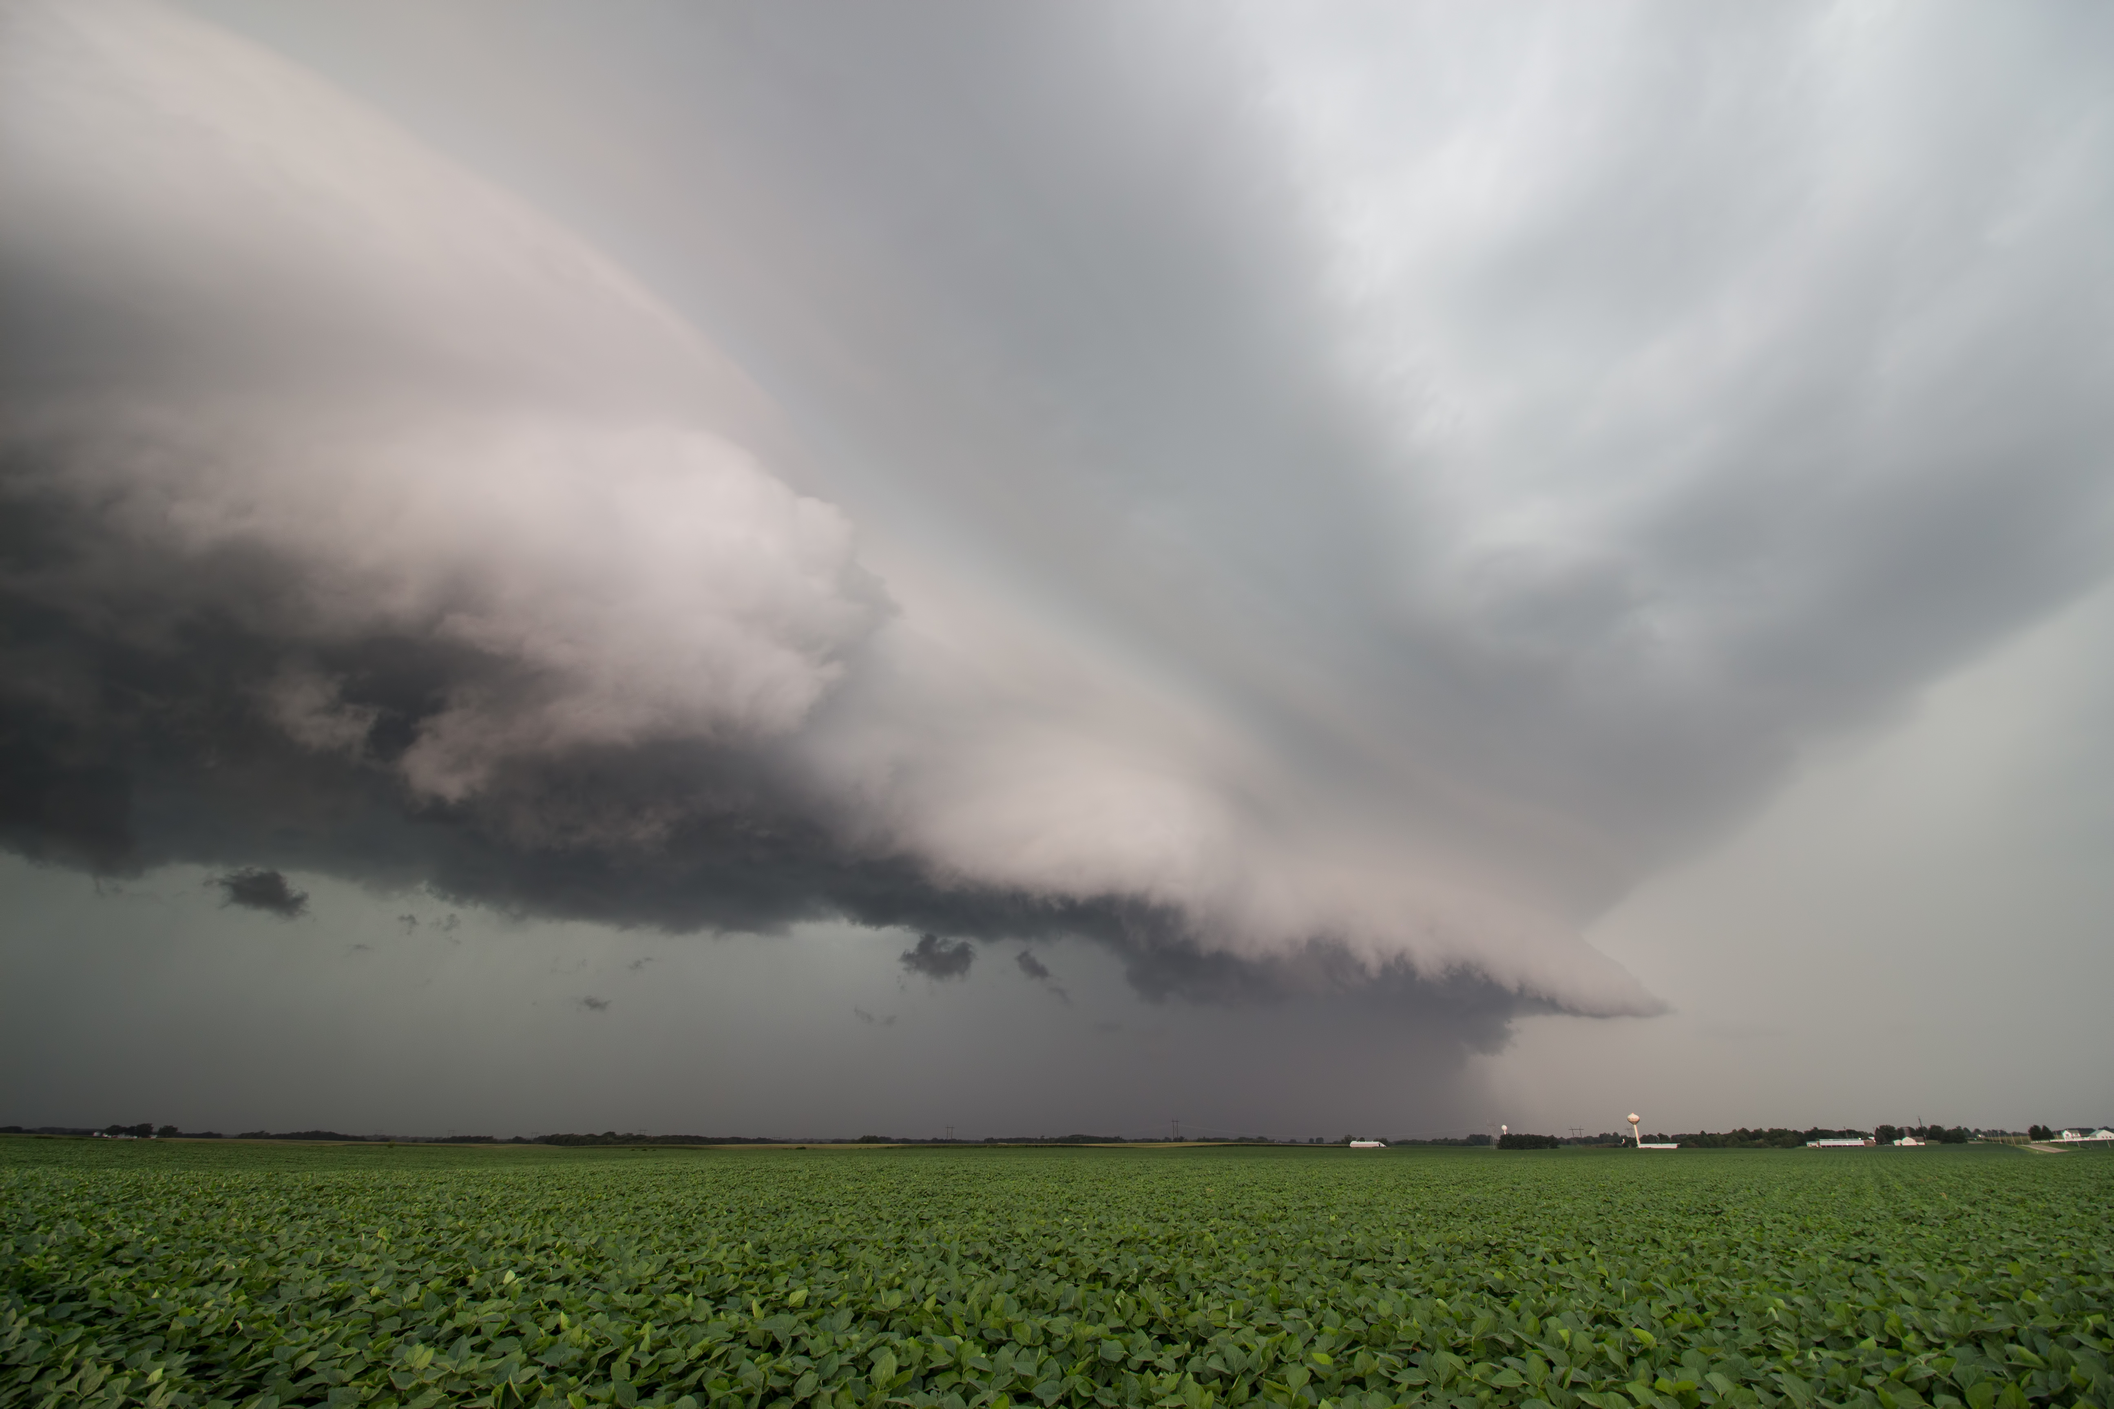
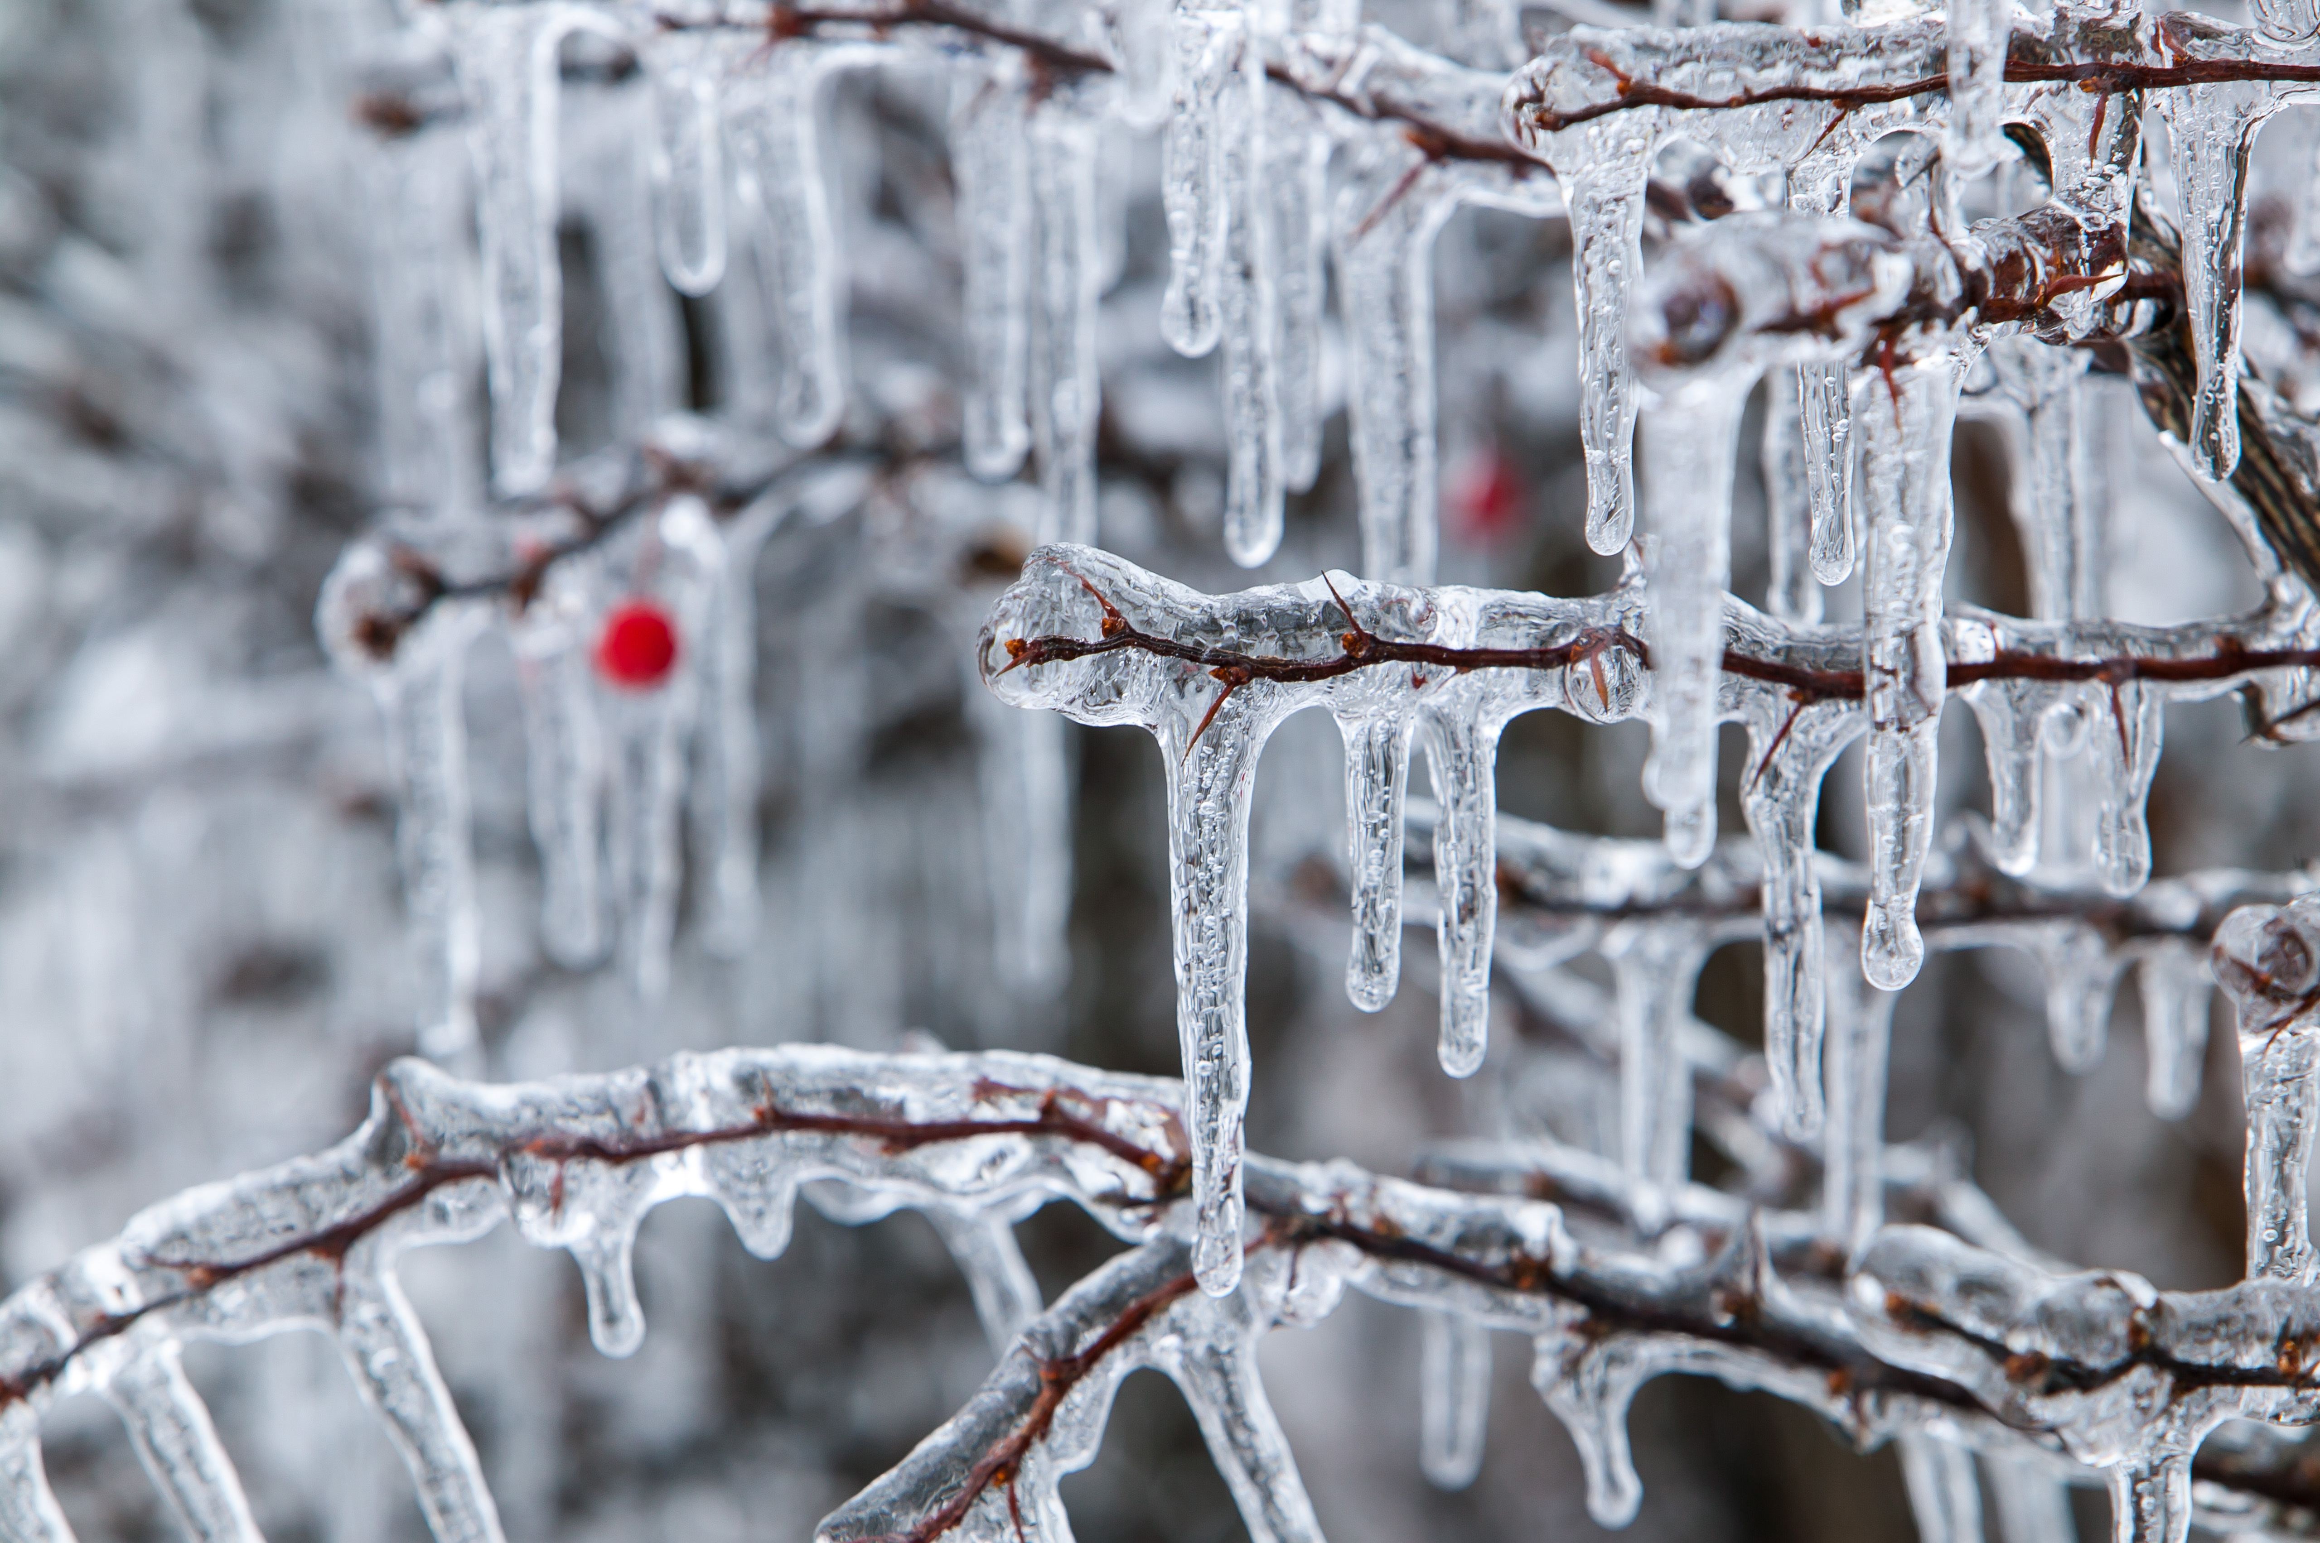
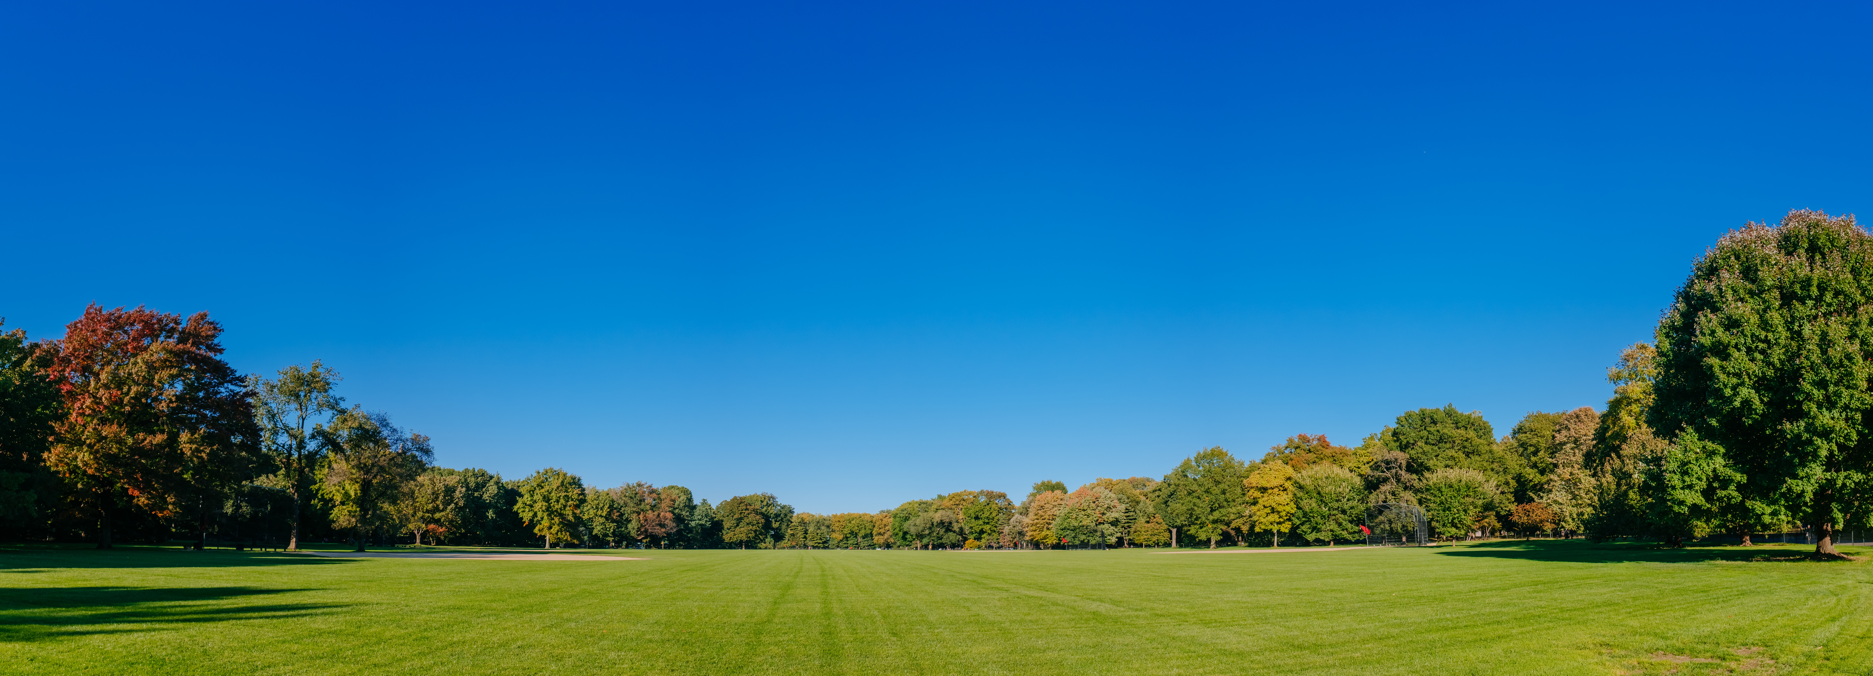
What Is Weather?
Are clouds and wind weather?
Are ice and sleet weather?
Are clear skies an example of weather?
Weather Basics
Notes:
Is this weather? Yes, this is weather too. Weather can also be “good”.
Can you tell me the sky condition in this photo?
Would you consider these examples of “good weather” or “bad weather”?
The temperature?
The cloud Clouds?
The wind?
Is there precipitation in this photo?
Would this be a good day to fly?

Slide 5
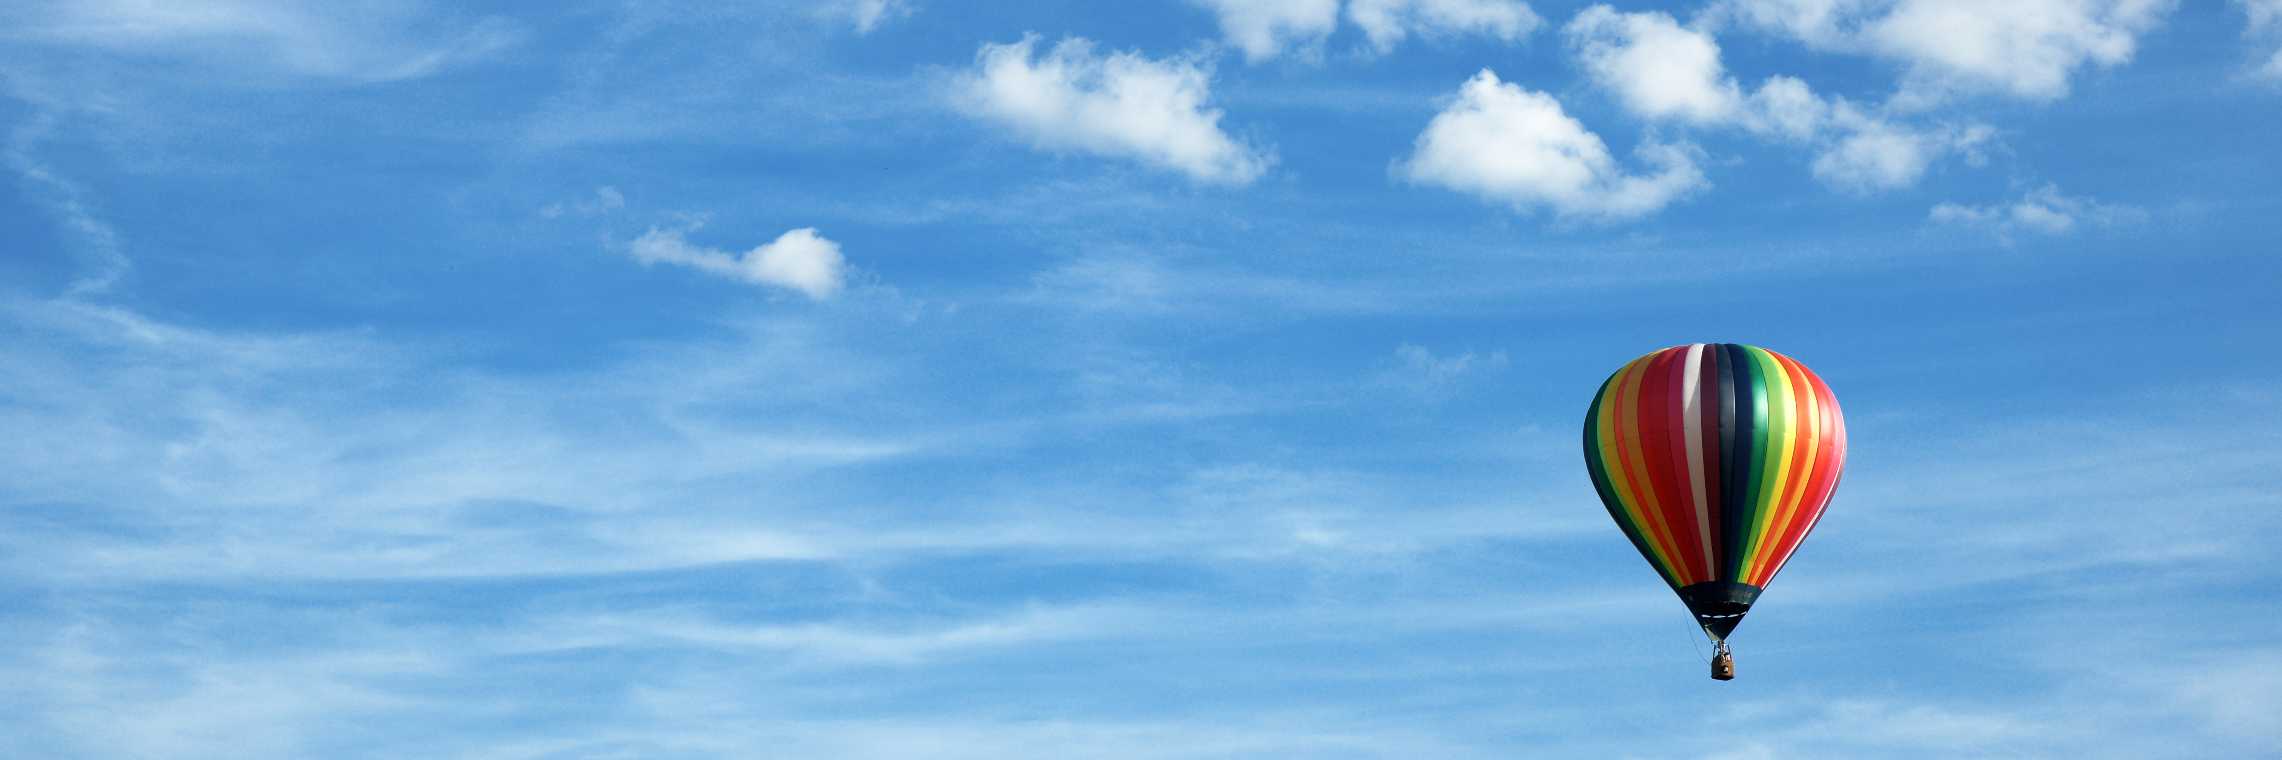
How Does Weather Affect Flying?
Weather Basics
Notes:
Ask “How does the weather affect flying?”
How does wind, rain, snow affect flying?
What would you expect the weather to be to fly in a hot air ballon?

Slide 6
How Do We Know the Weather?
Pilots should always check the weather before they fly
For nonpilots: Check local weather on radio, TV, or the internet
In aviation, we use tools such as ATIS and METARS to understand the weather conditions
Weather Basics
Notes:
Discuss the various ways that pilots use to check the weather.
Also mention that a pilot should simply look outside at the weather!

Slide 7
ATIS - Automated Terminal Information Service
ATIS is a continuous broadcast of local airport weather conditions and other vital information for pilots that a person may listen to using their phone or airplane radio
Updated every hour or as conditions change
Weather Basics
Notes:
The next slide will be a good time to listen to atis using a phone or handheld radio.

Slide 8
ATIS - Automated Terminal Information Service
Let’s listen to our local ATIS and identify the following conditions at the airport:
Wind speed
Wind direction
Visibility
Cloud cover
Air temperature
Weather Basics
Notes:
(listen to ATIS and discuss) –
Explain that airports have their own ATIS, and specifically focus on the listed items and less so on the other items depending on availability of time.

Slide 9
METAR - Meteorological Terminal Air
METAR is a method used in aviation to report the weather at local airports
Standardized and used around the world
Is written in an abbreviated format
Updated every hour or as conditions change
Weather Basics
Notes:
Discuss what a METAR is and move on to the next slide…better information)

Slide 10
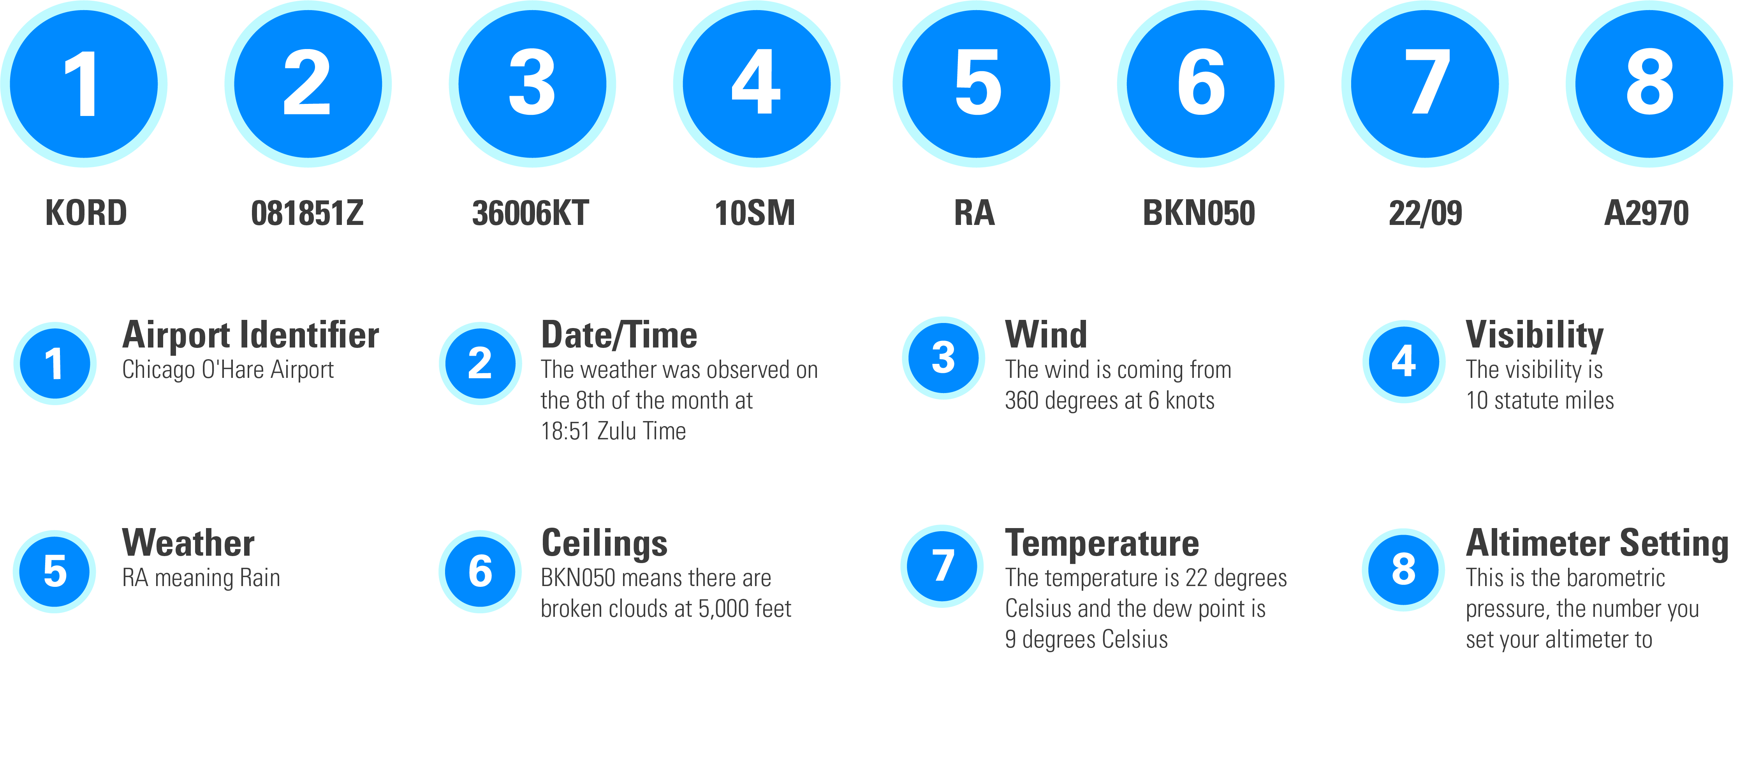
METAR - Meteorological Terminal Air Report
Today we have automated systems to translate this information for us!
Weather Basics
Notes:
(Provide a short explanation of this content - as this is not ground school, so as go into detail as time permits)
As time permits, visit www.aviationweather.com and show METARS (or other sites that provide aviation weather)

Slide 11
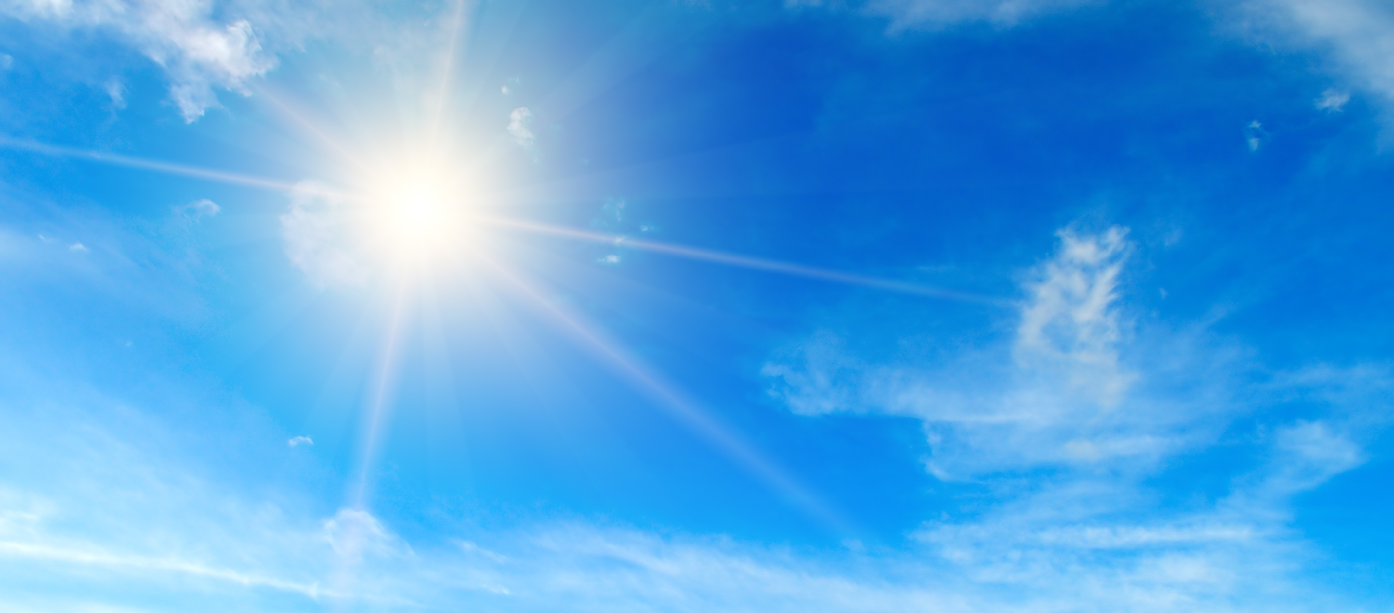
What Makes Weather?
The sun makes weather
Weather Basics
Notes:
We now know how to get the weather, let’s discuss “What Makes Weather”.
The Sun Makes Weather!
The energy that the Earth receives from the Sun is the basic cause of our changing weather. Solar heat warms the huge air masses that comprise large and small weather systems.
We like to say that the Sun is where it all begins because it drives every aspect of whether. Whether it be air pressure, the movement of air, the water cycle, the development of clouds, and rain.
If it’s whether it was created some way or another by the Sun.
The first thing that we need to talk about when discussing the sun and its relationship to weather is exactly the role that the Sun plays.

Slide 12
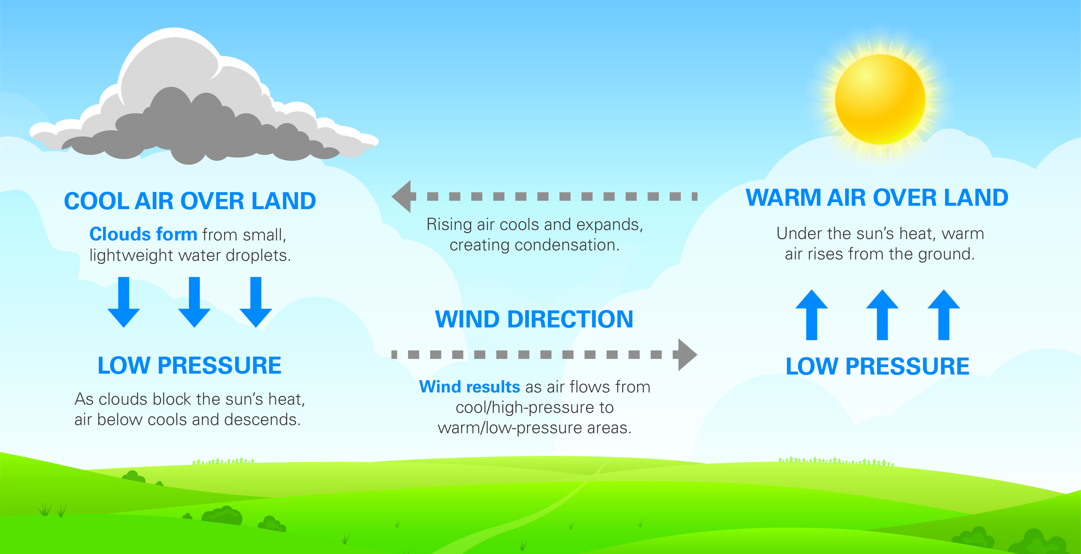
The Sun Makes Weather
Weather Basics
Notes:
This is one example of how the sun creates weather.
Temperature differences at the Earth's surface occur wherever there are differences in surface substances. A dark tarmacked surface such as a runway or the paved areas in front of the hangars will heat up more quickly on a sunny day (i.e. absorb more solar radiation) than a grassy field. Similarly, along the coast, large areas of land heat up more quickly than nearby sea water (water has a large heat capacity and is a good conductor of heat). Air near the land surface is heated by radiation and conduction, expands and begins to rise, being lighter than the surrounding air. This is convection. To replace the rising air, cooler air is drawn in from the surface of the sea. This is advection, called a sea breeze, and can offer a pleasant cooling influence on hot summer afternoons when further inland the heat may become oppressive.
Air above the sea sinks and is again pulled in over the land. The full sea breeze circulation is show in the diagram. A very hot summer sun may cause a sea breeze of up to 15 mph along the coast, felt in decreasing strength 20 to 25 miles inland.
You now understand how the sun creates weather!

Slide 13
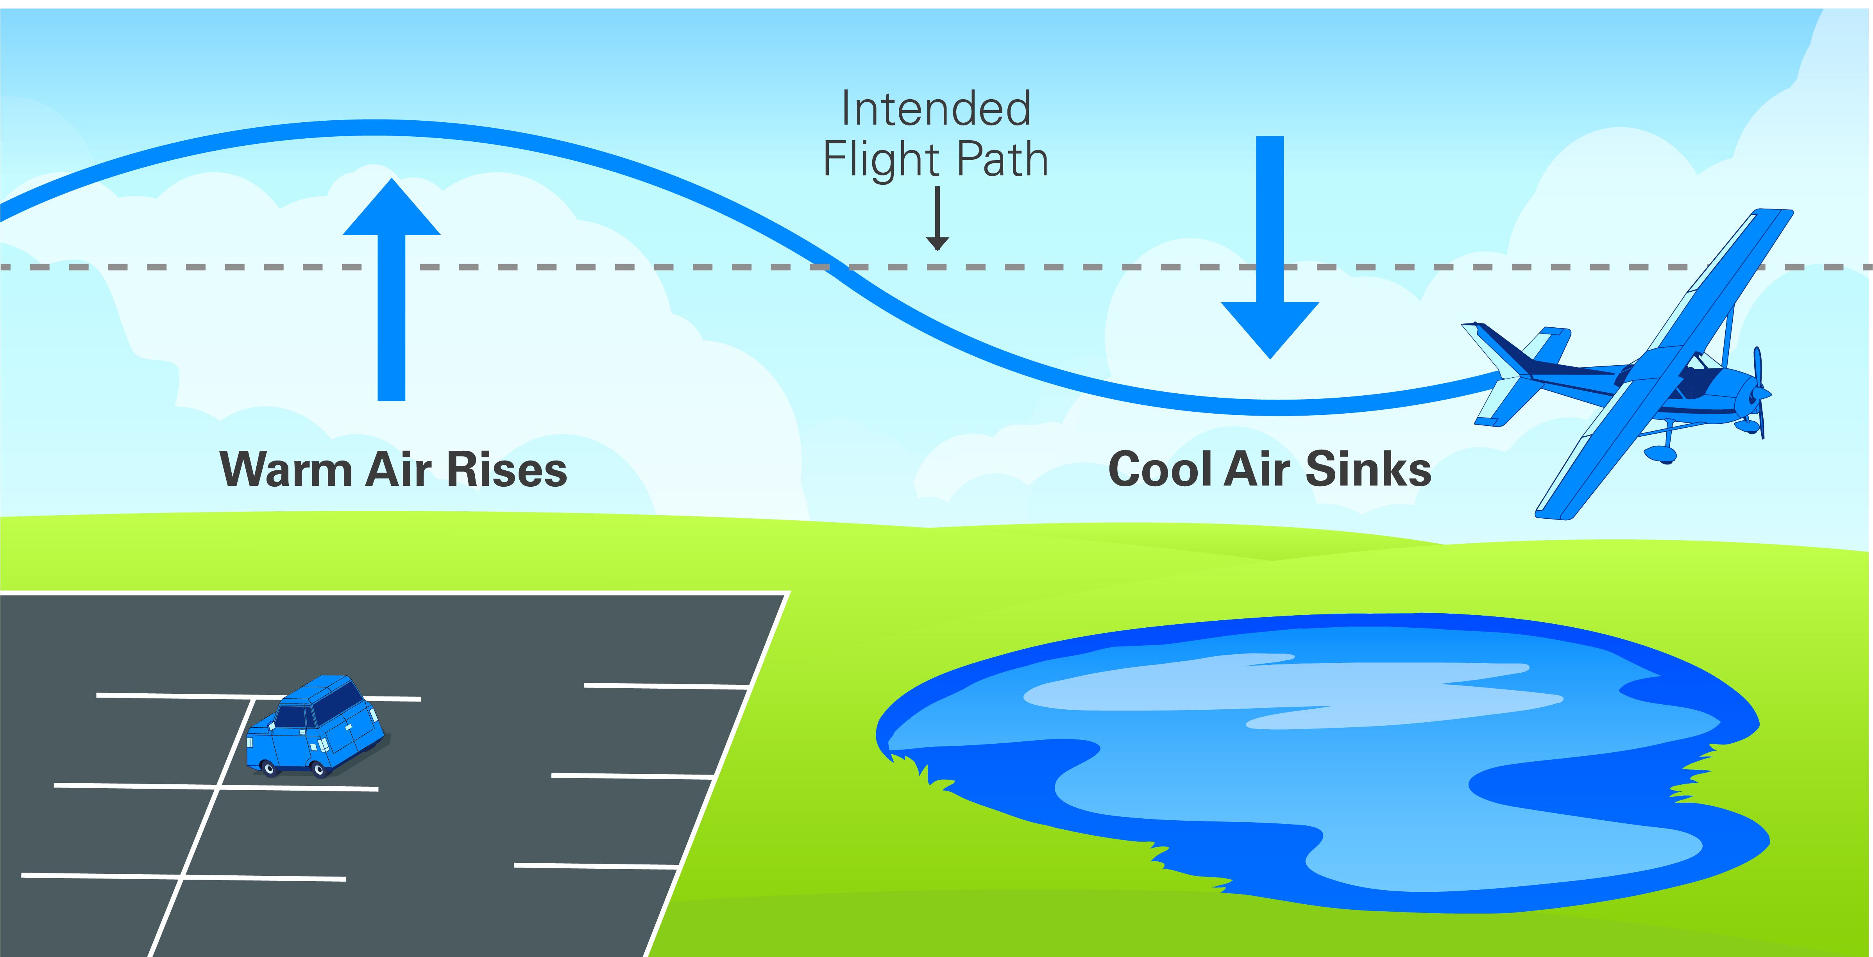
The Sun Makes Weather
How do effects of the sun affect flying?
Weather Basics
Notes:
As seen in the previous slide, we learned that air raises and falls over different types of terrain.
As seen here, the rising and falling air can affect the path that this airplane. A pilot needs to be aware of how the terrain affects controlling the airplane.

Slide 14
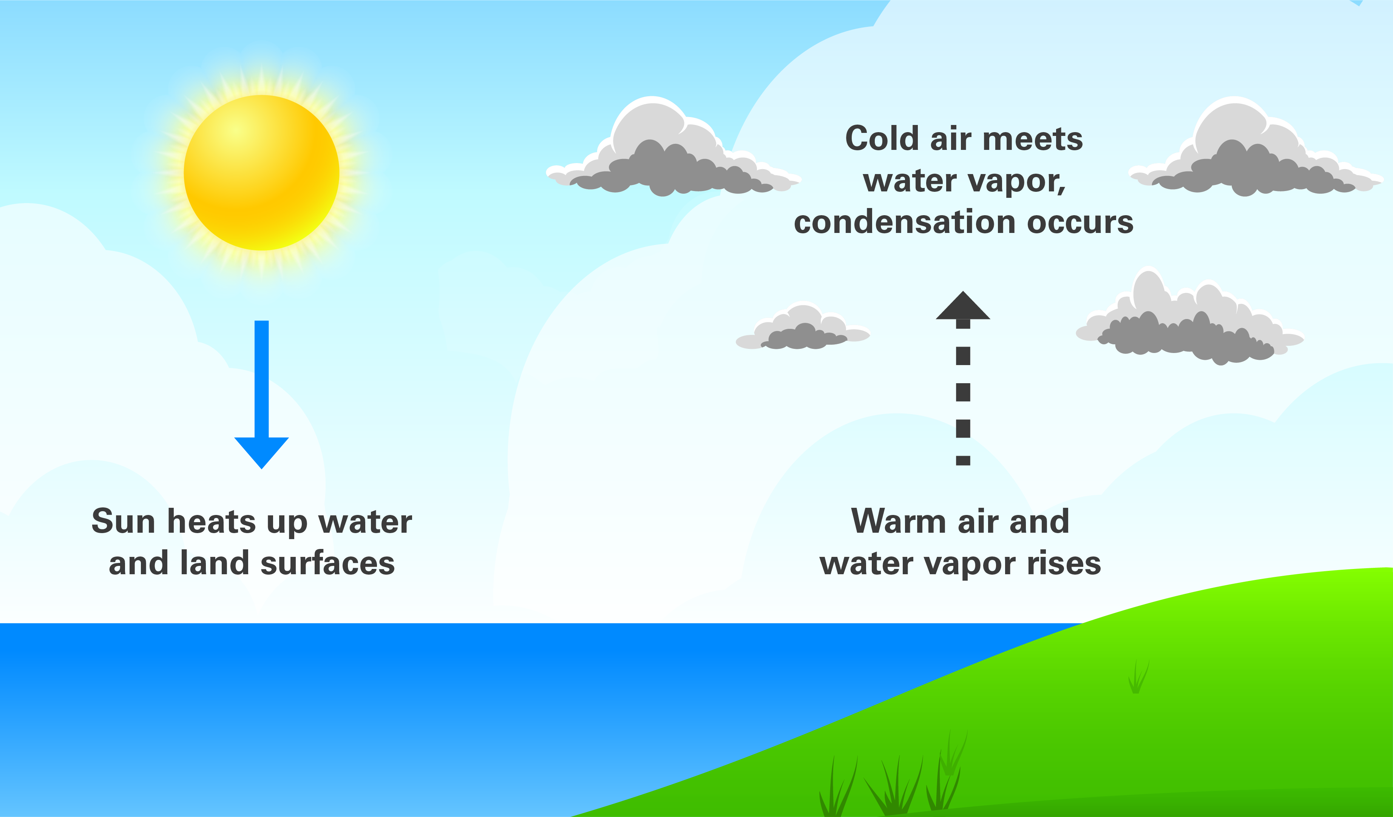
How Clouds Form
Weather Basics
Notes:
Let’s consider how clouds form.
Does anybody want to offer a thought on how clouds are formed?
Clouds form by a process called condensation. The atmosphere is made up of gases including water vapor. Sometimes more water vapor is added to the atmosphere when water on the earth’s surface turns into gas by evaporation by the sun’s heat. Warm air is less dense than cold air, so it risers as we have seen in the previous diagram. As the warm air continues to rise, the air molecules expand and cool down. As the surrounding air temperatures fall, the water vapor cools and condenses into visible water and ice crystals forming clouds.
When there is so much moisture in the atmosphere where the clouds become over saturated with water vapor, and they can hold no more vapor, the vapor falls in the form or precipitation.
Can you guys tell me what we mean when we say “precipitation”?
Yes, we’re talking about rain, snow, sleet,…

Slide 15
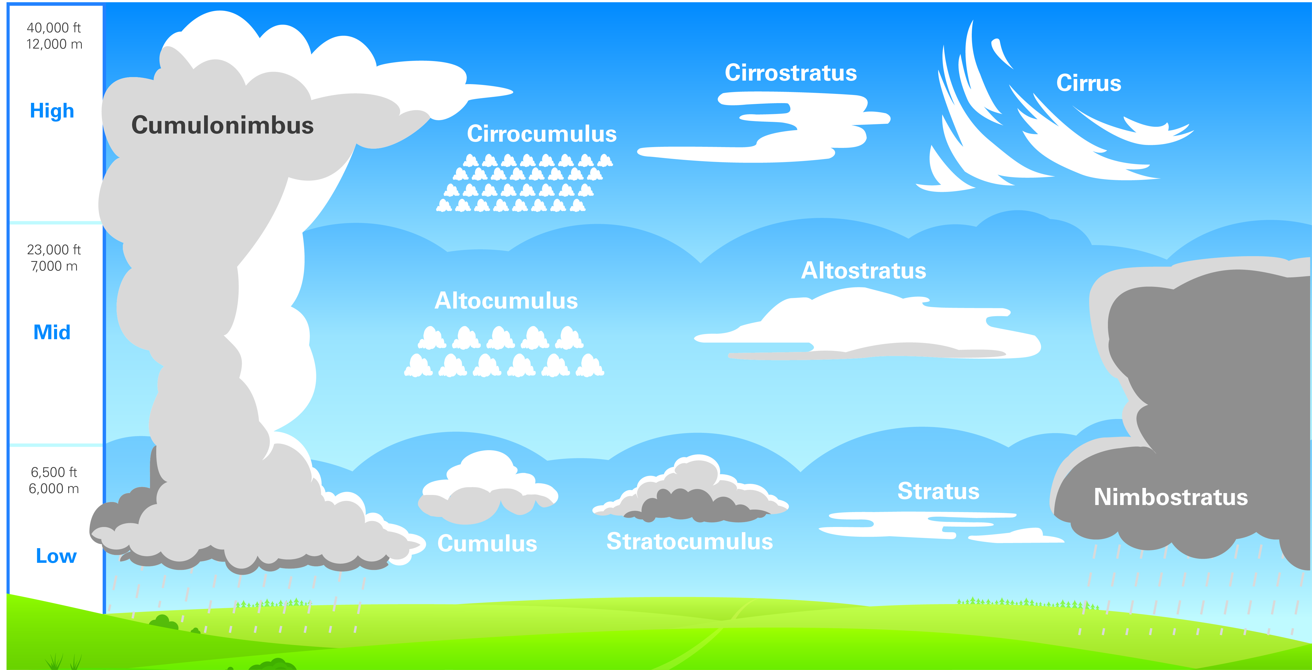
Types of Clouds
Why do we care about clouds when flying?
Weather Basics
Notes:
(Discuss as pilots, “Why we care about clouds)
(Discuss) Clouds can be put into three main groups:
High Altitude clouds: These are found 20,000ft or higher above the land surface. Cirrus, Cirrostratus and Cirrocumulus are the cloud types found here.
Middle Altitude Clouds: These are found between 6,500ft to 20,000ft above the land surface. Altostratus and Altocumulus are the cloud types found here.
Low Altitude Clouds: These cloud types can be found from ground level to about 6,500ft above it. They include Stratus, Stratocumulus and Nimbostratus clouds.
Vertical Clouds: These are clouds that extend from the lower to the higher altitude s of the atmosphere. They form by thermal convection or frontal lifting, sustained by powerful convectional current that hold and push the moisture in the clouds further upward. An example of a vertical cloud is the Cumulonimbus cloud.
Did you know why some Cumulonimbus clouds have a flat top on them? These are called anvil clouds. The reason they are flat on toip is because the clouds are reaching up into the jet stream, and the wind of the jet stream is flattening the tops of the clouds.
Foggy Clouds: These form close to the ground. Sometimes they make visibility very poor such that you can hardly see more than 60 away.
Cloud Names: There are 4 primary clouds, which have specific features of their own. These are Cirrus (meaning curl), Stratus (meaning spread over), Cumulus (meaning pile or heap), and Nimbus (meaning water or rain bearing). They are often combined with many other names to describe other secondary cloud types.
(Look Outside) What types of clouds are outside today?
(Discuss making a decision on when to fly and when not to fly related to cloud cover)

Slide 16
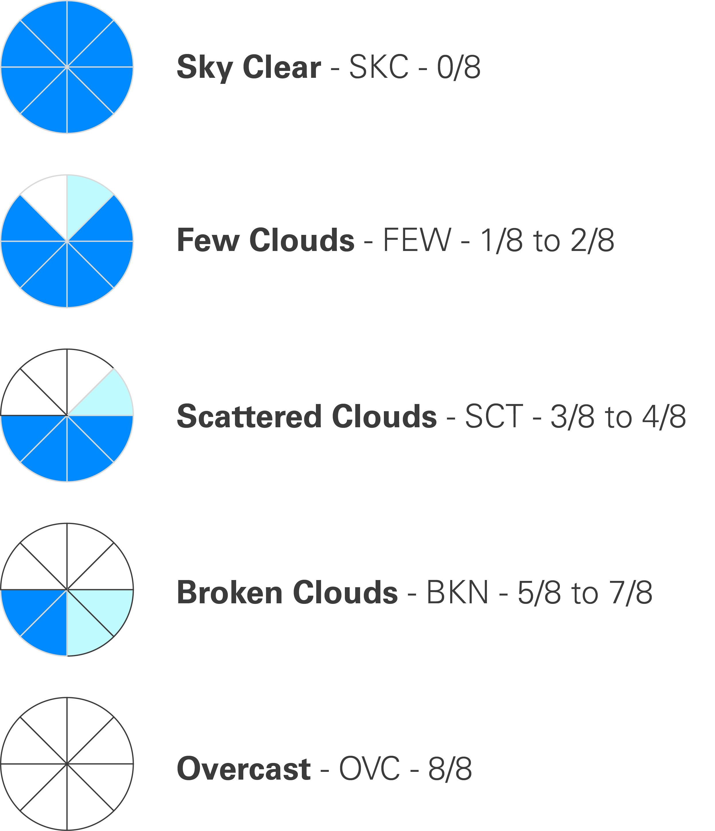
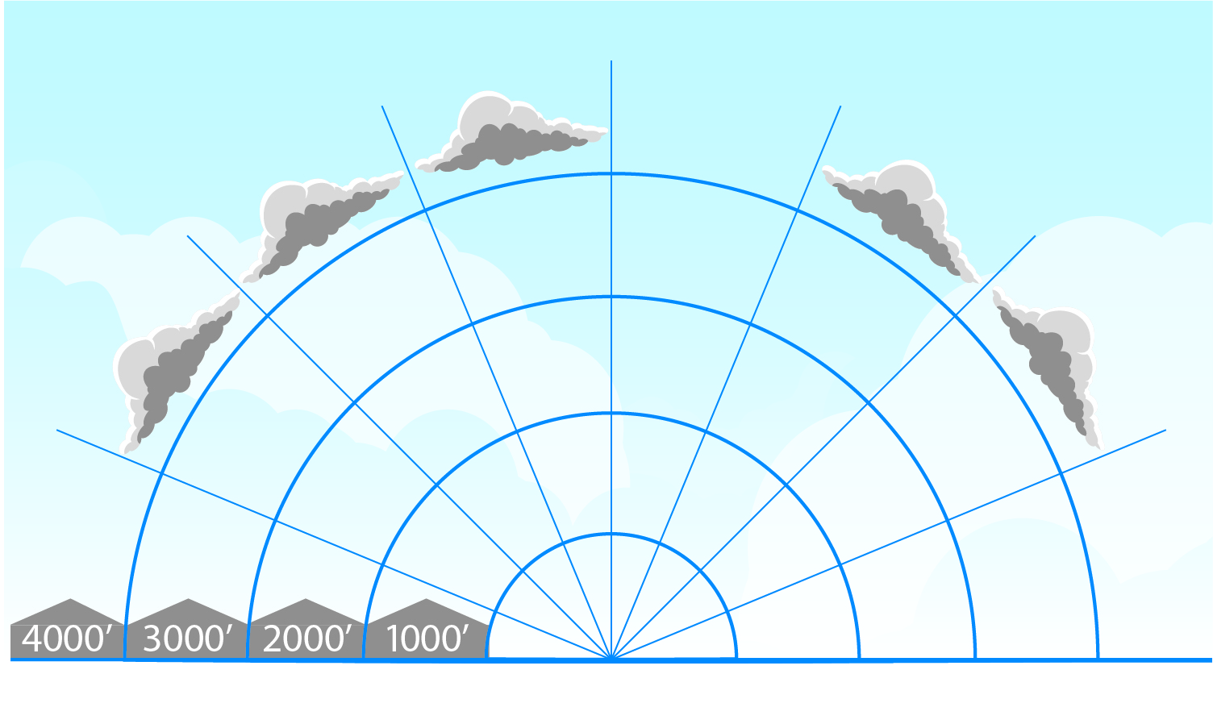
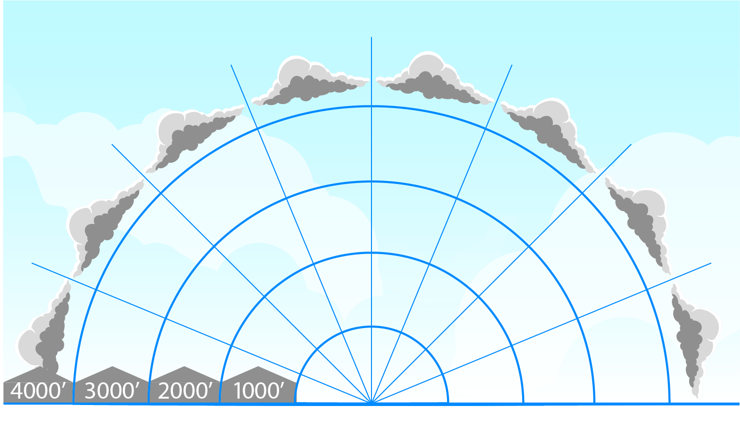
Clouds Coverage
5/8 to 7/8 = Broken Clouds
8/8 = Overcast
Why do we care about cloud coverage when flying?
Weather Basics
Notes:
(Discuss the different types of cloud cover conditions)
Different types of cloud cover conditions include
Cloud cover is reported in terms of 1/8th of sky cover
SKC (sky clear) FEW (trace) - 1 to 2 eighths being Few
SCT (scattered) - 3 to 4 eighths being Scattered
BKN (broken) - 5 to 7 eighths being Broken
OVC (overcast) - 8 eighths being Overcast
(Discuss making a decision on when to fly and when not to fly related to cloud cover)

Slide 17

Cloud Coverage
What type of clouds are in the sky today?
What is the cloud coverage?
Clear
Scattered
Broken
Overcast
What information does ATIS offer to you today
regarding cloud cover at your airport?
Weather Basics
Notes:
(Discuss as pilots, “What is the cloud coverage today? Would you fly today?)

Slide 18
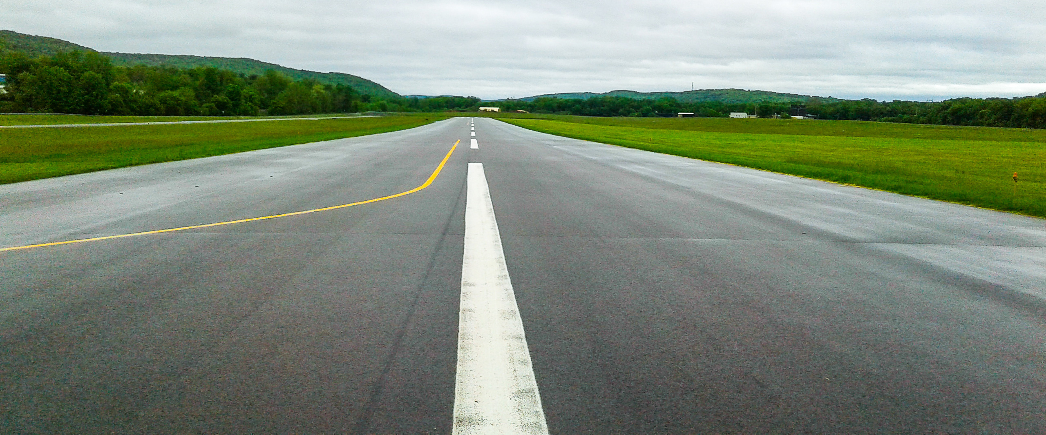
Overcast and Ceilings
Ceiling: a measurement of the height of the base of the
lowest clouds.
What information does ATIS offer to you today regarding
the ceiling at your airport?
Weather Basics
Notes:
(Discuss as pilots,
“what a ceiling is”
“should fly up through it?”
“What are the risks involved”
The importance to make the right decisions and to follow the rules to keep you safe.

Slide 19
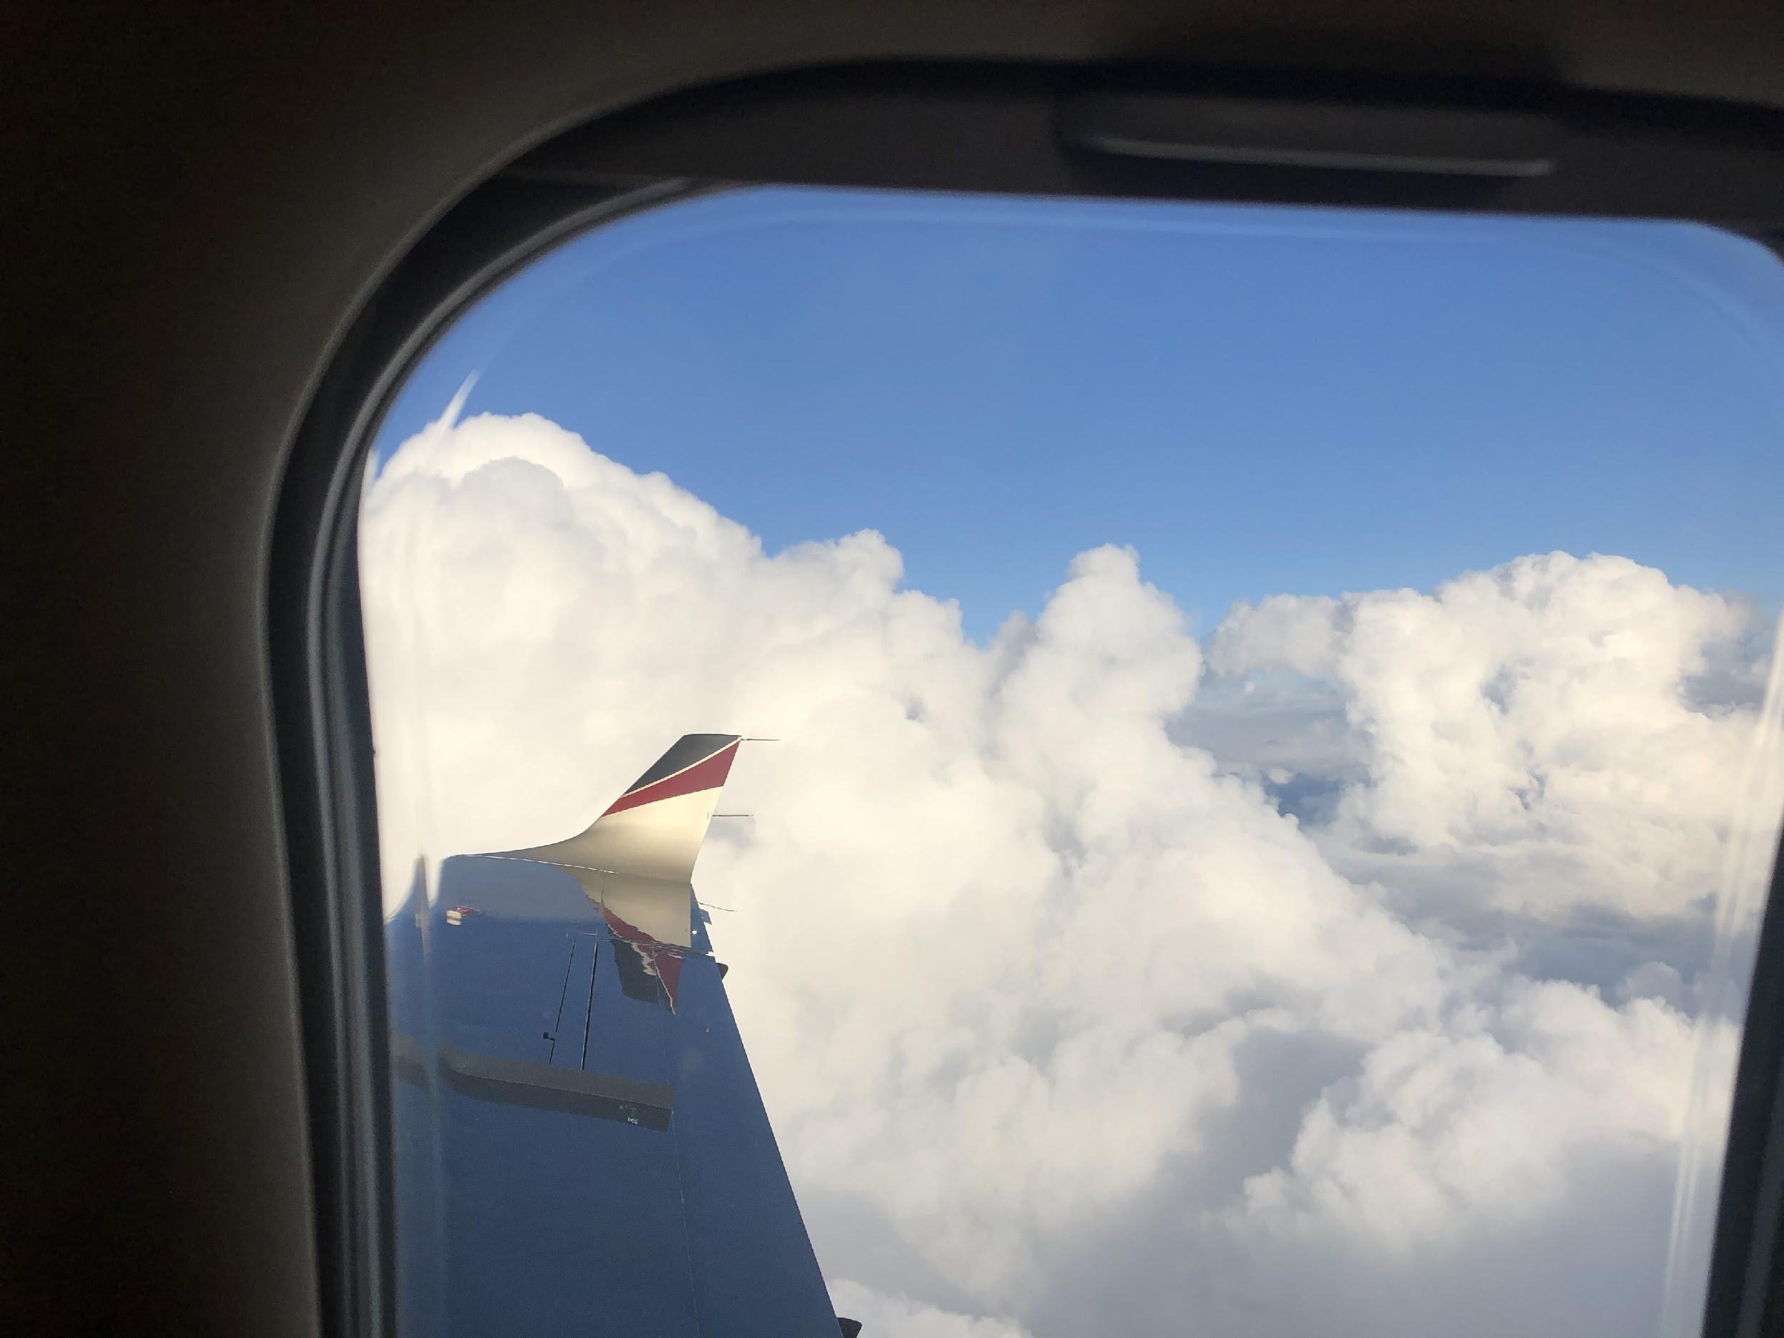
Clouds and Flying
How do clouds affect flying?
Weather Basics
Notes:
Discuss as pilots,
“How do clouds affect flying?
“How is this airplane able to fly up into the clouds?”
Discuss the idea of IFR if time permits

Slide 20
Visibility
Visibility is a measure of the distance at which an object
or light can be clearly seen, measured in miles
Weather Basics
Notes:
(Discuss as pilots)
“is this a good day to fly?”
Why is it not a good day for a VFR pilot. Explain what a VFR pilot is (Visual Flight Rules) and VMC (Visual Meteorological Conditions).
Briefly explain what IFR means (Instrument Flight Rules) and IMC (instrument Meteorological Conditions)

Slide 21
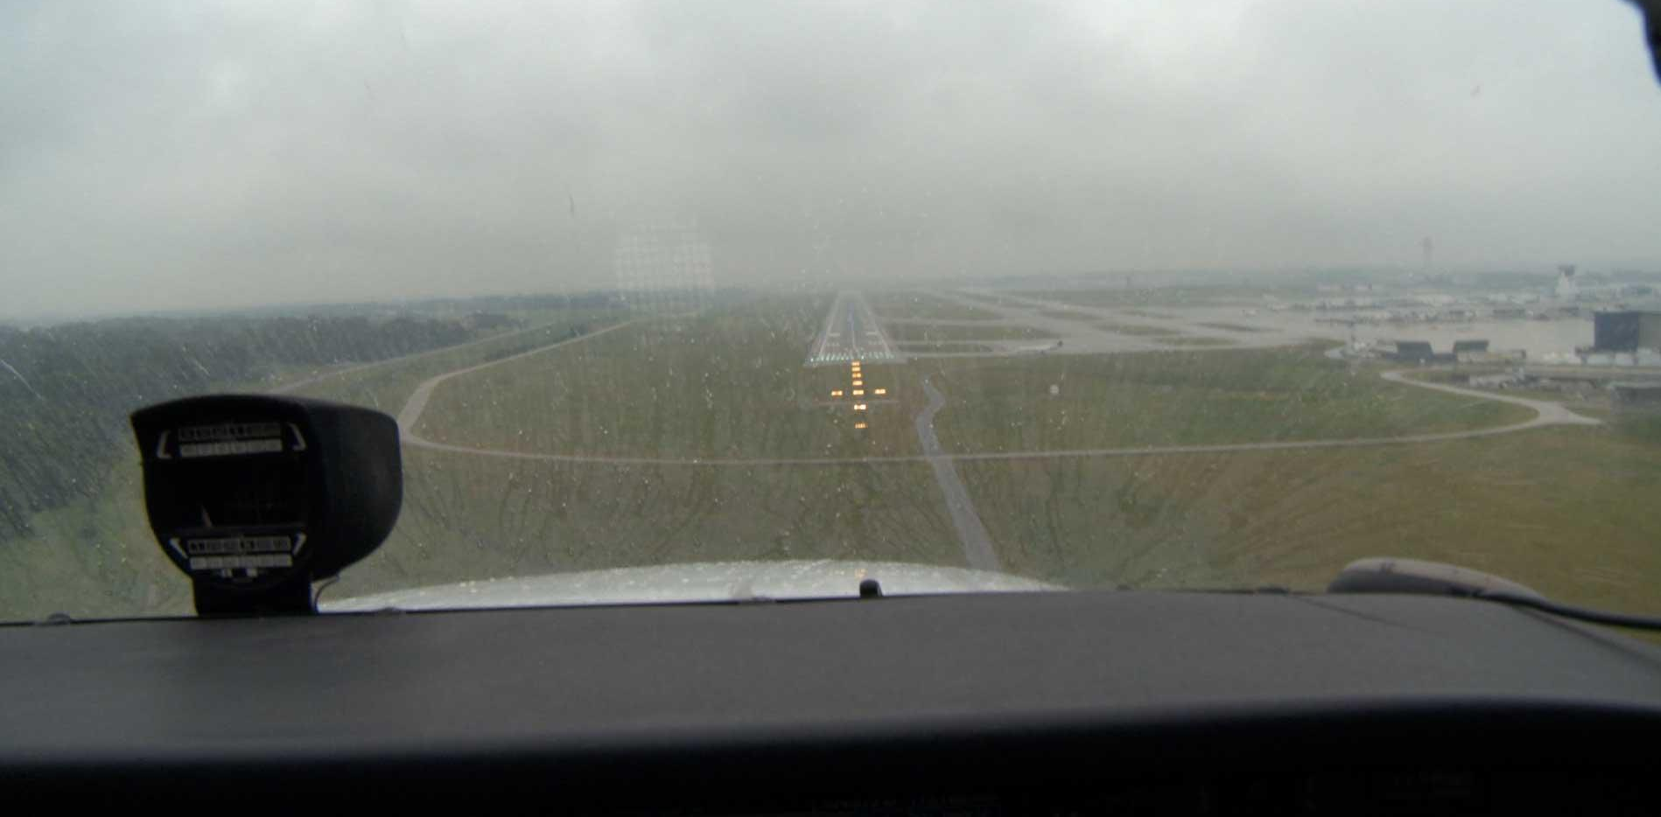
Aviation Visibility
How does visibility affect flying?
What information does ATIS offer to you today regarding the visibility at your airport?
Weather Basics
Notes:
(Discuss as pilots?
“ATIS provides us with information regarding visibility”

Slide 22
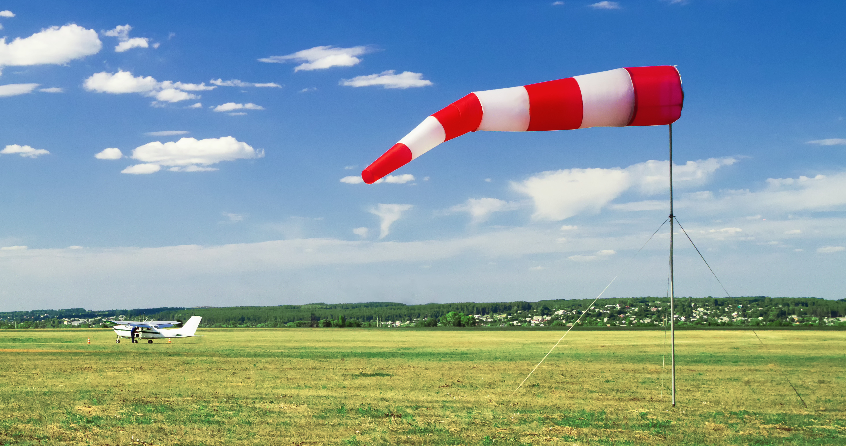
Wind
How does wind affect flying?
Weather Basics
Notes:
Wind
(Discuss how wind affects flying – for example a tail wind vs a nose wind…)

Slide 23
What Is Wind?
How does wind affect flying?
Weather Basics
Notes:
Wind
Recall that we discussed - how the sun creates weather in local areas by heating the land, then cooling as it rises?
And we discussed - that Wind is moving air and is caused by differences in air pressure within our atmosphere. Air under high pressure moves toward areas of low pressure. The greater the difference in pressure, the faster the air flows.
Now let’s discuss how large areas of similar weather conditions over a period of time create large air masses.
An air mass is a large body of air that has similar temperature and moisture properties throughout. The best source regions for air masses are large flat areas where air can be stagnant long enough to take on the characteristics of the surface below. Maritime tropical air masses (mT), for example, develop over the subtropical oceans and transport heat and moisture northward into the U.S.. In contrast, continental polar air masses (cP), which originate over the northern plains of Canada, transport colder and drier air southward.
Once an air mass moves out of its source region, it is modified as it encounters surface conditions different than those found in the source region. For example, as a polar air mass moves southward, it encounters warmer land masses and consequently, is heated by the ground below. Air masses typically clash in the middle latitudes, producing some very interesting weather.
When air hovers for a while over a surface area with uniform humidity and temperature, it takes on the characteristics of the area below. For example, an air mass over the tropical Atlantic Ocean would become warm and humid; an air mass over the winter snow and ice of northern Canada would become cold and dry. These massive volumes of air often cover thousands of miles and reach to the stratosphere. Overtime, mid-latitude cyclonic storms and global wind patterns move them to locations far from their source regions.

Slide 24
How do we know what the wind speed and wind direction are at any airport?
Read the METARs
Listen to ATIS
Look at the windsock
Weather Basics
Notes:
Wind
Listen to ATIS
Additional Activity - Look at a METAR

Slide 25
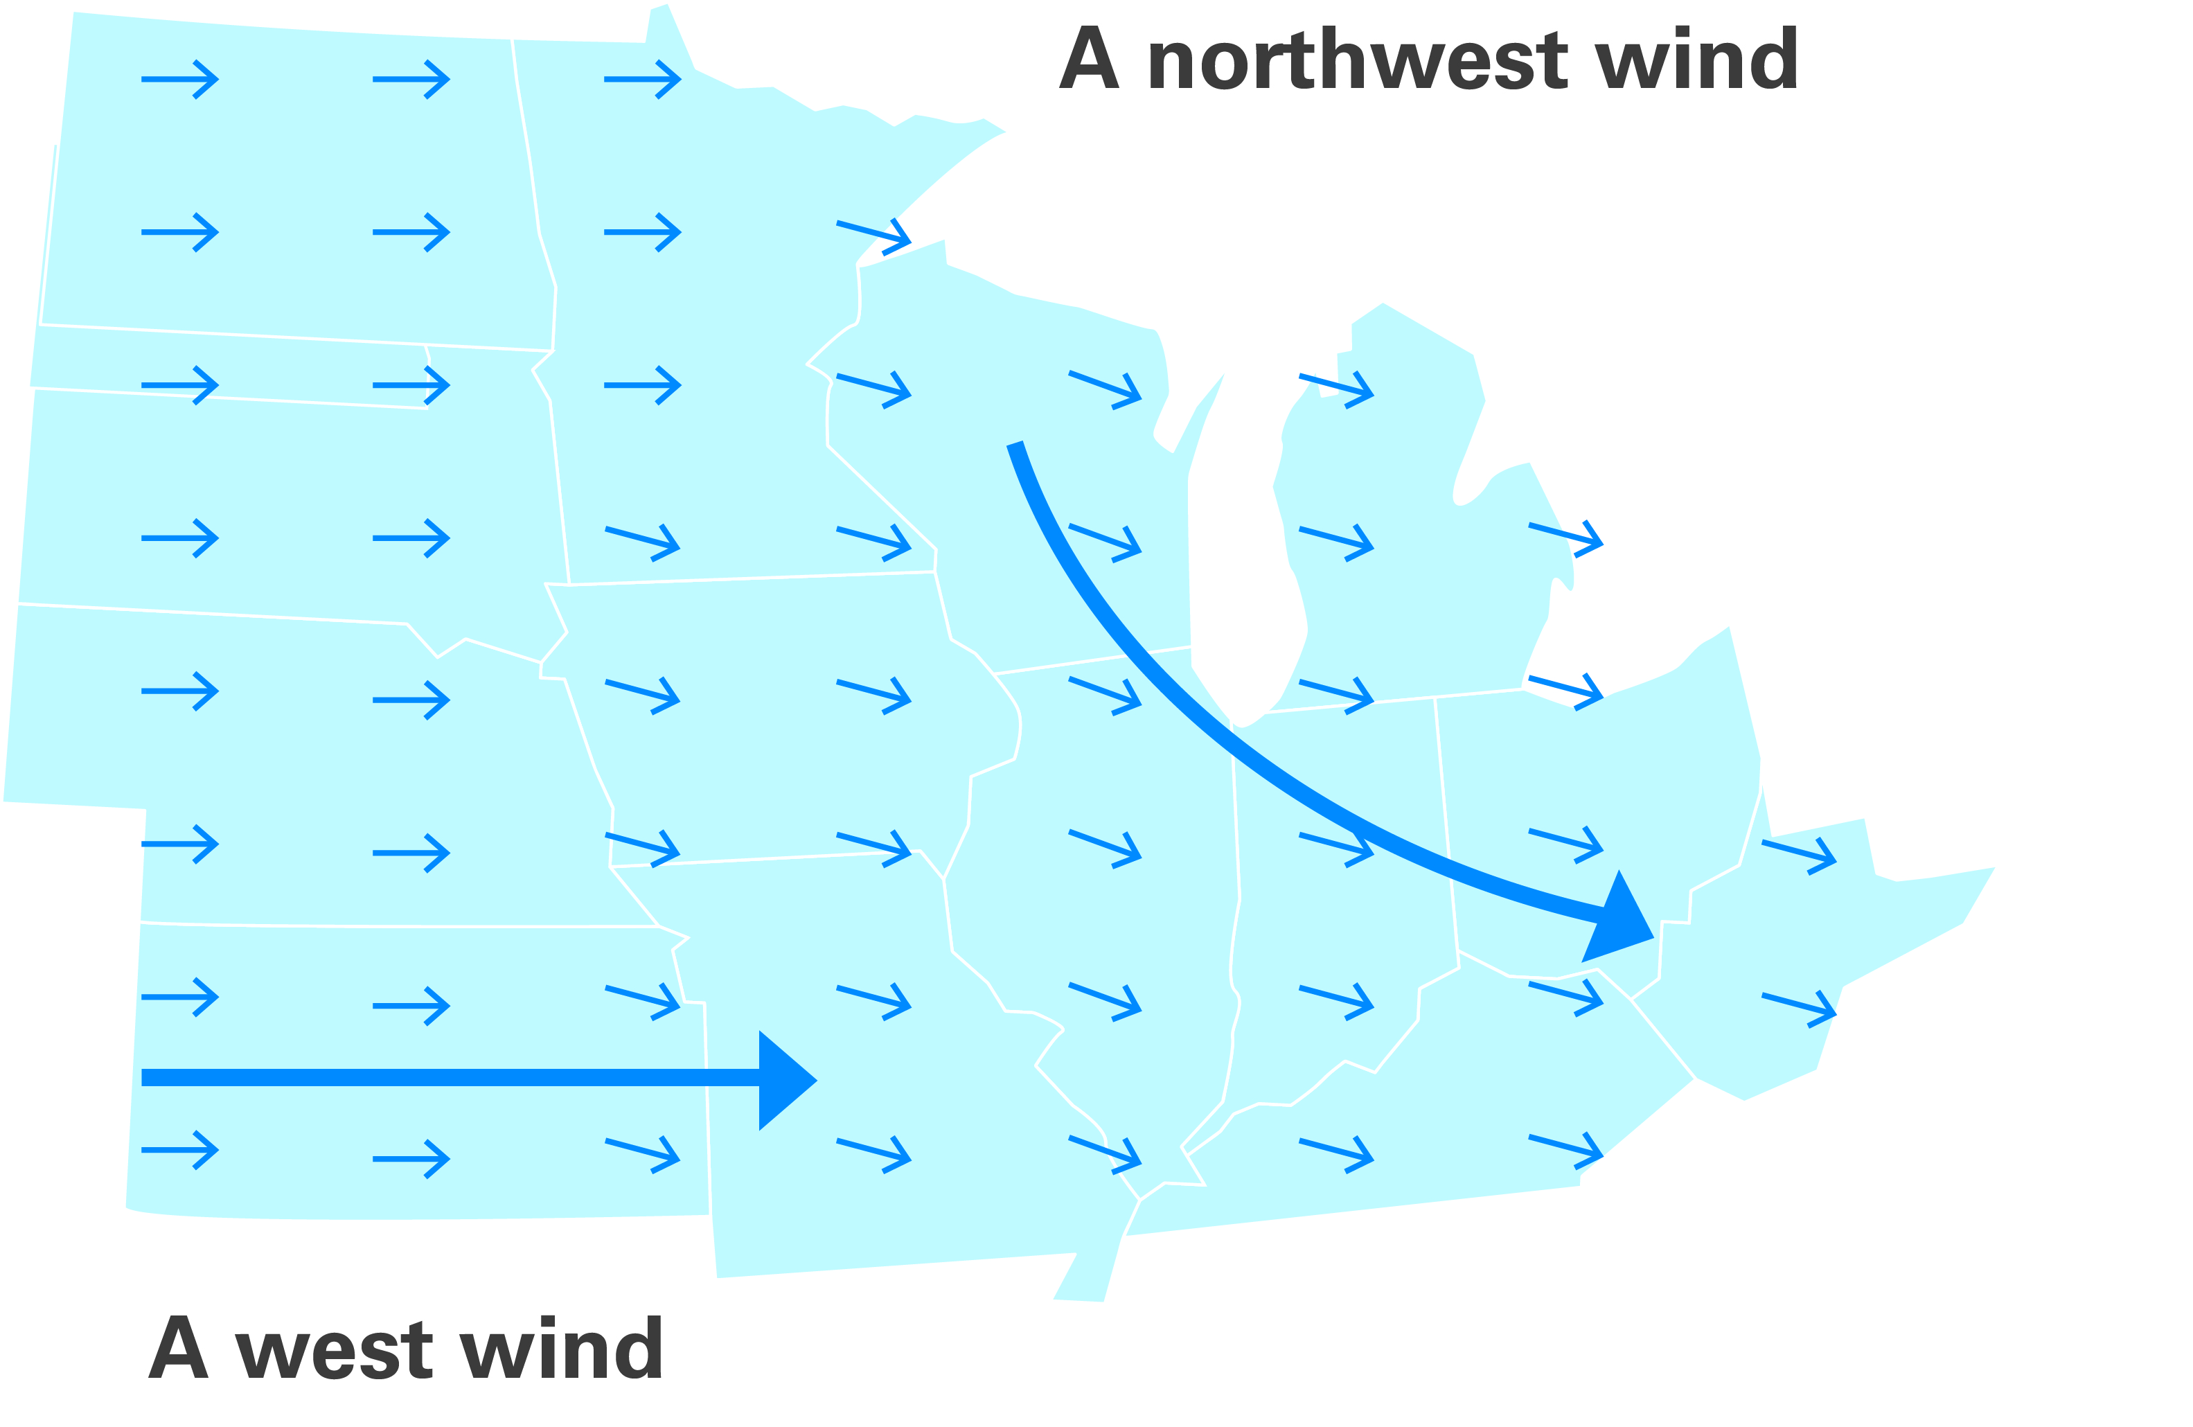
Wind Direction
Wind is described by the direction it's coming from,
not the direction it's going.
Weather Basics
Notes:
Wind
And we discussed - that Wind is moving air and is caused by differences in air pressure within our atmosphere. Air under high pressure moves toward areas of low pressure. The greater the difference in pressure, the faster the air flows.
Now let’s discuss how large areas of similar weather conditions over a period of time create large air masses.
An air mass is a large body of air that has similar temperature and moisture properties throughout. The best source regions for air masses are large flat areas where air can be stagnant long enough to take on the characteristics of the surface below. Maritime tropical air masses (mT), for example, develop over the subtropical oceans and transport heat and moisture northward into the U.S.. In contrast, continental polar air masses (cP), which originate over the northern plains of Canada, transport colder and drier air southward.
Once an air mass moves out of its source region, it is modified as it encounters surface conditions different than those found in the source region. For example, as a polar air mass moves southward, it encounters warmer land masses and consequently, is heated by the ground below. Air masses typically clash in the middle latitudes, producing some very interesting weather.
When air hovers for a while over a surface area with uniform humidity and temperature, it takes on the characteristics of the area below. For example, an air mass over the tropical Atlantic Ocean would become warm and humid; an air mass over the winter snow and ice of northern Canada would become cold and dry. These massive volumes of air often cover thousands of miles and reach to the stratosphere. Overtime, mid-latitude cyclonic storms and global wind patterns move them to locations far from their source regions.

Slide 26
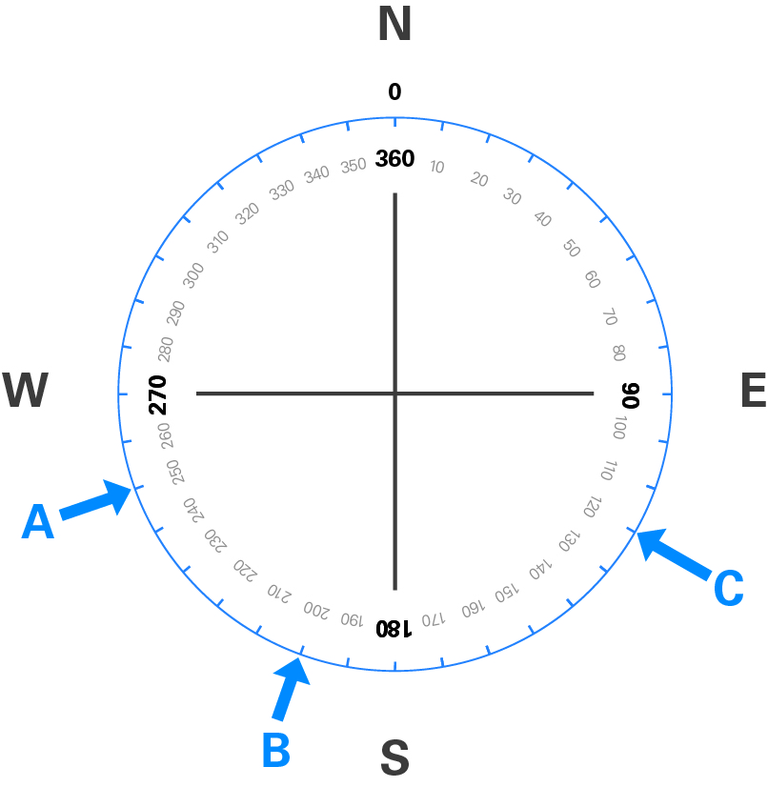
Wind Direction
  Where is the wind coming from on the compass rose?
  Compass Rose
    Divided into 360º increments
    Examples
      A. Winds from 250º
      B. Winds from 200º
      C. Winds from 120º
Weather Basics
Notes:
We describe the direction of the wind with reference to the compass.
Review the three examples and use a pointer to ask the group to name the direction of the wind that you are pointing at.
Explain that a “North Wind” is coming from the north, not going to the north.
A west wind is coming from the west, or 270 degrees)
When outside on a windy day, try to identify the exact direction that the wind is coming from by doing the following:
Turn your head into the wind. Keep turning and adjusting the direction your face is into the wind, until your hear the same amount of wind in each ear. At this point, you are facing directly into the wind.

Slide 27
How Does Wind Affect
an Airplane on Takeoff
and Landing?
Take off and land into the wind
Use the most favorable runway
  Runway numbering
Weather Basics

Slide 28
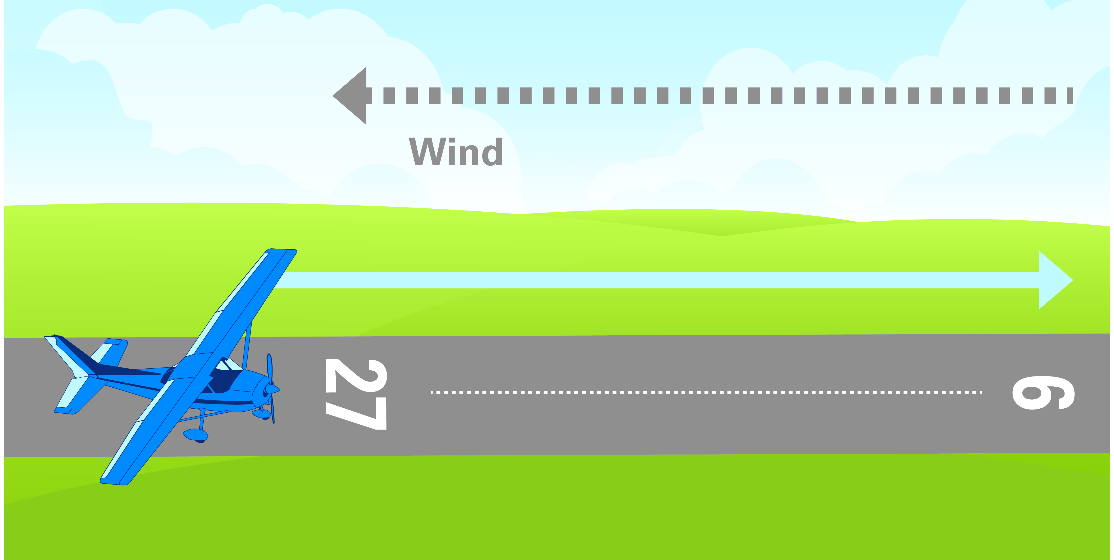
Wind and Runway Selection
Weather Basics
Notes:
“Why we take off and land into the wind”

Slide 29
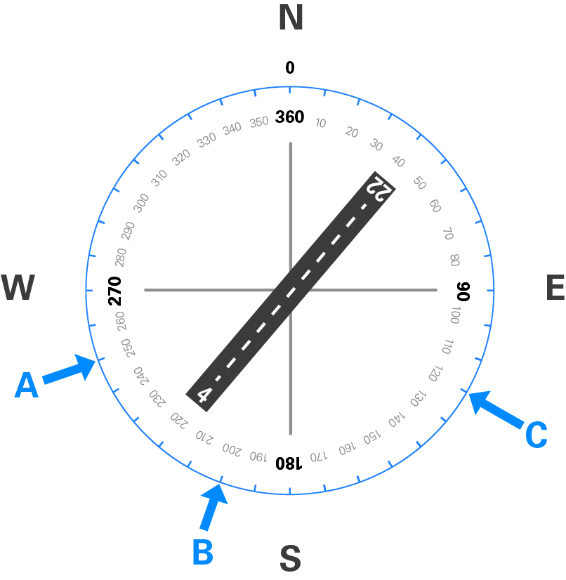
Selecting a Runway Based on Wind
  Which runway is best?
  Choose the runway for takeoff or landing that aligns best into
  the wind
  Which runway is best (4 or 22)?
    A. Winds from 250 @ 14kt
    B. Winds from 200 @ 8kt
    C. Winds from 120 @ 4kt
Note: Runway number is the direction you’re heading, drop last zero.
Weather Basics
Notes:
Discuss which runway is best.

Slide 30
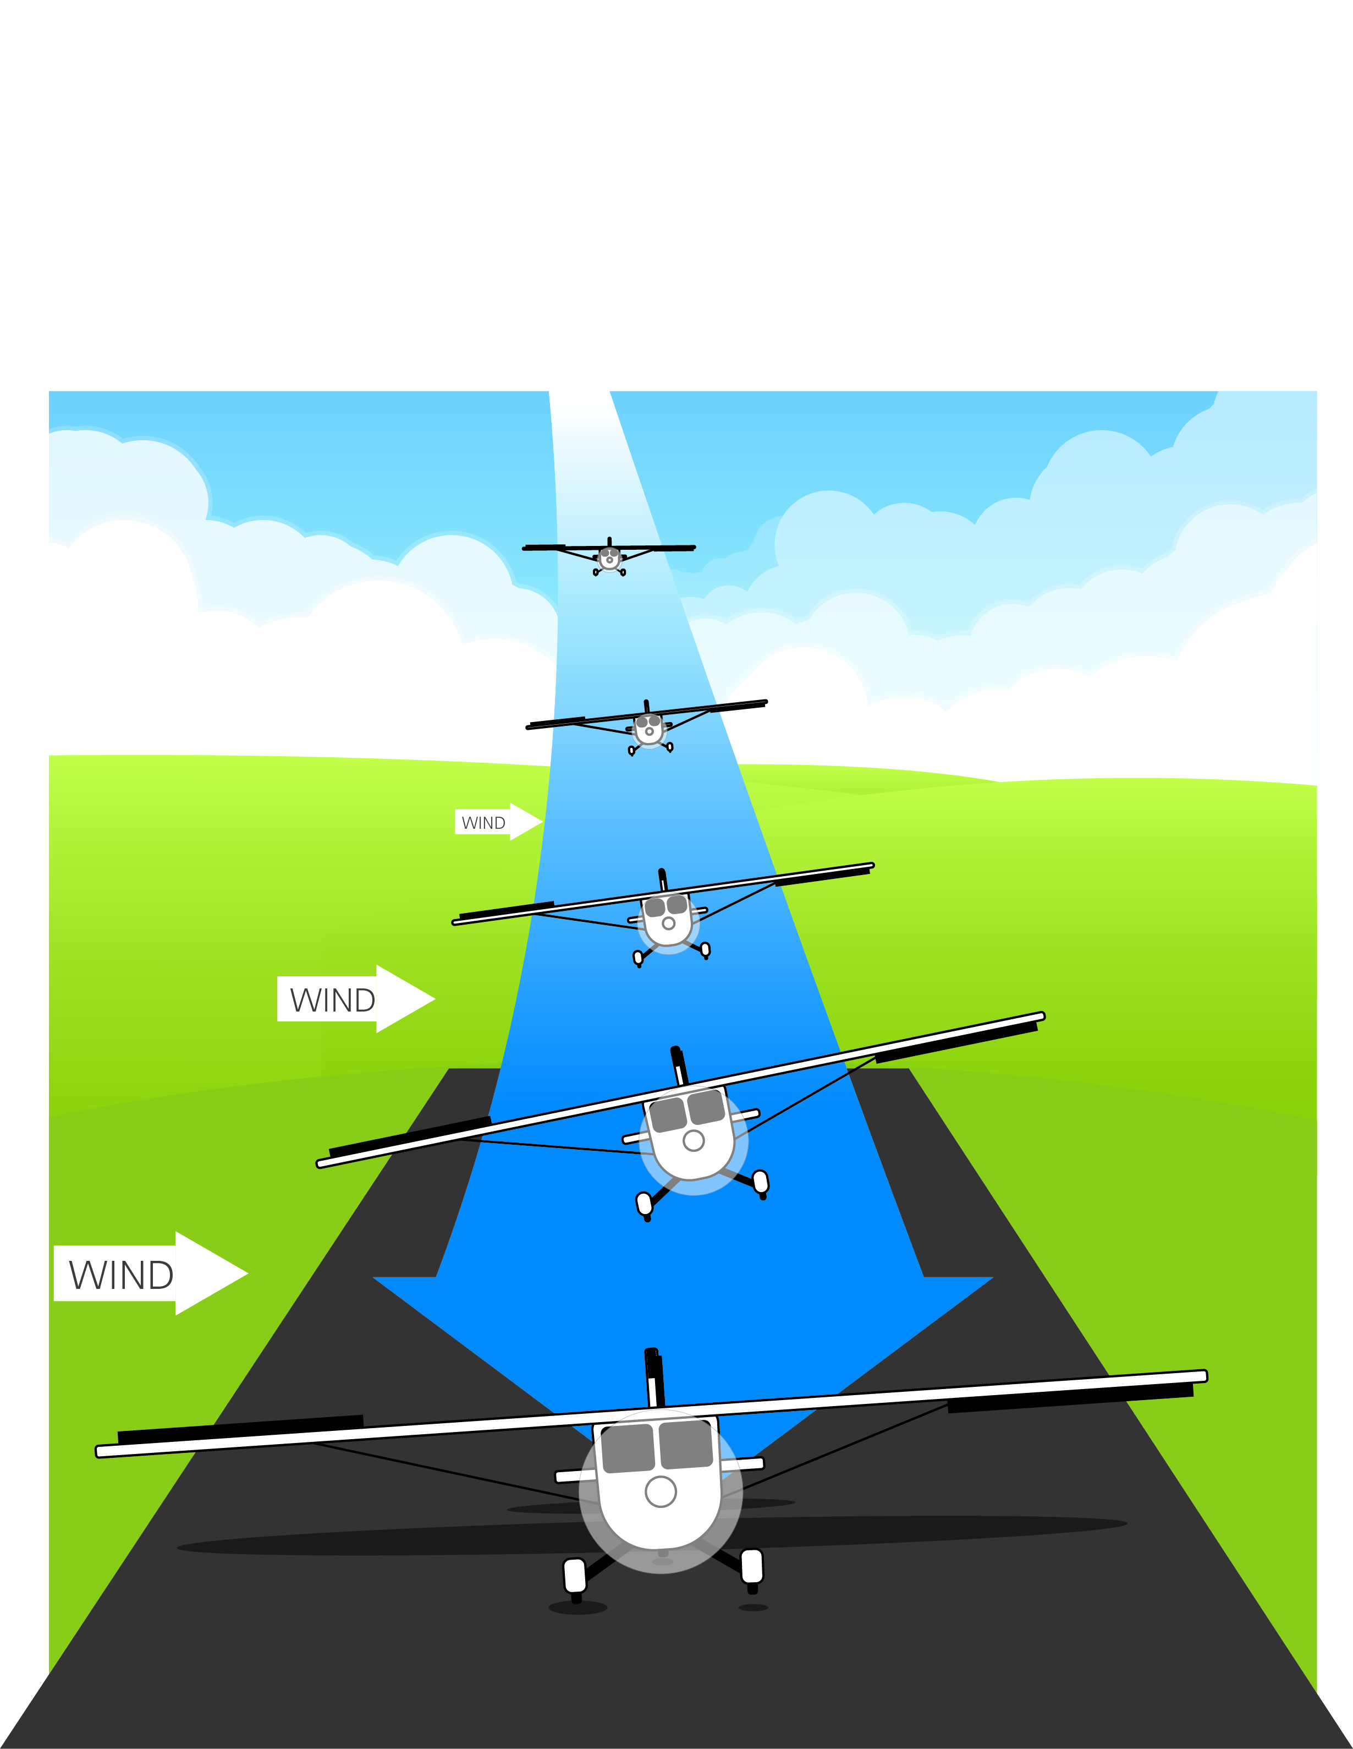
What Is a Crosswind?
How does a crosswind affect flying?
Weather Basics
Notes:
A Cross Wind
(Discuss)
“We can not always be lucky enough to have the wind coming straight down the runway….”
“What do we need to do to manage the airplane in these cases?”

Slide 31
Activity
Weather Basics Worksheet
Weather Basics

Slide 32
Objectives
Now you’ve learned about
What is weather?
How does weather affect flying?
How do we know the weather?
What makes weather?
Clouds
Visibility
Wind
Weather Basics

Slide 33
Weather
Basics
Questions?
The development of this program was made possible in part by
a generous donation from the Sporty’s Foundation.

