Slide 1
Aviation
Communication
Chapter Presenter
The development of this program was made possible in part by
a generous donation from the Sporty’s Foundation.

Slide 2
Session Objectives
You will learn
Standard Aviation Terminology
  Phonetic alphabet
Common Communications
  Aviation lingo
Radio Skills
Towered vs. Nontowered Communication
Aviation Communication
Notes:
Simply read the list of points and comment that we discuss each of these in depth on upcoming slides.

Slide 3
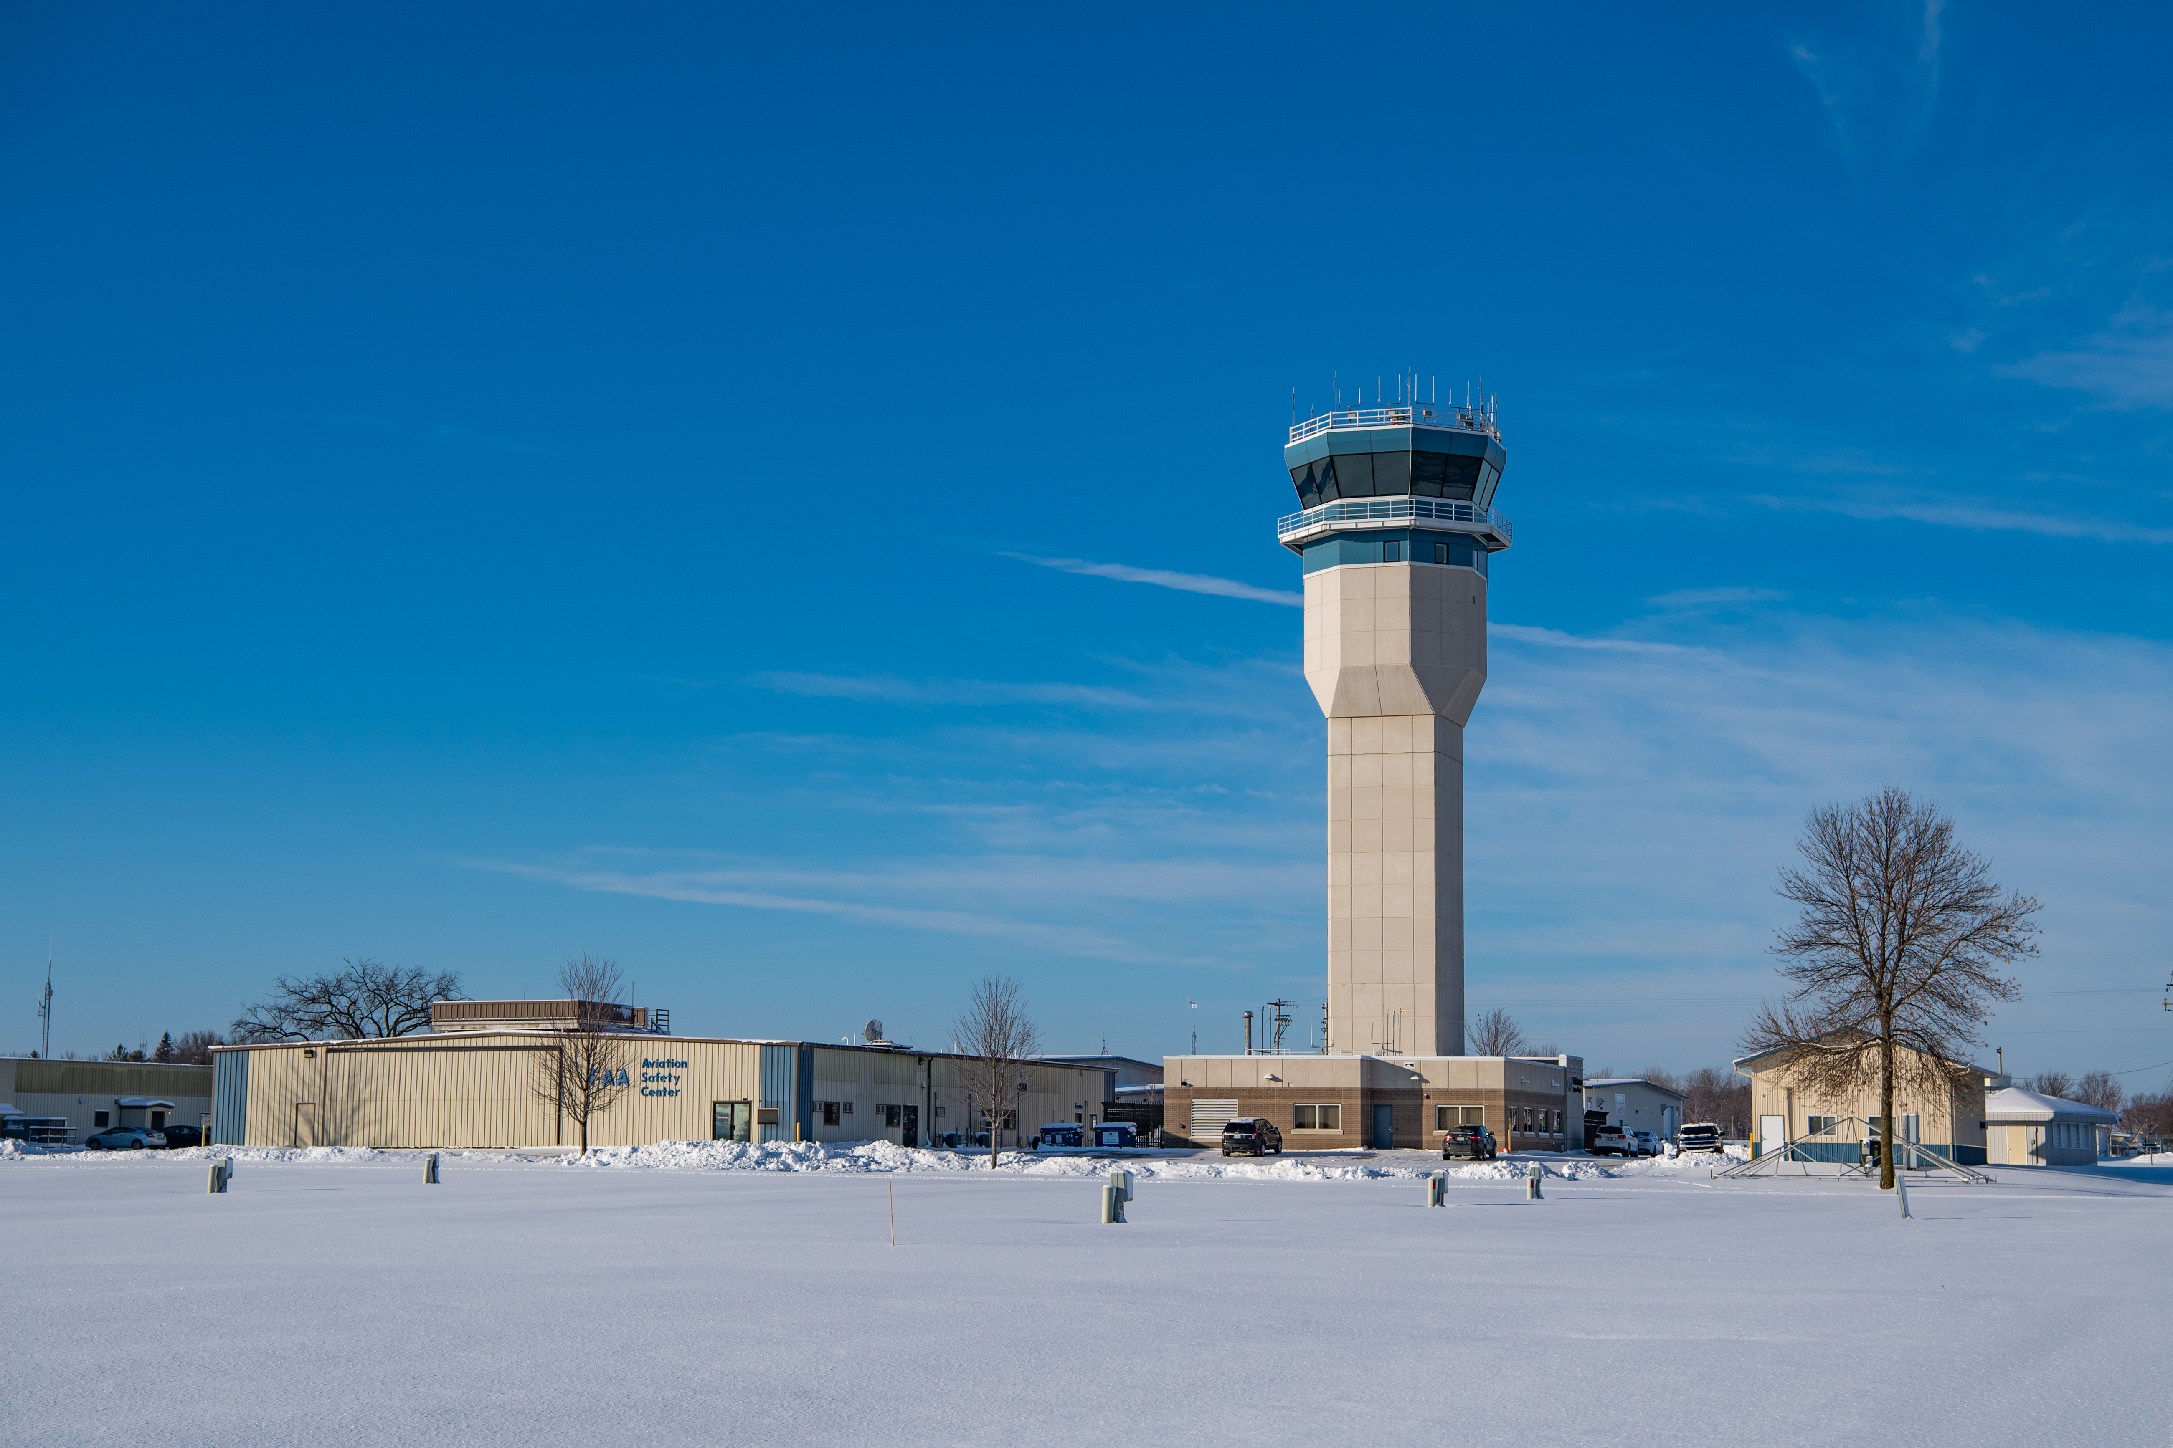
Whom Do Pilots Communicate With?
Air traffic controllers – Towered airport
Other pilots –
Nontowered airport
Weather experts
Aviation Communication
Notes:
Explain “why it is important to communicate”.
Busier airports have control towers.
Explain what an “Air Traffic Controller” is.

Slide 4
Typical Communications
Report a position
Announce intentions to other pilots
With Air Traffic Control
  Make requests (takeoff, landing)
  Receive clearances for certain operations
Get weather updates
  Communication Avoids Safety Conflicts
Aviation Communication
Notes:
Explain why we:
Report a position – so the tower knows where we are to provide the correct next instruction, or other pilots know where we are to enable us to stay separated.
It’s important to get weather updates as it may have changed enroute.

Slide 5
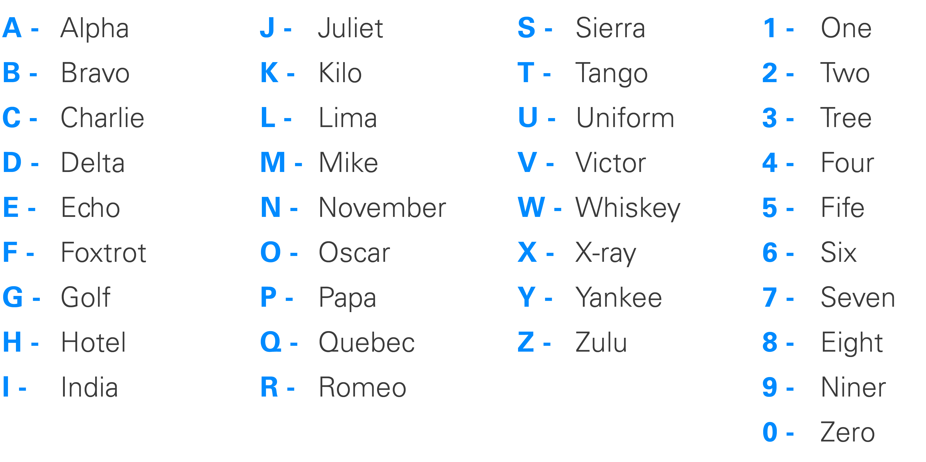
Terminology: Start with
the Alphabet
Aviation Communication
Notes:
Review the phonetic alphabet and numbering system.
Explain why pilots use the phonetic alphabet:
To help eliminate mistakes caused by a change in the sound of a letter, pilots use the International Phonetic Alphabet. The International Phonetic Alphabet assigns word sounds to every letter in the alphabet. Instead of saying the letter A, pilots say the word Alpha.
Have students say this aloud and together after you have reviewed this once.

Slide 6
Group Activity
Phonetic Alphabet Worksheet
  Aircraft call signs
  Airports
Aviation Communication
Notes:
A group activity is available at this time.

Slide 7
Aviation Lingo - Runways
Say single digits of the runway numbers
  4 = “Runway Four” (Approx. 40 Heading)
  22 = “Runway Two Two” (Approx. 220 Heading)
  R=Right, L=Left, C=Center
Aviation Communication
Notes:
Explain
Runways are named by a number between 01 and 36, which is generally the magnetic direction of the runway in degree. A runway numbered 04 points east (40°), runway 22 (220°) is mostly south, and a little west, runway 27 points west (270°) and runway 36 points to the north (360° rather than 0°).
When taking off from or landing on runway 09, a plane is heading around 90° (east).
A runway can normally be used in both directions, and is named for each direction separately: e.g., "runway 15" in one direction is "runway 33" when used in the other. The two numbers differ by 18 (= 180°). For clarity in radio communications, each digit in the runway name is pronounced individually: runway one-five, runway three-three, etc. (instead of "fifteen" or "thirty-three").
that the runway numbers align with the compass direction numbers.

Slide 8
Aviation Lingo - Altitudes
Read single digits but drop the last three
Follow by “hundred” or “thousand”
  8,000 feet = “Eight thousand”
  10,000 feet = “One zero thousand”
18,000 feet and above, use “flight level”
  29,000 feet = “Flight level two niner zero”
Aviation Communication
Notes:
Explain how to read an altimeter
If available have a real altimeter to pass around.
Explain that the altimeter is on the aircraft instrument panel.
Reading a standard 2-hand altimeter is easy. The short pointer measures altitude in intervals of 1,000 feet (2 = 2,000 feet). The long pointer measures altitude in intervals of 100 feet.

Slide 9
Aviation Lingo - Headings
Say 3 single digits
  60 degrees = “Heading zero six zero”
  180 degrees = “Heading one eight zero”
  320 degrees = “Heading tree two zero”
Aviation Communication
Notes:
Heading. The direction in which the longitudinal axis of an aircraft is pointed, usually expressed in degrees from North (true, magnetic, compass or grid)
The heading indicator is an instrument used to determine aircraft heading.
The face of the heading indicator is marked with headings (tic marks) and maintains its orientation (rotates) as the airplane turns. The apparent movement of the card gives the pilot an immediate, precise indication of the airplane's heading and the direction in which the airplane is turning.

Slide 10
Activity
Aviation Lingo Worksheet
  Common Communications
    Runway
    Altitude
    Heading
Aviation Communication
Notes:
Participate in the activity.

Slide 11
Towered vs. Nontowered Communications
Towered
Communication is between pilot and air traffic controller
No communication with other pilots
Instructions and clearances from tower must be followed
Nontowered
No air traffic controller
All communication is between pilots
Pilots state their location
and intentions to other
pilots in the area
Aviation Communication
Notes:
Air control (known to pilots as "tower" or "tower control") is responsible for the active runway surfaces. Air control clears aircraft for takeoff or landing, ensuring that prescribed runway separation will exist at all times.
People who want to become air traffic controllers typically need an associate's or a bachelor's degree from an AT-CTI program. Other candidates must have 3 years of progressively responsible work experience, have completed 4 years of college, or have a combination of both.

Slide 12
Using the Radio
Radio Frequencies
Like a radio station
Examples:
  118.50
  121.5 – Emergency
  Frequency
Using the Radio
Speak and listen through a headset
Transmit using
“Push to Talk” button
  Push and hold when talking
  Release to stop transmitting
  Remember to keep the mic close to your mouth to be heard clearly!
Aviation Communication
Notes:
FREQUENCY USE
Use radio frequencies for the specific purposes for which they are intended. A frequency may be used for more than one function when required.
Monitor assigned radio frequencies continuously. Keep speaker volumes at a level sufficient to hear all transmissions.
AUTHORIZED TRANSMISSIONS
Transmit only those messages necessary for safe and efficient use of the National Airspace System (NAS).
Use the words or phrases in radio communications
RADIO MESSAGE FORMAT
Use the following format for radio communications with an aircraft:
Who you are talking to
Identification your aircraft
Where you are (location)
Explain you intentions
Who you are talking to

Slide 13
Group Activity
  Talking on the Radio
    Talking with the tower
    Pair up:
        One person act as the air traffic controller
        One person act as the pilot
Aviation Communication
Notes:
Participate in activity

Slide 14
Objectives
You can now recognize
Standard Aviation Terminology
  Phonetic alphabet
Common Communications
Basic Radio Skills
Aviation Communication

Slide 15
Aviation
Communication
Questions?
The development of this program was made possible in part by
a generous donation from the Sporty’s Foundation.

