Slide 1
Aircraft
Building
Chapter Presenter
The development of this program was made possible in part by
a generous donation from the Sporty’s Foundation.
Notes:
What does EAA do to support the amateur-built/homebuilt program?
EAA was founded in 1953 with a focus on amateur-built/homebuilt aircraft activities. Since that time, the interests of EAA members have grown to include virtually all of aviation’s broad and dynamic spectrum. The core of EAA activities continues to revolve around amateur-built/homebuilt activities.
For more than 60 years, EAA has been educating builders and pilots so they may enhance the safety of their aircraft and their individual flying abilities. For instance, EAA technical counselors, who are experienced airplane builders, restorers and mechanics, volunteer their time to visit builders and review their projects. EAA flight advisors help pilots evaluate their flying skills so they are well suited to flying this particular type of aircraft. In some cases, the evaluation will point toward more flight training before a pilot flies a newly built or restored airplane.
EAA also offers a full range of instructional books and educational videotapes, as well as a full-time staff that provides information on specific aircraft so people can embark on a project suited to their individual needs and abilities.

Slide 2
Session Objectives
You’ll be able to
Understand you can build your own airplane
Know the different types of airplanes you can build
Understand different aircraft building skills:
  Wood
  Metal
  Fabric
  Electrical
  Composite
Aircraft Building

Slide 3
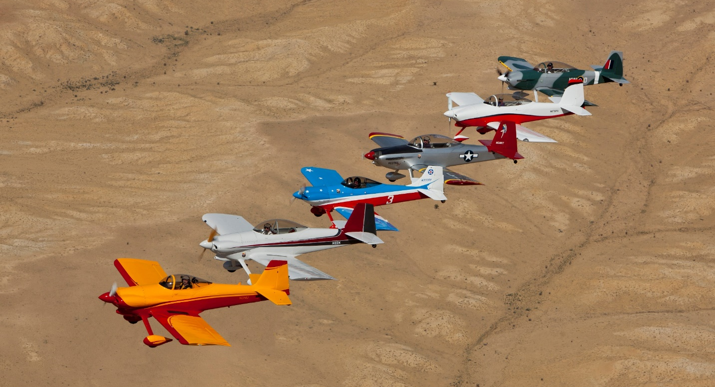
Build an Airplane
These are all homebuilt airplanes!
Aircraft Building
Notes:
What are amateur-built/homebuilt aircraft?Amateur-built aircraft are built by individuals and licensed by the Federal Aviation Administration (FAA) as “Experimental.” The Experimental designation has been in existence for more than five decades. It defines aircraft that are used for non-commercial, recreational purposes such as education or personal use.
Under FAA regulations, if an individual builds at least 51 percent of an aircraft, the aircraft is eligible to be registered in the amateur-built category. They are available in kits (where some of the airplane is already fabricated), or plans (where the builder purchases or manufactures all the parts and assembles them). These airplanes are also commonly known as “homebuilts,” for the obvious reason that many individuals construct these aircraft at home, often in their garages.
Currently, more than 33,000 amateur-built/homebuilt aircraft are licensed by FAA. They represent proven aircraft designs that have been flown safely for many years.
Who constructs amateur-built/homebuilt aircraft?
People from all walks of life, including astronauts, airline pilots, military jet pilots, machinists, welders, professional people and others.
Why do they build them?
A variety of reasons: a personal challenge, education, performance, or to invest “sweat equity” into the cost of an airplane.
Costs range from under $10,000 to more than $100,000 based on desired performance characteristics and optional engine and avionics packages. By comparison, a new factory-built Cessna 172 costs more than $250,000.
Many amateur-built/homebuilt aircraft utilize composite materials that help create airplanes that are lighter, faster and more fuel efficient than similar production aircraft.
How long does it take?
An average amateur-built/homebuilt aircraft will take between 1,000 and 3,000 hours to complete. Some individuals build their airplane in less than a year; others may take a decade or more.

Slide 4
What Types of Airplanes Can You Build?
Many options
  Fast or slow
  Big or small
  Simple or complex
Freedom to explore
Fun Fact: There are more than 33,000 homebuilt airplanes registered in the United States
Aircraft Building
Notes:
What does the term “Experimental” mean regarding a homebuilt airplane?
The term “Experimental” is actually a bit of a misnomer; it refers to the FAA category in which the airplane is registered, not the exclusivity or the use of the airplane.
While there are a handful of homebuilt aircraft that are original designs, the vast majority of homebuilt airplanes are built using standardized, tried- and-true kits or plans that have been successfully constructed thousands of times.
When the current homebuilt aircraft rules were first introduced in the early 1950s, there was difficulty finding a category where the finished aircraft could be registered. After all, the airplanes were not factory-built, such as Cessnas or Pipers, nor were they transport aircraft (airliners) or military aircraft. Federal officials saw the most practical category as Experimental, and created a new subcategory called “amateur-built.”
FAA’s Experimental category also includes nearly 10 other subcategories, including aircraft used for crew training, air racing, and historic aircraft (such as World War II military aircraft) flown to air shows and exhibitions.

Slide 5
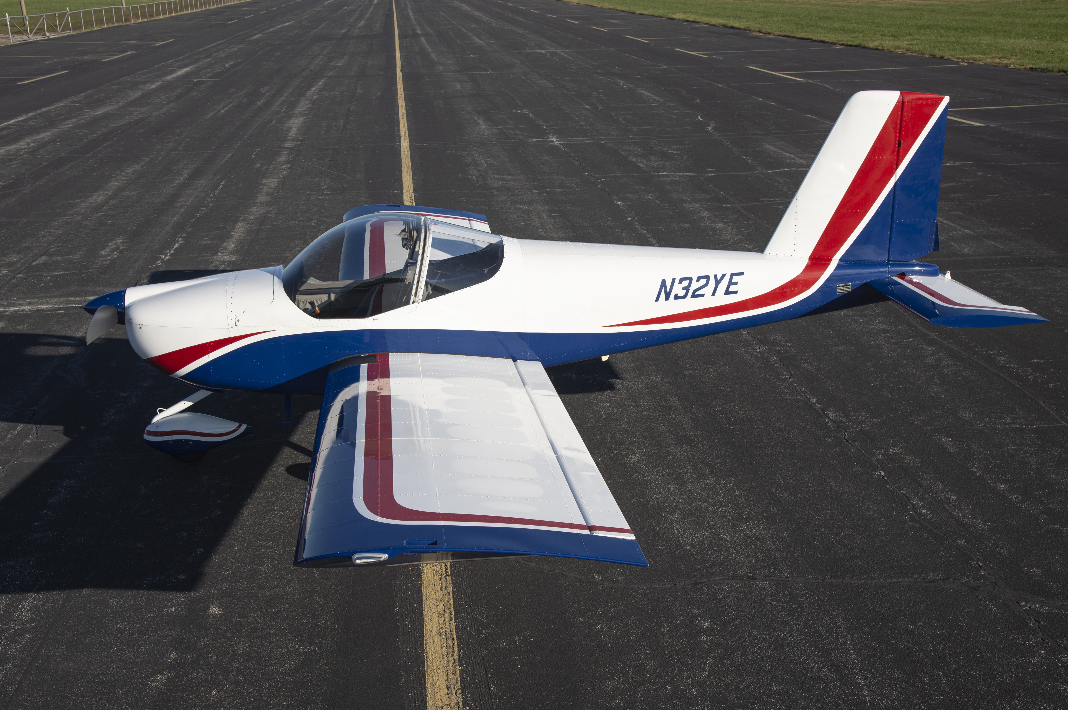
Metal
Aircraft Building
Notes:
Probably the most popular experimental airplanes today are airplanes made from kits. These are typically aluminum construction, riveted together.
The airplane shown in this example is a Vans RV-12 completed kit.
These types of airplanes are essentially built using formed aluminum sheet metal, which is the same type of construction in many factory built airplanes.

Slide 6
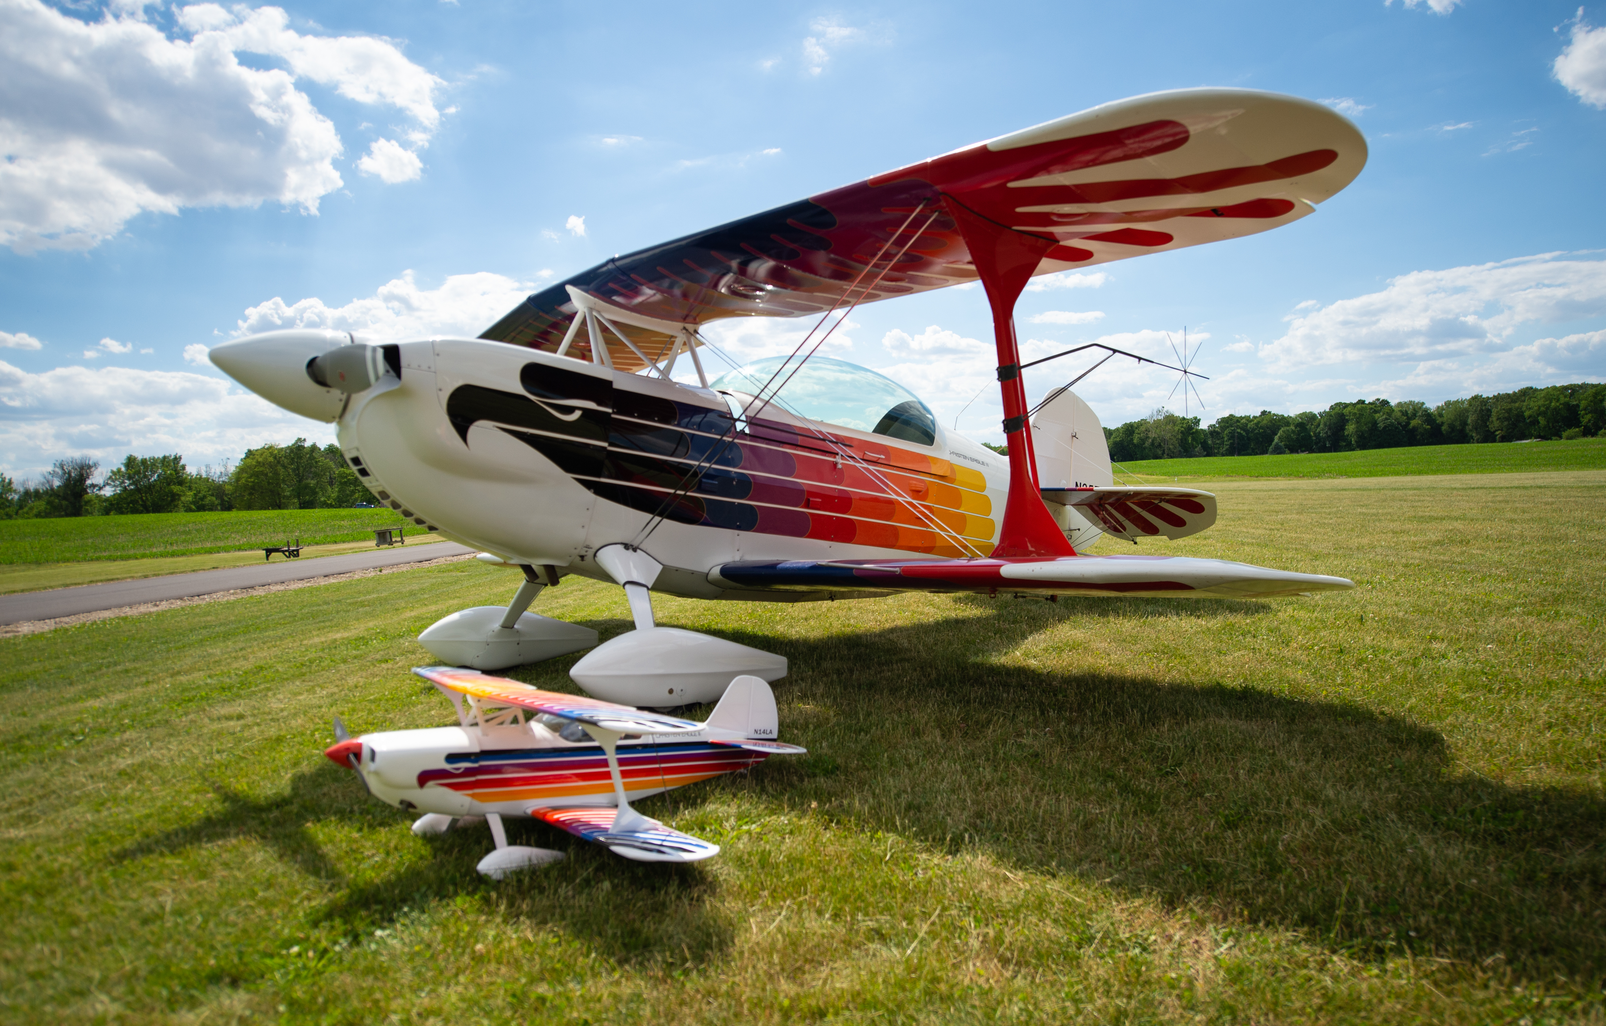
Tube, Wood, and Fabric
Aircraft Building
Notes:
Tube, wood and fabric pertain to the materials commonly used in older airplane designs however many home builders today still prefer to use these materials. Tube refers to the fuselage that is primarily made of steel tubing welded together in a cage-like configuration. Wood typically refers to the wing construction, and fabric refers to the fabric-like covering that is glued and shrunk over the entire metal and wood shapes.
The airplane shown here is Christian Eagle which is an airplane suited for aerobatics.

Slide 7
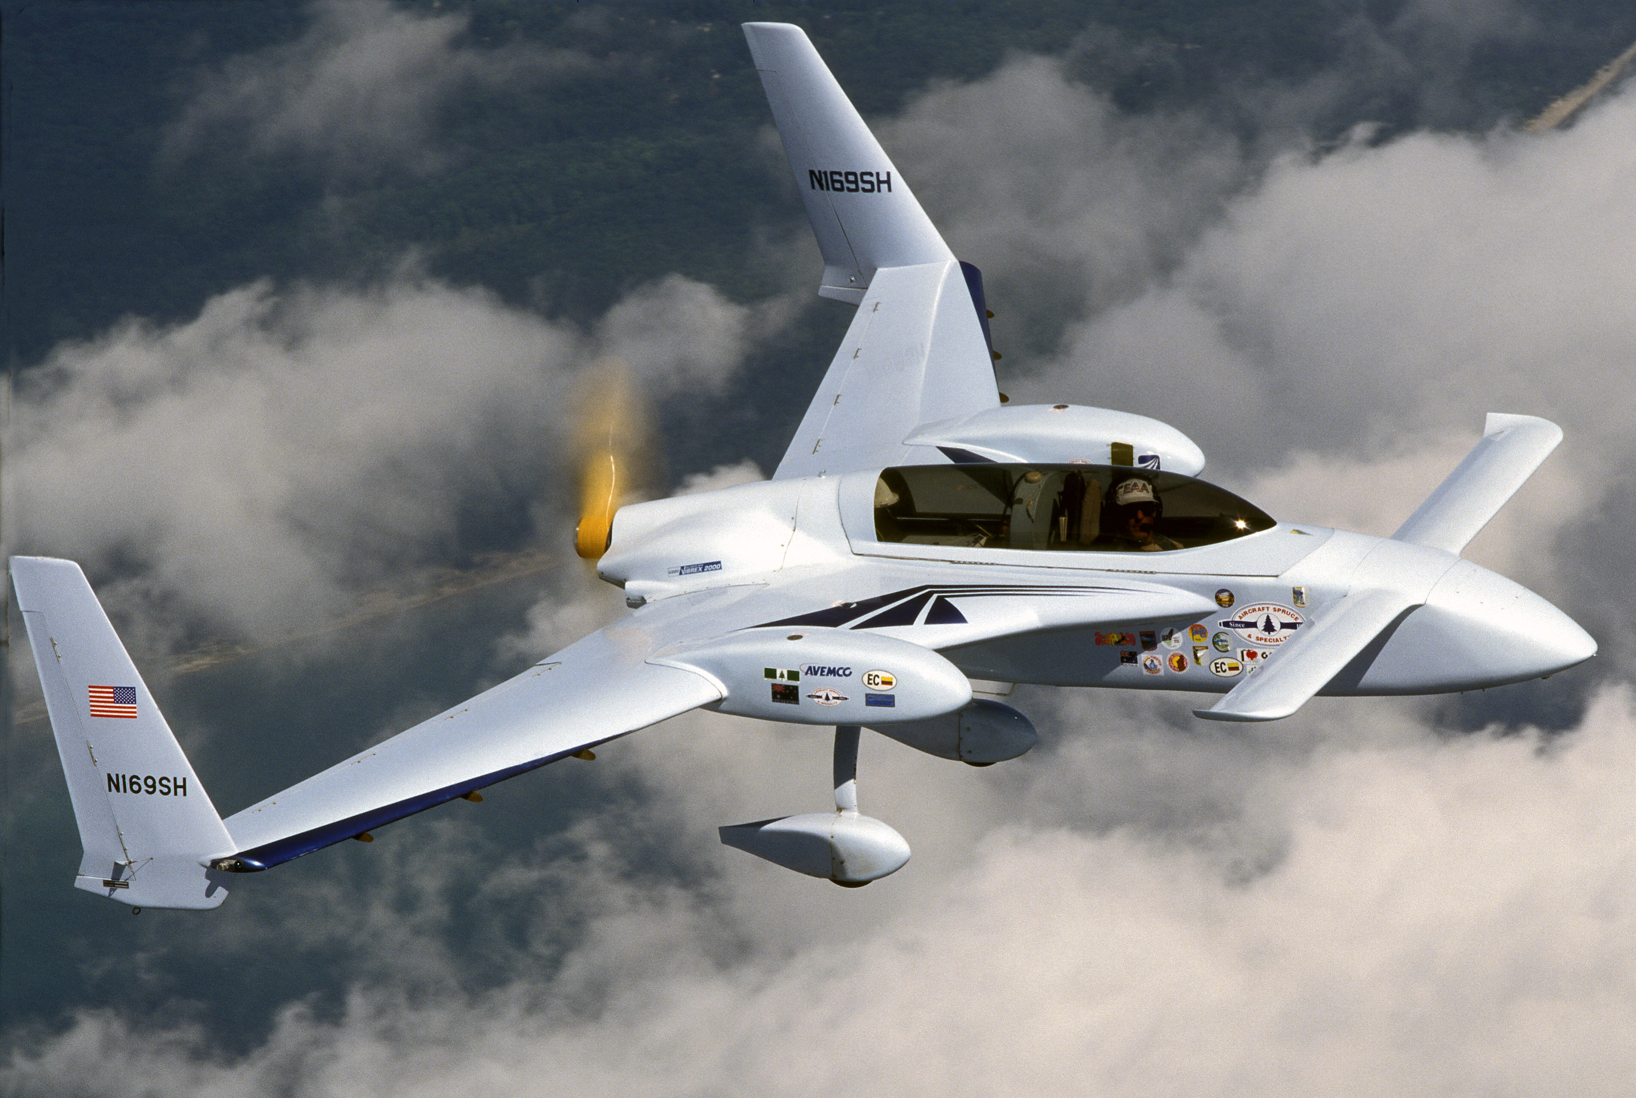
Composite
Aircraft Building
Notes:
As the name implies, composite is a combination of materials used to build aircraft. Here, builders use fiberglass and carbon fiber fabric coated with two-part epoxy resin to form the shape.

Slide 8

Aircraft Building Skills
Also known as “homebuilding”
Aircraft Building
Notes:
Explain to the students what the term “homebuilding” means related to experimental aircraft construction.

Slide 9
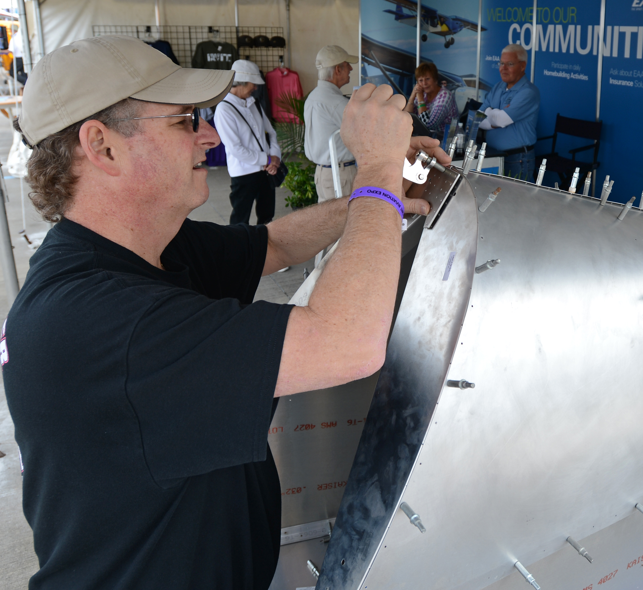
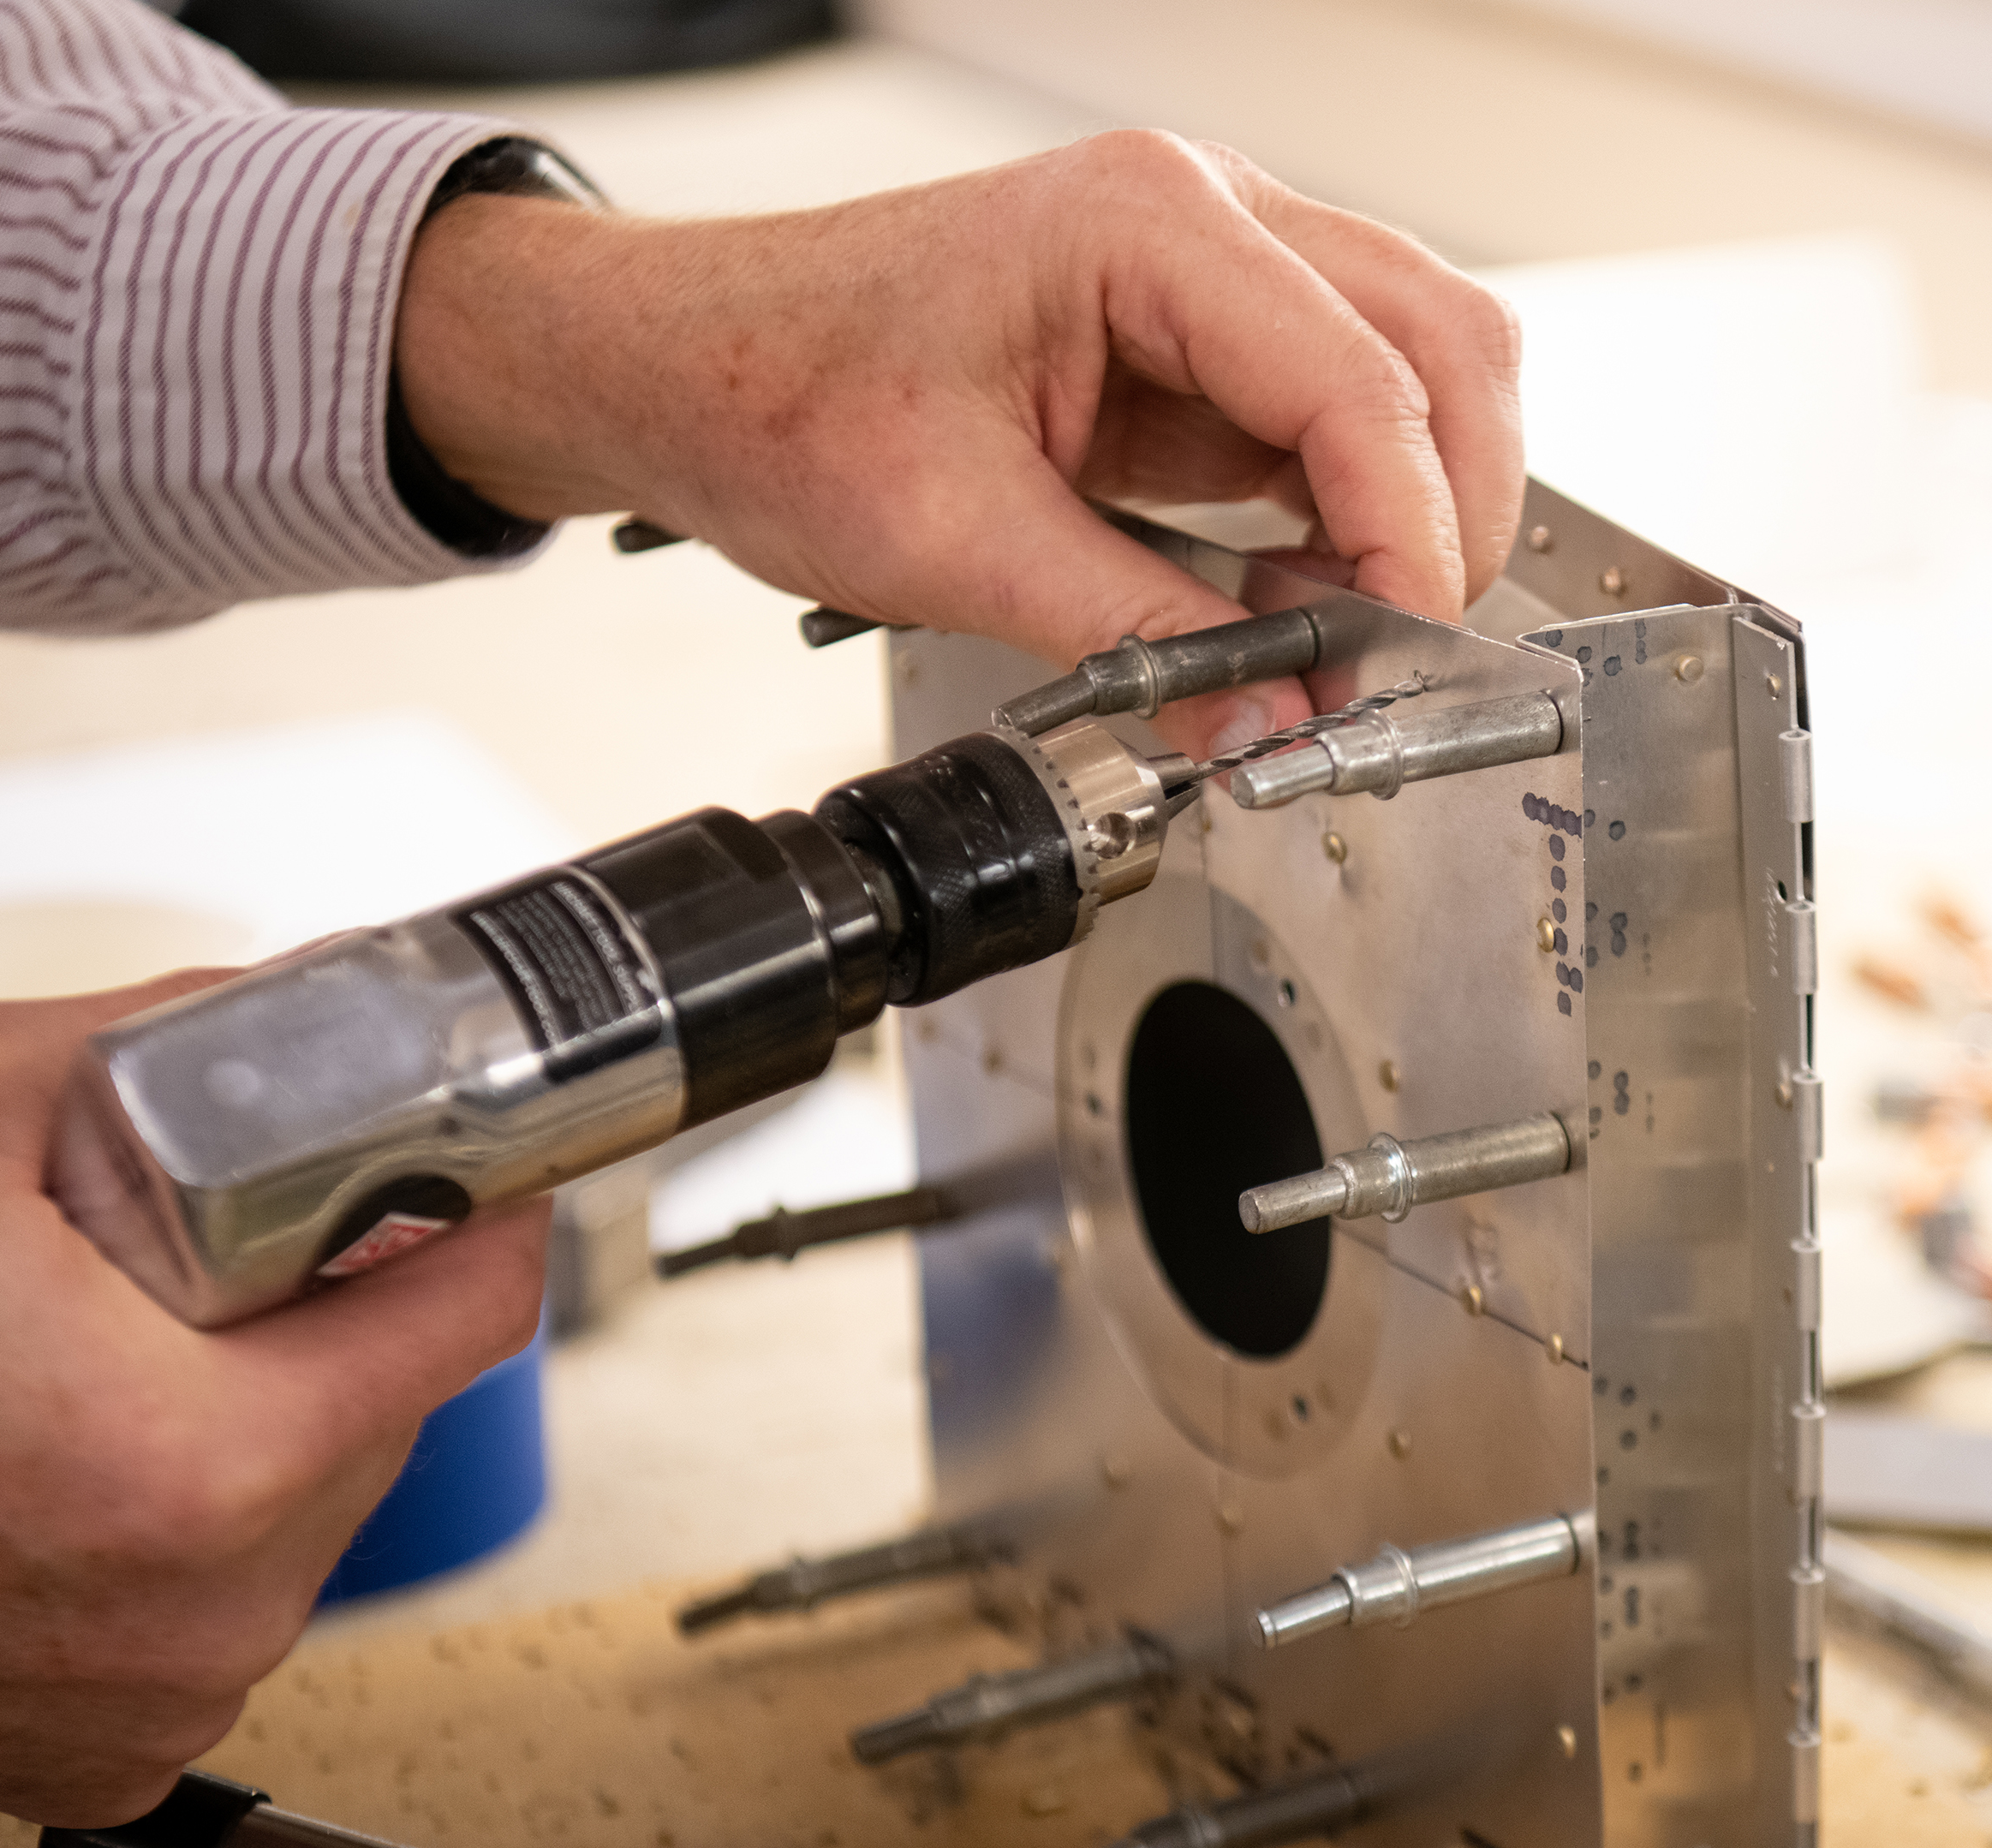
Metal Skills
Tasks
  Smooth Edges and Deburr
  Drill
  Countersink
  Cleco
  Rivet
Aircraft Building
Notes:
Explain the basic process used when building a metal airplane.
Explain the tools used.
Use real tools to show to the students.
Consider a hands-on activity such as the EAA workshops Name Tag project, or the EAA Workshops Cell Phone holder project to introduce kids to building techniques.

Slide 10
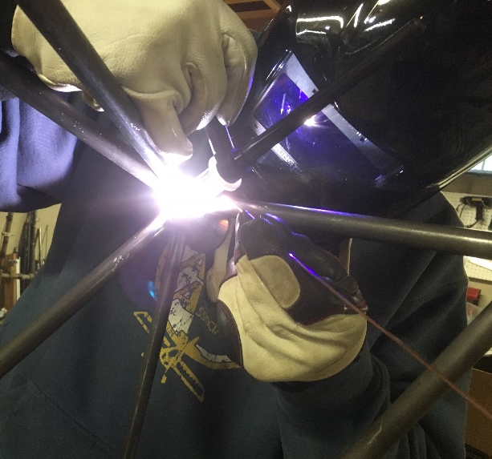
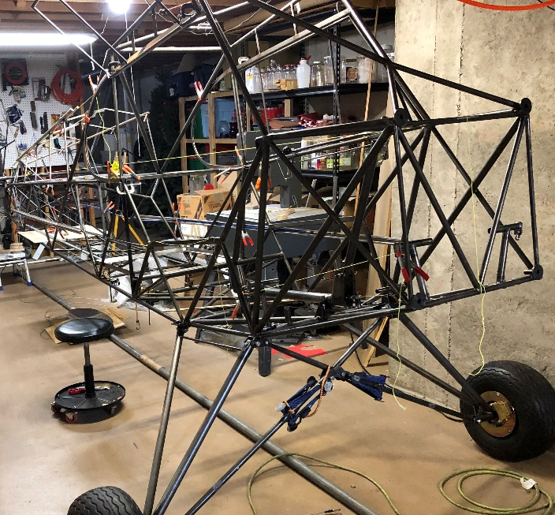
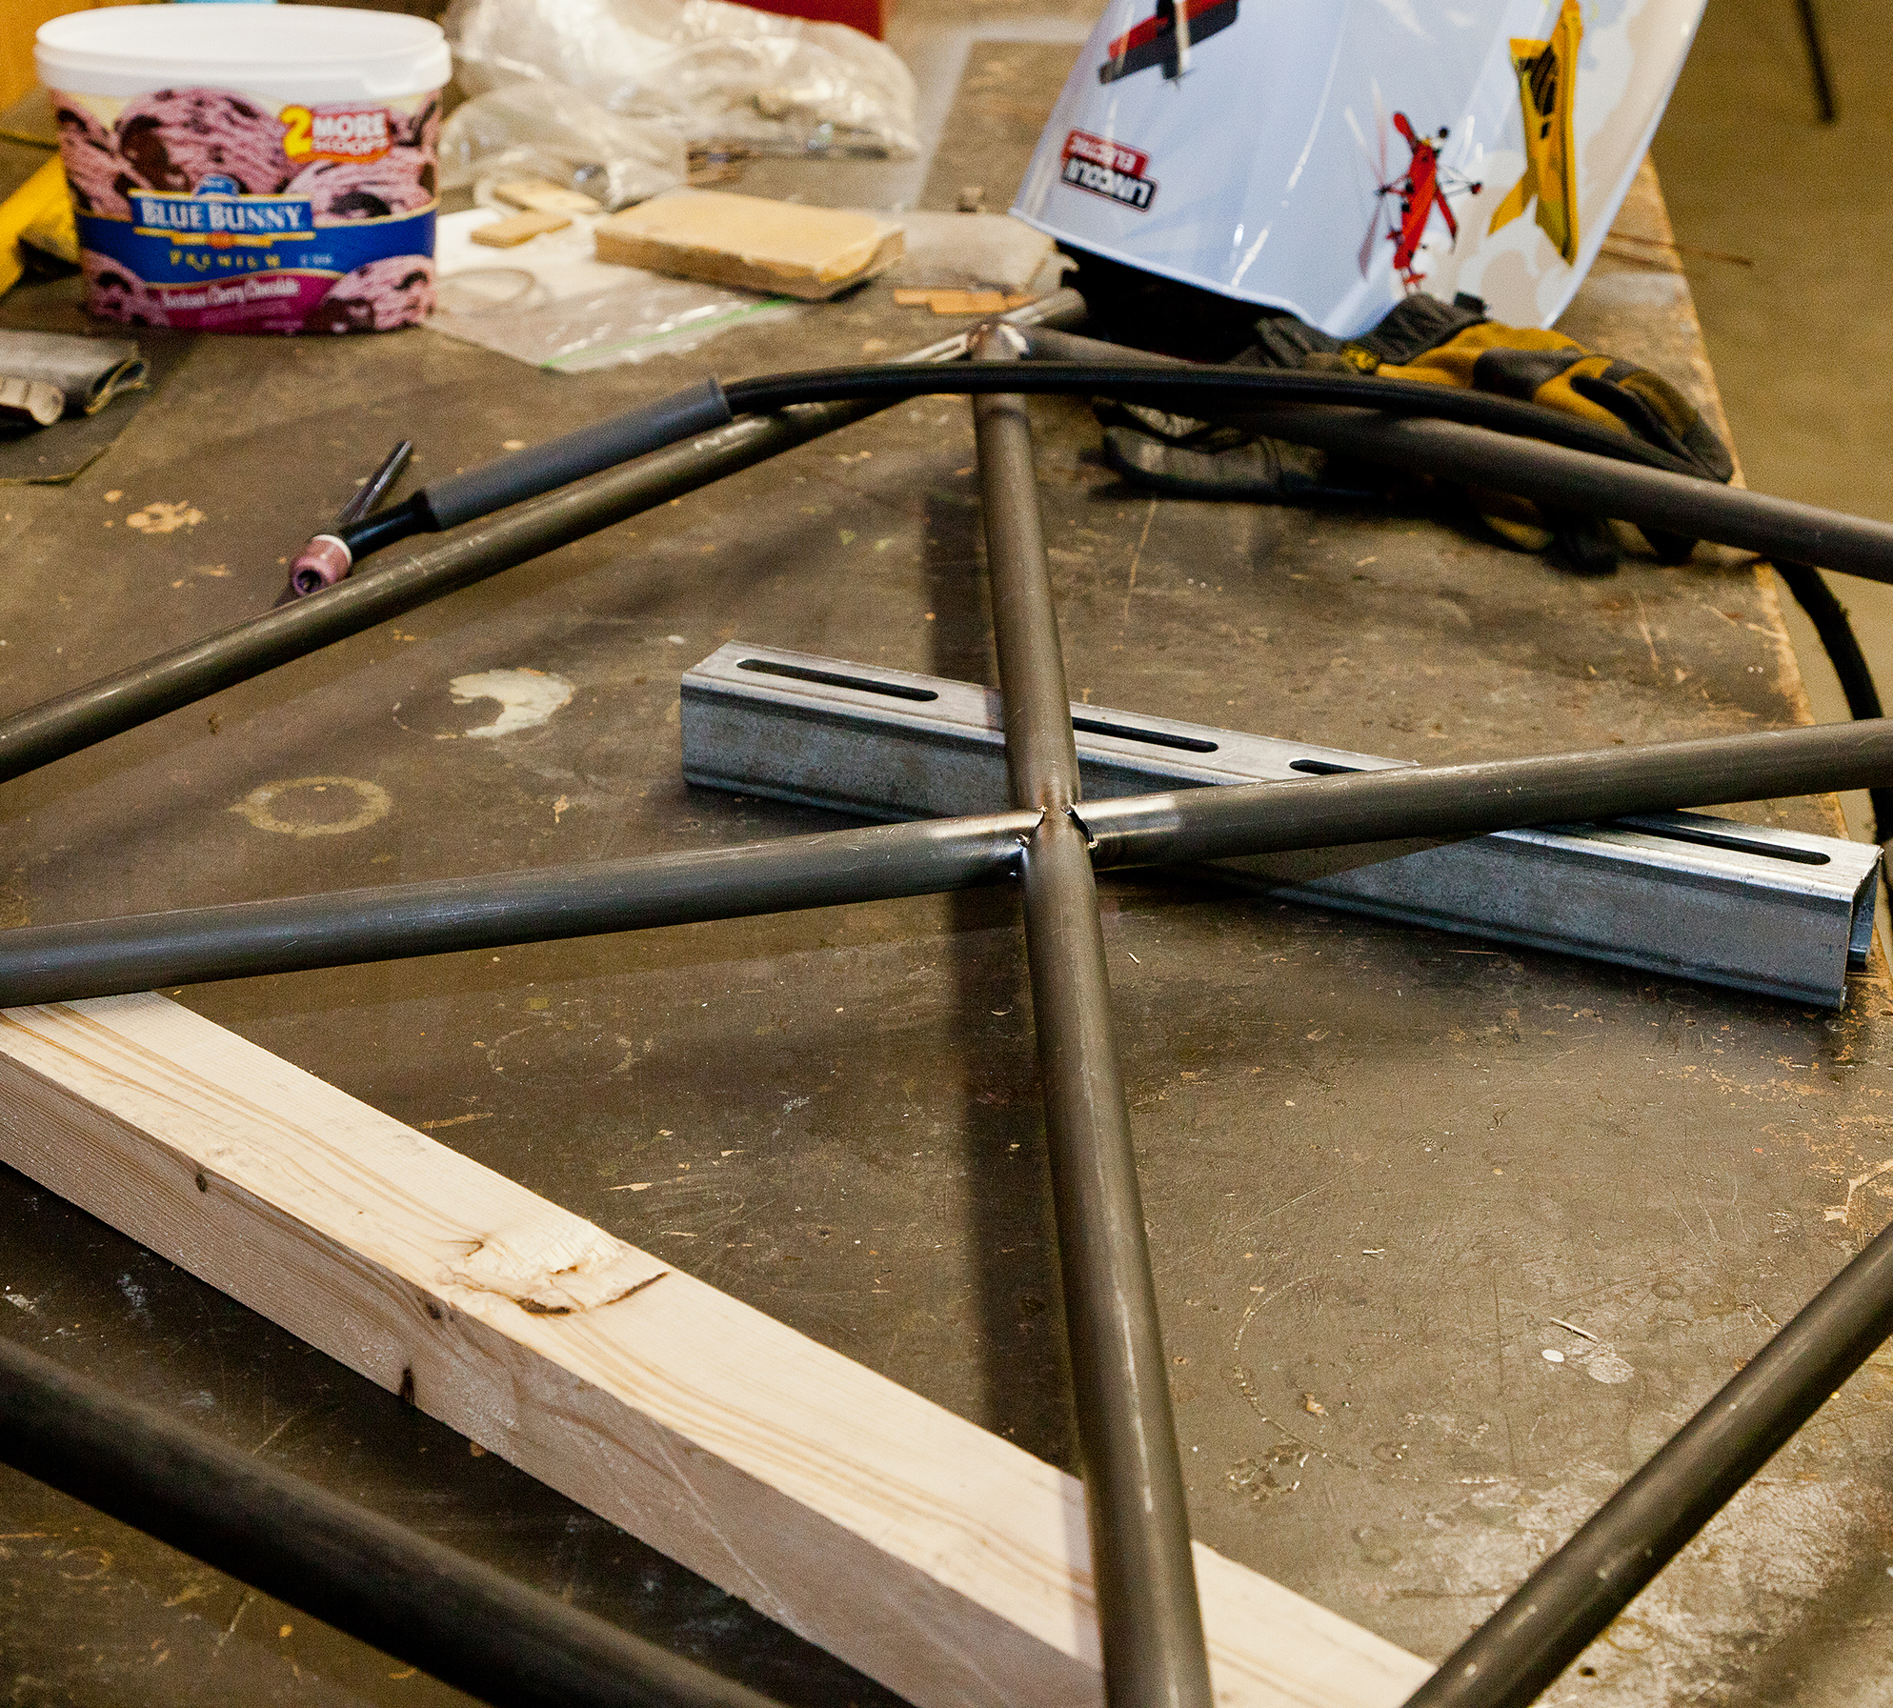
Tube and Welding Skills
Tasks
  Blueprint Reading
  Steel Fabrication
  Cutting and Fitting
  Welding
  Hand Tool Skills
Aircraft Building
Notes:
Explain to the students, “what’s involved” in welded tube construction.
Consider having a tools available to see.

Slide 11
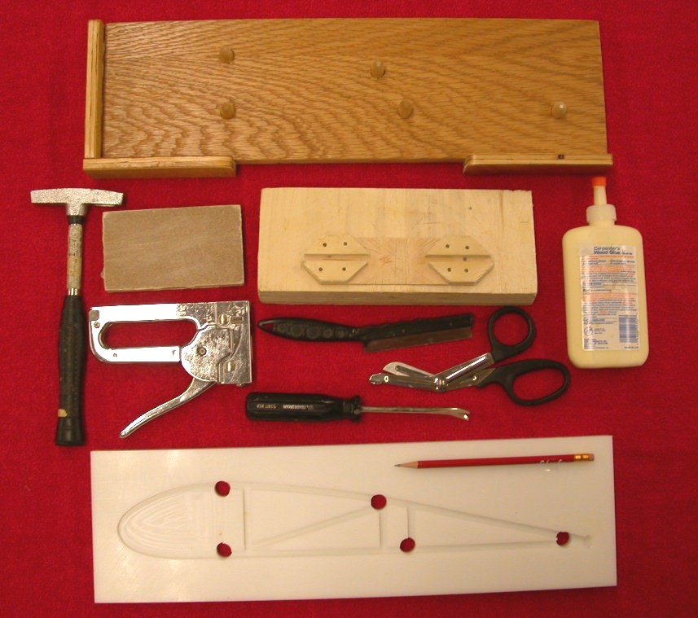
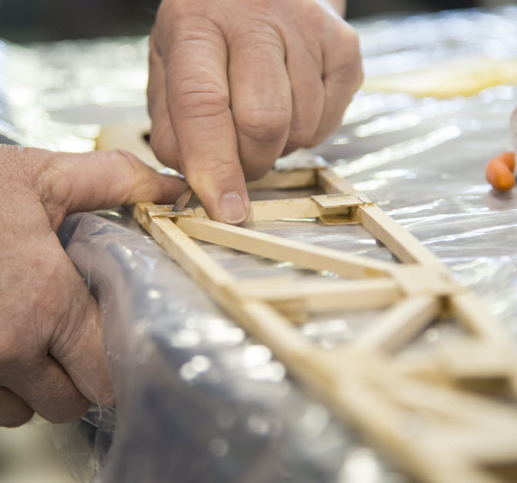
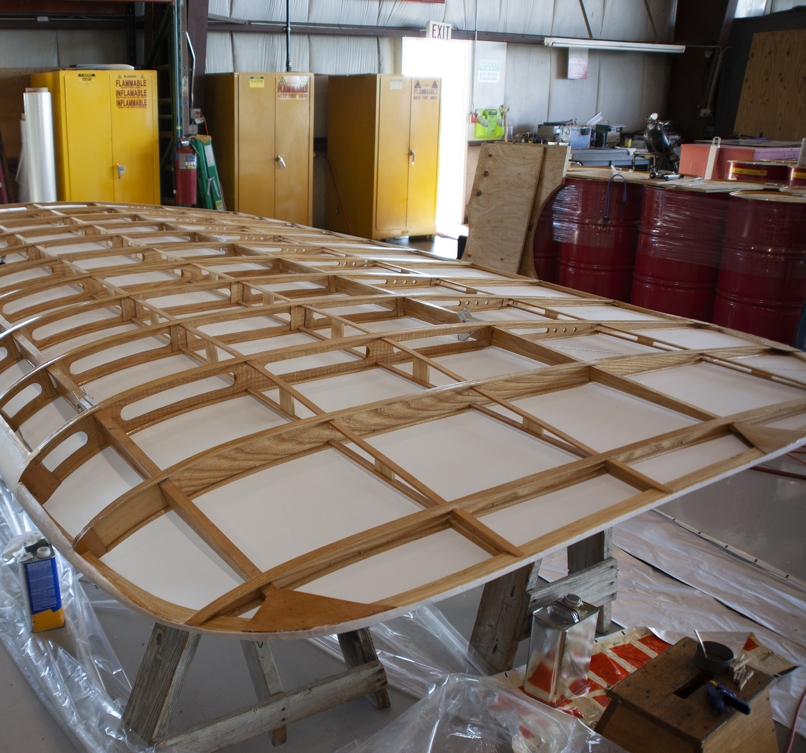
Woodworking Skills
Tasks
  Cutting and Fitting
  Sanding
  Gluing
  Stapling and Tack Nailing
  Varnishing
Aircraft Building
Notes:
Explain the basic process used when building a wood airplane.
Explain the tools used.
Use real tools to show to the students.
Consider a hands-on activity such as the EAA workshops Wood Wing Rib project to introduce kids to building techniques.

Slide 12
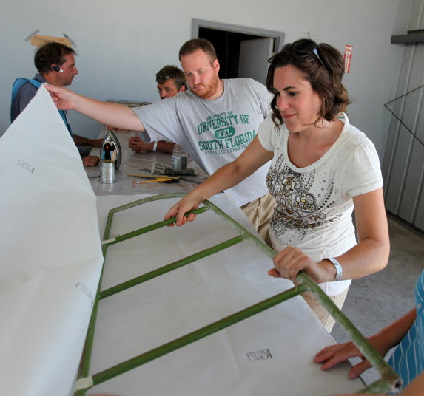
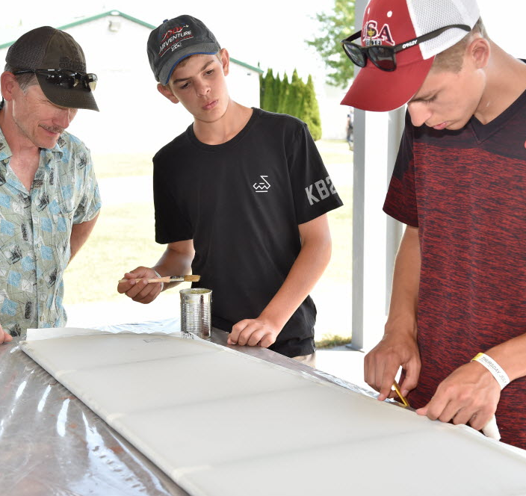
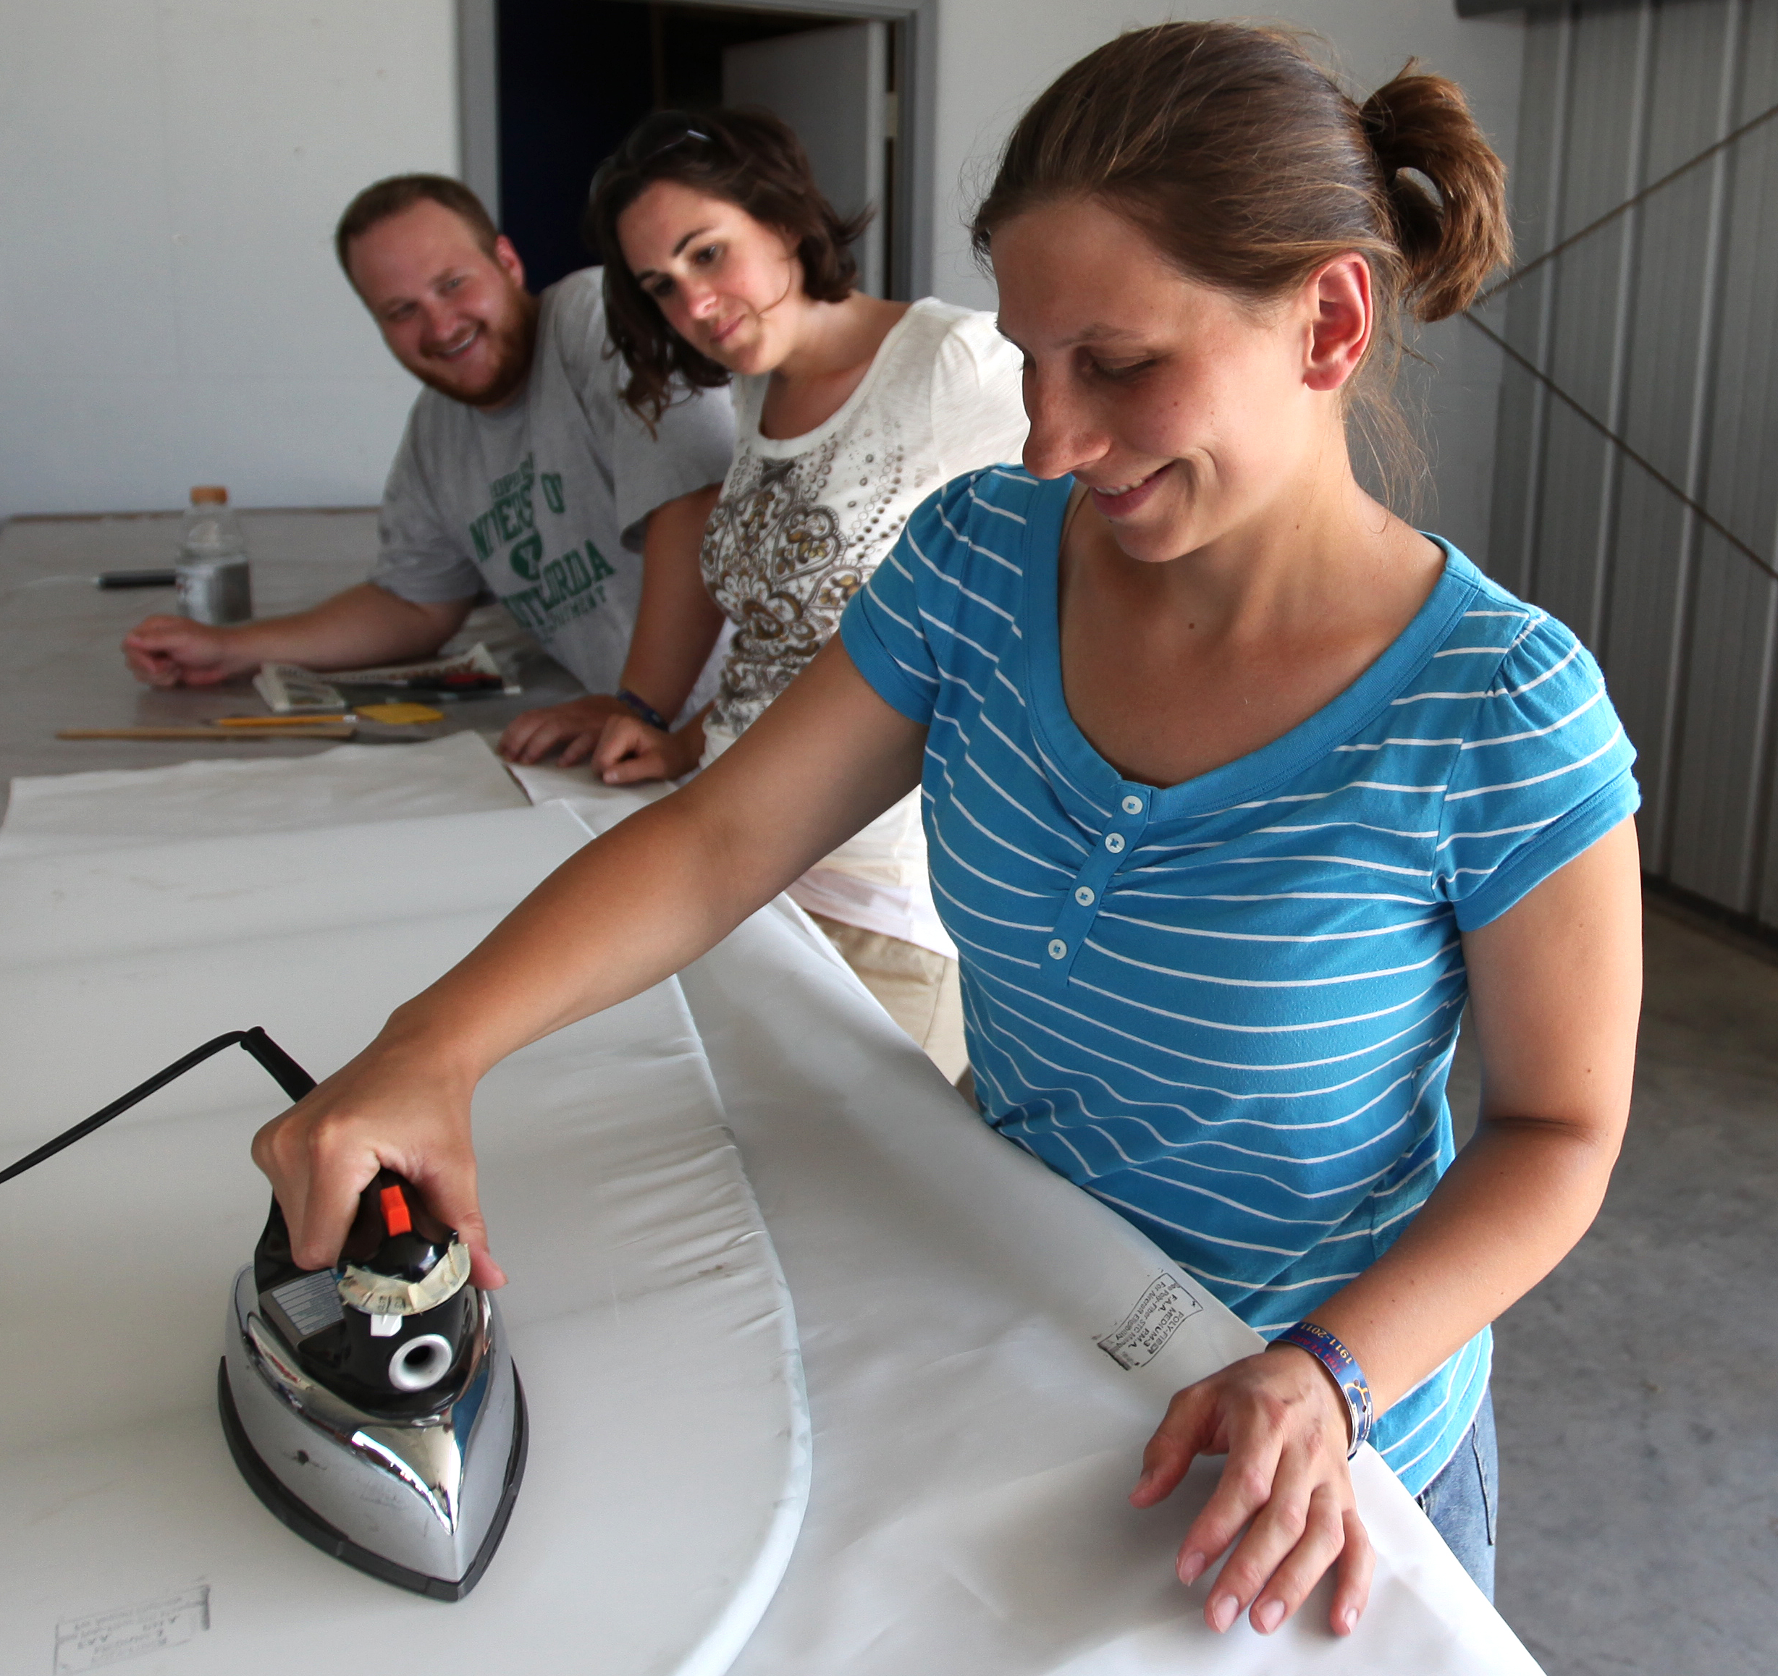
Fabric Skills
Tasks
  Apply Fabric Cloth
  Gluing
  Hand Stitching
  Hot Iron Shrinking
  Painting
Aircraft Building
Notes:
Further explain to the students, “what’s involved” in tube and fabric aircraft instruction by explaining more about fabric covering.
Consider having pieces of fabric available to pass around.
Consider having a real fabric airplane available to look at as part of the presentation.

Slide 13
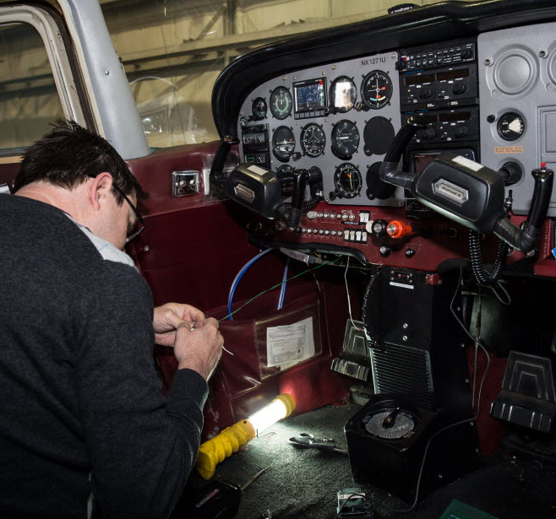
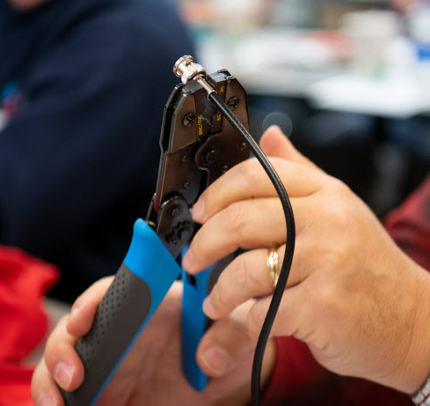
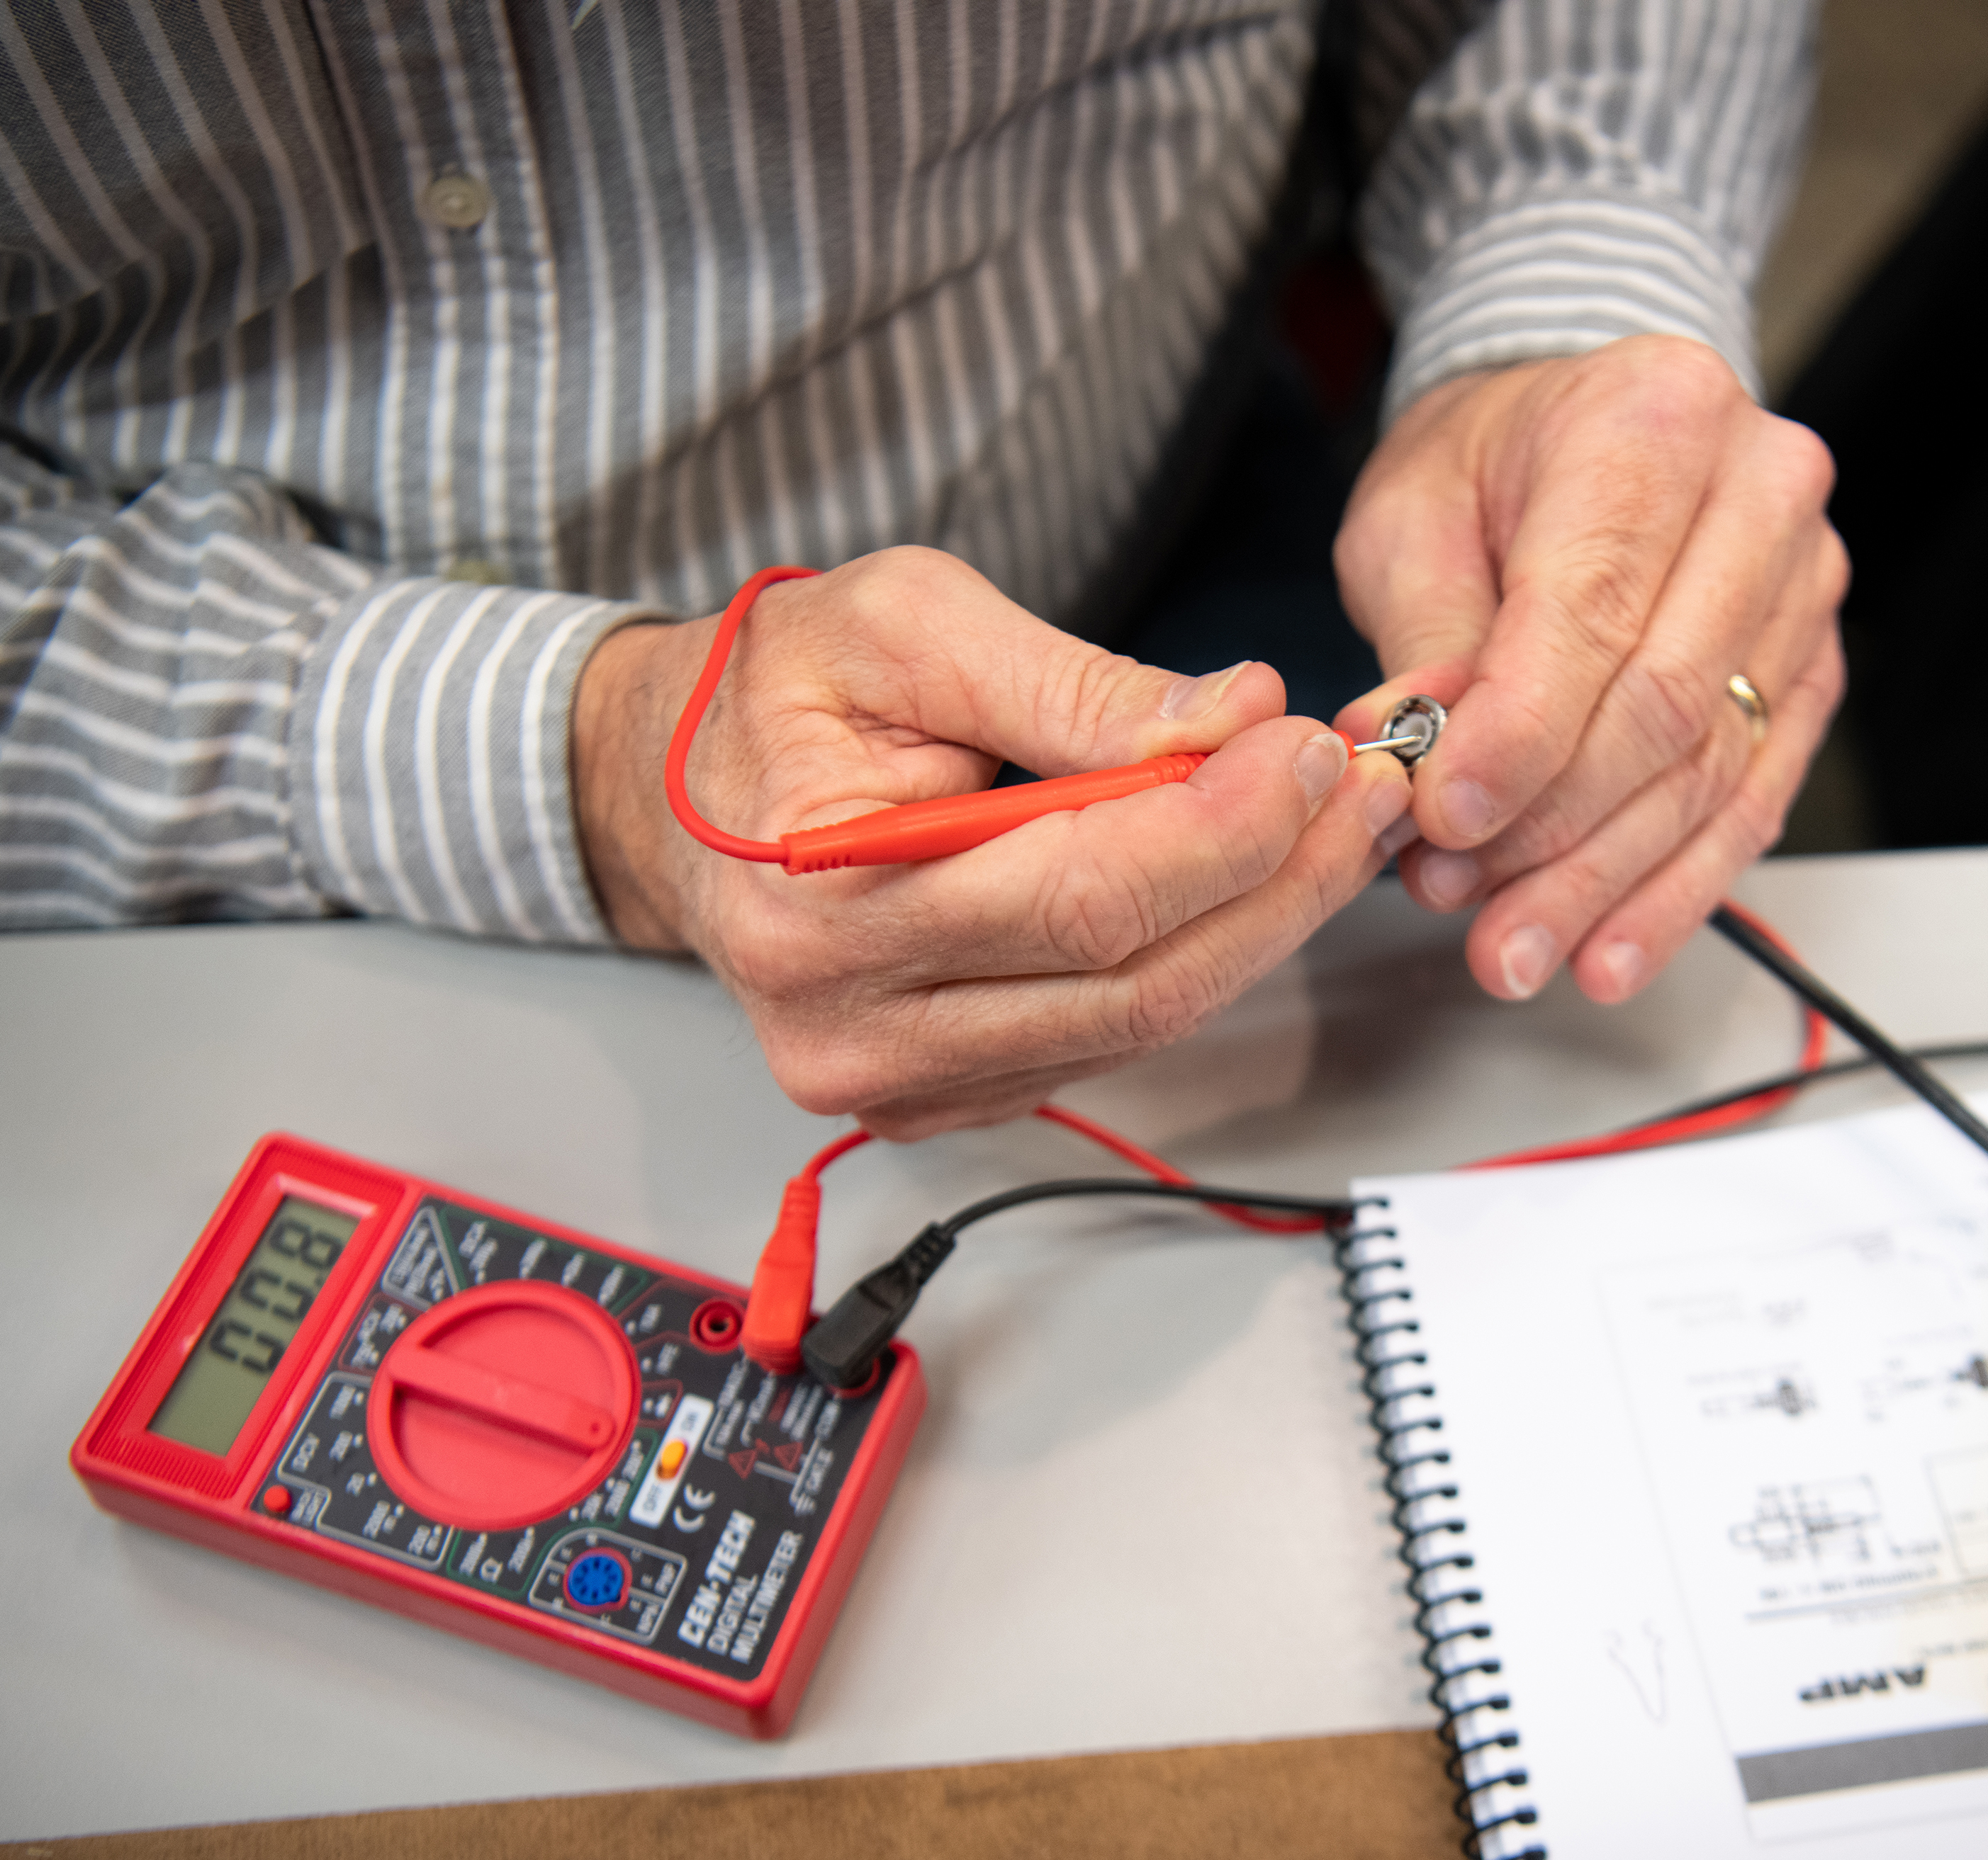
Electrical Skills
Tasks
  Blueprint Reading
  Electrical Knowledge
  Assembly Skills
  Soldering
  Hand Tool Skills
Aircraft Building
Notes:
Explain to the students that they have the opportunity to design their own instrument panel and electrical system for their homebuilt airplane.
Consider to have tool and equipment available to see.
Consider a hands-on activity such as the EAA workshops Electrical project to introduce kids to building techniques.

Slide 14
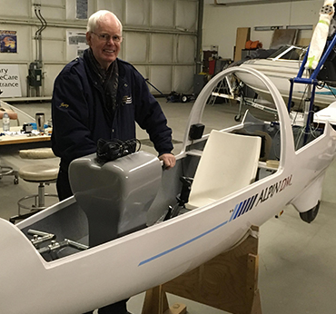
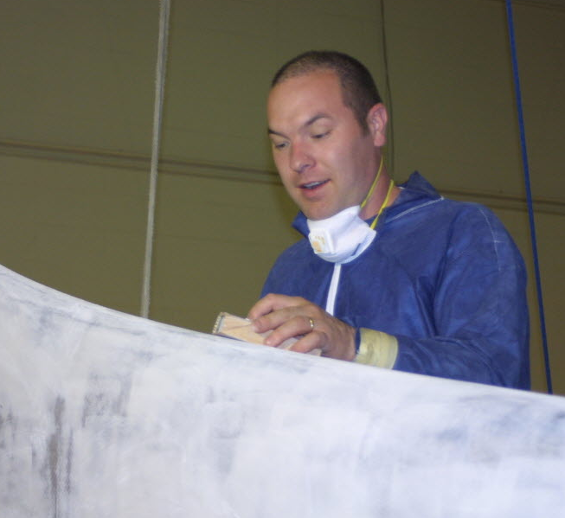
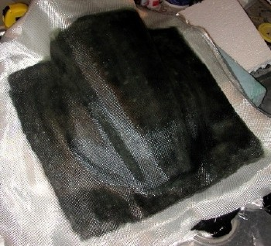
Composite Skills
Tasks
  Foam Form Making
  Fiberglass Cloth Lay-Up
  Resin Application
  Sanding and Finishing
  Painting
Aircraft Building
Notes:
Utilize a chapter member’s expertise on composite aircraft to share information on composites.
Consider to have a member composite airplane available for viewing.

Slide 15
Safety Hazards
Sharp Edges
  Wear appropriate PPE
  (personal protective equipment)
Noise
  Wear ear protection
Debris
  Wear eye protection
Air Quality
  Wear suitable breathing equipment when necessary
Aircraft Building
Notes:
Discuss the need to work safely, and review some the hazards involved in hands-on activities.

Slide 16
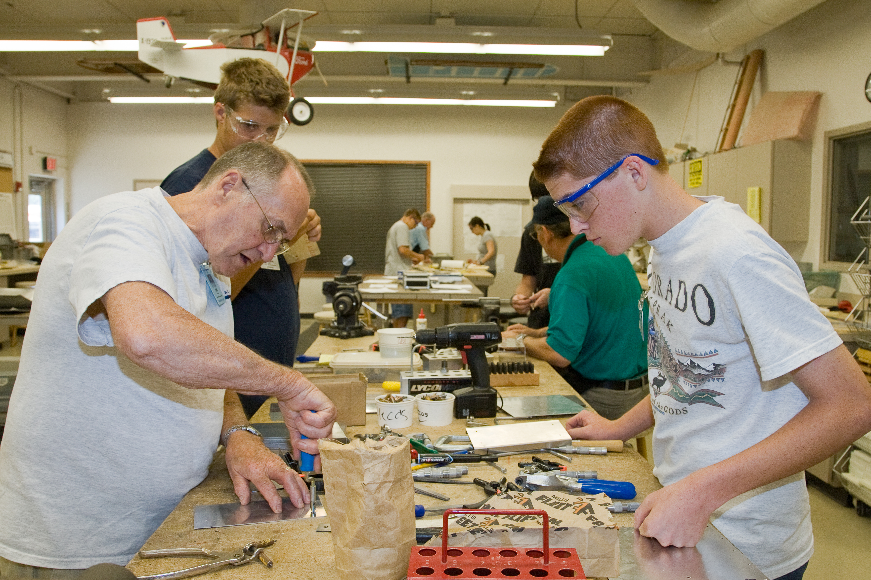
You Can Do This!
EAA is here to help
Aircraft Building
Notes:
Fun and discovery combine for an experience that young people can find nowhere else at the EAA Air Academy, a series of weeklong camps designed to introduce young people ages 12-18 to the aviation world.
Campers are engaged through a variety of hands-on activities while staying at the EAA Air Academy Lodge in Oshkosh, Wisconsin. Experienced aviation instructors help them delve into flight through studies, hands-on demonstrations, flight simulation, and other exciting activities.
Recognized by MSN Money as one of 10 summer camps “worth the money,” Air Academy provides the foundation for a lifelong love of aviation.

Slide 17
Objectives
You can now
Understand you can build your own airplane
Know the different types of planes you can build
Understand different aircraft building skills:
  Wood
  Metal
  Fabric
  Electrical
  Composite
Aircraft Building

Slide 18
Aircraft
Building
Questions?
The development of this program was made possible in part by
a generous donation from the Sporty’s Foundation.

